Slide 1

5 Steps to Becoming HIPAA Compliant
Mark R. Wright, OD, FCOVD

Slide 2

Mark Wright, OD, FCOVD
Director: OSU College of Optometry Business Management Program
Board Member: APME
CEO: Pathways to Success
CEO: Practice Management Center
Editor: Review of Optometric Business
Author: Coding, Reimbursement and Contracting for Optometry
1980 – 2007 founder Professional VisionCare, Westerville, OH
Notes:
2
2
Dr. Wright is a 1980 graduate of The Ohio State University College of Optometry, where he is clinical assistant professor and faculty coordinator of OSU’s Business Management Program. Retired from practice last year, Dr. Wright is president of Pathways to Success, Eyecare Business Training and Progressive Publishing Company. All three of these companies are dedicated to the special practice management needs of eyecare practices. Dr. Wright has lectured extensively throughout the U.S. and abroad. His topics include not only practice management, but also managed care, sports vision and vision and traumatic brain injuries. He is also the practice management editor for the Journal of Optometric Vision Development. This is Mark’s first presentation to the MBA. Please welcome Mark Wright…

Slide 3
SPEAKER FINANCIAL DISCLOSURE STATEMENT
Mark R. Wright, OD, FCOVD has been a paid speaker for the following companies:
  Alcon
  B&L
  ESSILOR
  Jobson
  Vistakon
  VSP
He is an officer of:
  Pathways to Success
  Practice Management Center
  Progressive Publishing Company
He is the professional editor of:
  Review of Optometric Business
Diversified Ophthalmics
Eye Recommend
IDOC
IVA
ODX
PERC
Vision Source

Slide 4
Course Description
HIPAA rules help us to properly manage Protected Health Information (PHI). This course will help you to know what is required when you designate 5 HIPAA Officers, create HIPAA privacy policies and procedures, trainfile staff on HIPAA privacy policies and procedures, implement HIPAA privacy policies and procedures, and notify patients about their HIPAA privacy rights.

Slide 5
Course Objectives
The attendee will be able to …
  Designate HIPAA Officers
  Create privacy policies and procedures
  Train staff on the new privacy policies and procedures
  Implement privacy policies and procedures
  Notify patients about their privacy rights

Slide 6
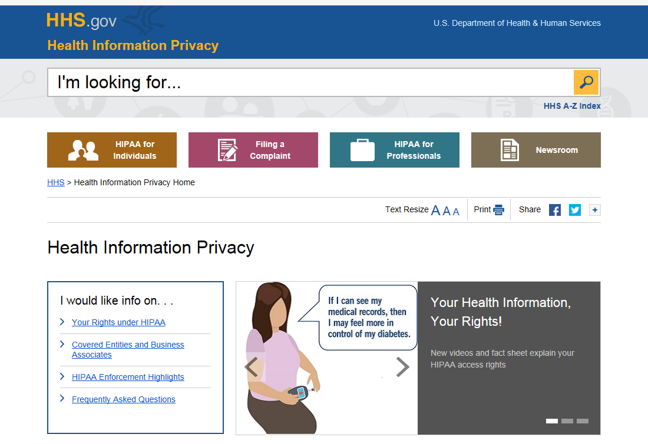
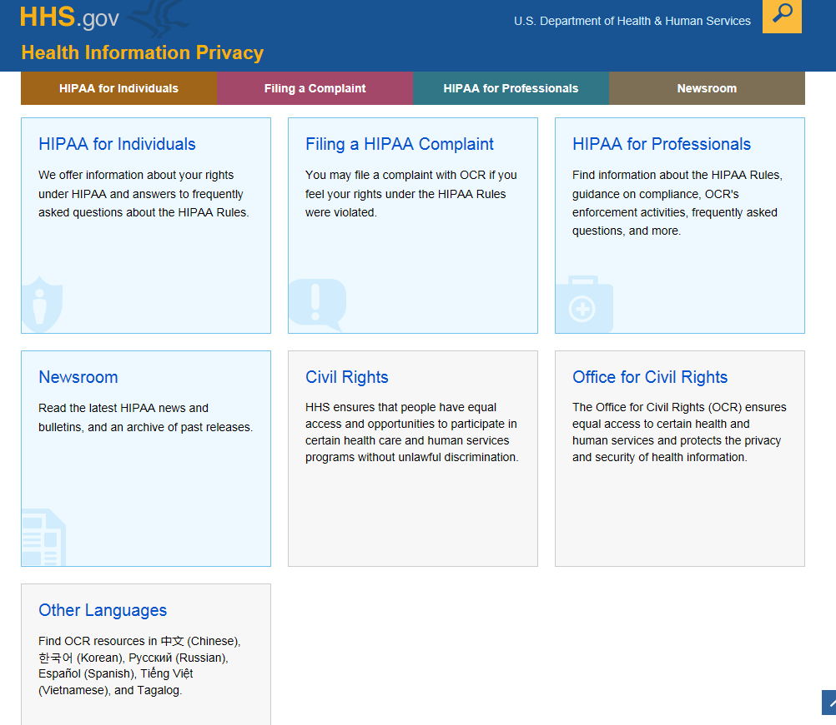
http://www.hhs.gov/ocr/privacy/

Slide 7
To be HIPAA compliant under the Privacy Rules we must take the following 5 steps:
Designate
Designate HIPAA Officers
Privacy, Public Information, Review, Security
Create
Create privacy policies and procedures
Train
Train staff on the new privacy policies and procedures
Implement
Implement privacy policies and procedures
Notify
Notify patients about their privacy rights

Slide 8
To be HIPAA compliant under the Privacy Rules we must take the following 5 steps:
  Designate HIPAA Officers
      Privacy, Public Information, Review, Security
  Create privacy policies and procedures
  Train staff on the new privacy policies and procedures
  Implement privacy policies and procedures
  Notify patients about their privacy rights

Slide 9
HIPAA PRIVACY OFFICER duties are to …
Create and implement policies and procedures to comply with the HIPAA Privacy Rule
Monitor compliance efforts
Respond to specific HIPAA Privacy Rule compliance questions
Conduct educational sessions for staff about HIPAA requirements and compliance
Receive and investigate allegations of noncompliance
Resolve any problems

Slide 10
The Privacy Officer should manage an internal review system separate from the complaint process for patients who are dissatisfied because of denial of access or denial of amending their own health information.
If the patient wants to file a complaint with the Office of Civil Rights, it must be done within 180 days of when the act occurred. (The Secretary of Health and Human Services may waive this 180 a limit if a good cause is shown.)
OCR provides further information on its website about how to file a complaint (www.hhs.gov/ocr/hipaa/).
The Privacy Officer should inspect Disclosure and Use Logs to make sure they are being used correctly.
HIPAA PRIVACY OFFICER duties are to …

Slide 11
PUBLIC INFORMATION OFFICER
The role of the Public Information Officer is a public relations/patient ombudsman. The Public Information Officer will explain our Privacy Policies and Procedures to patients as well as receiving, investigating and resolving patient Privacy complaints.

Slide 12
PUBLIC INFORMATION OFFICER duties are to …
Receive, investigate and document patient privacy complaints
Correct problems identified through investigation of privacy complaints
Provide information to patients and the public about our privacy practices and compliance
Report any concerns about privacy compliance to our Privacy Officer while cooperating in the investigation and resolution of the problem
Accept and act upon patient requests for confidential methods of communication

Slide 13
PUBLIC INFORMATION OFFICER duties are to …
Accept and act upon patient's requests to restrict the way we handle protected health information for treatment, payment or health care operations
Accept and act upon patient request for access to their own protected health information
Accept and act upon patient request to amend their own protected health information
Accept and act upon patient request for accounting of our disclosures of their protected health information

Slide 14
HIPAA Review Officer
If the patient is refused access to their PHI, then we must give the patient the chance to have the decision reviewed by another health care professional who was not involved in the final decision.
The patient must be informed in writing …
  stating that the request is denied
  stating the reasons for denial
  a description of how to complain to either our office or the Department of Human Services
  the name and telephone number of our Public Information Officer

Slide 15

HIPAA Security Officer
The Security Officer is in charge of personnel security, information access control, physical access control, security awareness training, the formal mechanism for processing records, software security configuration management, securing workstations, and internal auditing.
The Security Officer is in charge of the development, implementation, maintenance and compliance of security incident procedures (e.g. someone trying to hack into your computer system).

Slide 16

Privacy Officer
Public Information Officer
Security Officer
Review
Officer

Slide 17
Who are your HIPAA Officers?
Privacy
Public Information
Review
Security

Slide 18
Who are your HIPAA Officers?
Privacy
Public Information
Review
Security
Val Kilmer George Clooney Michael Keaton Christain Bale

Slide 19
To be HIPAA compliant under the Privacy Rules we must take the following 5 steps:
  Designate HIPAA Officers
      Privacy, Public Information, Review, Security
  Create privacy policies and procedures
  Train staff on the new privacy policies and procedures
  Implement privacy policies and procedures
  Notify patients about their privacy rights

Slide 20

Create Privacy
Policies and Procedures
The SECOND STEP in becoming HIPAA compliant is to create privacy policies and procedures. This will be an ongoing process. Think of this more as a journey than destination.

Slide 21
Policies and Procedures Overview
1
Identify relevant state laws relating to access and disclosure of patients' health information (7 years)
2
Create a list of privacy concerns with policies & procedures to resolve the concerns
3
Identify every staff member and the level of access to patient information they are permitted
4
Create policies & procedures for the patient to gain access to their relevant health information
5
Create policies & procedures for the patient to amend their own health information

Slide 22
Policies and Procedures Overview
6
Create policies & procedures for de-identifying patient information
7
Create policies & procedures for handling subpoenas and special requests for information
8
Create policies & procedures for faxing and e-mailing patient information
9
Create policies & procedures for commonly occurring requests for patient health information
10
Create policies & procedures for handling inappropriate disclosures of PHI

Slide 23
Create a list of privacy concerns with policies & procedures to resolve the concerns
Walk through the office and identify places where PHI could be compromised …
  Conversations at the front desk
  Conversations in the administrative areas
  Patient screens facing an open door
  File room access
  Computers left open in reach of patients
  Telephone calls
  Update this list as needed

Slide 24
Identify every staff member class and the level of access to patient information they are permitted
 | Types of information | Access level
Doctors
Opticians
Patient relations
Financial relations
Information tech
Administrative
Quality control

Slide 25

If a staff member is doing a job that does not require access to protected health information, then we must restrict their access to just the information needed to do the job. A quote from the OCR document (dated 12-3-02) helps clarify this issue:
"For example, it may not be reasonable for a small, solo practitioner who has largely a paper-based records system to limit access of employees with certain functions to only limited fields in a patient record, while other employees have access to the complete record. In this case, appropriate training of employees may be sufficient."

Slide 26
Create policies and procedures for the patient to gain access to their relevant health information
When a patient makes a request to view their own health information the following steps must occur.
Start a new Request for PHI Form
Give all requests to the Privacy Officer
A time is scheduled within 30 days of the request that is convenient for the patient and the Public Information Officer
The patient’s record is pulled from central files and the patient’s electronic record is printed
The Disclosure log is reviewed and any disclosures for the patient’s PHI are printed
Lab invoices are removed from the patient record
The patient is permitted to view the record

Slide 27
When can a patient NOT inspect or copy their information
If information was prepared in connection with a lawsuit.
If a person who is not a health-care provider gave us information and we promised that person their identity would remain confidential.
If information would likely put in danger the life or physical safety of the patient or someone else.
If information would likely cause substantial harm to another person.
if the PHI is generated as part of the patient participation in a clinical trial and the request is made during the clinical trial. (The patient must be allowed to inspect or copy their PHI when a clinical trial is over.)

Slide 28
What if you say “NO” to releasing PHI
Privacy Officer
Review Officer

Slide 29
Partial Denial
If some of the PHI falls into one of the reasons for denial and some does not, we must allow the patient or personal representative access to the PHI that does not fall into the reason for denial.

Slide 30
Create policies and procedures for the patient to amend their own health information
When a patient requests to amend their own health information in our files, have them fill out the Patient Comments/Requests of the Request for PHI form.
Submit the request to the Privacy Officer
Within 30 days we will respond to the request either with approval or denial.
Complete the Request for PHI form.

Slide 31
Amending PHI
Never destroy the incorrect information.
Amendment is accomplished by appending information or creating an electronic link.
Corrective information must be given to anyone that the patient wants and to anyone who received the wrong information previously.

Slide 32
Create policies and procedures for de-identifying patient information
Get
Get approval from the Privacy Officer
Enter
Enter patient name into the
De-Identification Form
Shred
Shred all paper information using an appropriate paper shredder.
Delete
Delete electronic information.

Slide 33
Create policies and procedures for handling subpoenas and special requests for information
Identify
Identify the minimum information requested.
Have
Have the information reviewed by the Privacy Officer.
Fill out
Fill out the disclosure log..
Provide
Use the patient portal.

Slide 34

When a patient requests copies of medical records, the Privacy Rule permits reasonable, cost based fees can be charged to the patient.
The fee may include the cost of copying (including supplies and labor) and postage if the patient request a mailed copy.
If the patient agrees to receive a summary or explanation of the protected health information, then a charge for preparation of the summary or explanation can also be included.
The rules state specifically that costs associated with searching for or retrieving the requested information may not be included.

Slide 35
Create policies and procedures for handling inappropriate disclosures of PHI
Immediately inform both the Public Information Officer and the Privacy Officer
Fill out the Inappropriate Disclosure Log
Take whatever steps are necessary to mitigate the inappropriate disclosure
Identify what led to the inappropriate disclosure and implement new policies and procedures to prevent a recurrence
Complete the Inappropriate Disclosure Log

Slide 36
Mitigation
You do not have to seek out evidence of harm if PHI has been wrongfully used or disclosed. The duty only applies if you know of the harm. You can only know of the harm if:
  Someone tells you about it
  You learn of it during records review
  You learn of it by reviewing public sources
  You are made aware of it in any other way.
You cannot deliberately ignore clear indication of harm in order to avoid the duty to mitigate harm.

Slide 37
Mitigation
It is irrelevant if the wrongful use or disclosure was an innocent mistake or intentional.
Mitigation can be as simple as an apology or correction. It might require trying to get back PHI or having an agreement signed not to use or disclose the PHI.
Money reparations are not considered to be appropriate mitigation.

Slide 38
To be HIPAA compliant under the Privacy Rules we must take the following 5 steps:
  Designate HIPAA Officers
      Privacy, Public Information, Review, Security
  Create privacy policies and procedures
  Train staff on the new privacy policies and procedures
  Implement privacy policies and procedures
  Notify patients about their privacy rights

Slide 39

Train Staff on the New Privacy Policies and Procedures
Once the privacy policies and procedures have been created, staff must be trained - don’t forget to document the training
Add a Proficiency Test

Slide 40
To be HIPAA compliant under the Privacy Rules we must take the following 5 steps:
  Designate HIPAA Officers
      Privacy, Public Information, Review, Security
  Create privacy policies and procedures
  Train staff on the new privacy policies and procedures
  Implement privacy policies and procedures
  Notify patients about their privacy rights

Slide 41
Implement Privacy Policies and Procedures
Implementing the privacy policies and procedures means more than just training staff to follow the rules. Once a week, the Public Information Officer will answer the following 5 questions in writing and report to the Privacy Officer with a copy placed in a permanent file.

Slide 42
5 Weekly Questions
Are Privacy Policies and Procedures being followed in the office?
Is the Privacy Notice posted?
Are there enough copies of the Notice of Privacy Practices?
Have the Disclosure Logs been reviewed?
Spot check 5 patient records for HIPAA forms (NPP, Authorization)

Slide 43
Privacy Rule
The Privacy Rule does not require us to obtain a patient's consent before setting up appointments or scheduling procedures for the patient.

Slide 44
Restrictions on how we use PHI
The Privacy Law gives individuals the right to request restrictions on how we use their protected health information for treatment, payment, and health care operations.
We are not required to agree with their request for restriction, but we are bound by any restrictions to which we agree.
Two examples will help here:

Slide 45
2 Examples
A patient may request we contact her at home rather than at her office. In this case, we must accommodate her reasonable request for confidential communications.
A patient may request that eliminate any balances on their ledger. We may choose to decline this request.

Slide 46
To be HIPAA compliant under the Privacy Rules we must take the following 5 steps:
  Designate HIPAA Officers
      Privacy, Public Information, Review, Security
  Create privacy policies and procedures
  Train staff on the new privacy policies and procedures
  Implement privacy policies and procedures
  Notify patients about their privacy rights

Slide 47
Notify Patients about Their Privacy Rights
There are 3 actions required to be compliant with notifying patients about their privacy rights:
  The Notice of Privacy Practices must be posted in a prominent place within the office
  Copies available to be given to patients at their first appointment after April 14th, 2003, and signed by the patient
  For any disclosures that do not relate to treatment, payment, or health care operations, an Authorization form must be signed and dated for each disclosure.

Slide 48
Authorization Form
HIPAA rules require that any disclosure that does not relate to treatment, payment, or health care operations cannot occur unless an Authorization form is signed by the patient for each disclosure. Two examples of situations requiring Authorization forms are marketing and research.

Slide 49
NPP
The Notice of Privacy Practices must be available to any person who asks to see a copy.
If the office has a website, the Notice of Privacy Practices must be posted on the website.

Slide 50
NPP Valid Acknowledgement
A receptionist's notation in the provider's computer of the individuals receipt of the notice is not considered a valid written acknowledgment.

Slide 51
Emergencies
HIPAA recognizes that in an emergency situation the Notice of Privacy Practices should be provided to the patient as soon as it is reasonably practicable after the emergency situation is ended.

Slide 52
What about:
Dead Patient
What about the situation where a patient dies and their adult child needs access to the protected health information of the deceased parent? The rule states "disclosures of protected health information for treatment purposes -- even the treatment of another individual -- do not require an authorization."

Slide 53
Changing the NPP
If the Notice of Privacy Practices is changed at any time, then the new Notice of Privacy Practices must be posted in the office and patients must sign the amended Notice of Privacy Practices on their next visit to the office. The change to the Notice of Privacy Practices can be applied to all health care information, not just information that is created or received after the effective date of the amended Notice of Privacy Practices.

Slide 54


Slide 55

Thank you!
Consulting
mwright@pathways-o.com
Practice Transitions
optometrymatch.com

