Slide 1


On behalf of Vision Expo, we sincerely thank you for being with us this year.
Vision Expo Has Gone Green!
We have eliminated all paper session evaluation forms. Please be sure to complete your electronic session evaluations online when you login to request your CE Letter for each course you attended! Your feedback is important to us as our Conference Advisory Board considers content and speakers for future meetings to provide you with the best education possible.

Slide 2
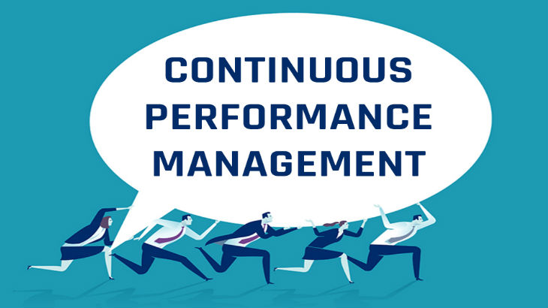
Mark R. Wright, OD, FCOVD

Slide 3
This power point presentation was created by
Mark R. Wright, OD, FCOVD
Copyright 2019 – Progressive Publishing Company – All rights reserved

Slide 4
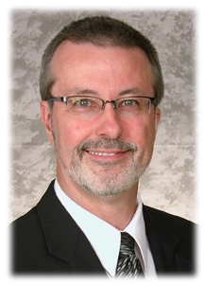
Mark Wright, OD, FCOVD
CEO: Practice Management Center
President: Pathways to Success
Editor: Review of Optometric Business
www.reviewob.com
Author: Coding, Reimbursement and Contracting for Optometry
Previous Director: Business Management Program at TOSU
2006 Benedict Professor: University of Houston
1980 – 2007 founder: Professional VisionCare, Westerville, OH
Notes:
4
4
Dr. Wright is a 1980 graduate of The Ohio State University College of Optometry, where he is clinical assistant professor and faculty coordinator of OSU’s Business Management Program. Retired from practice last year, Dr. Wright is president of Pathways to Success, Eyecare Business Training and Progressive Publishing Company. All three of these companies are dedicated to the special practice management needs of eyecare practices. Dr. Wright has lectured extensively throughout the U.S. and abroad. His topics include not only practice management, but also managed care, sports vision and vision and traumatic brain injuries. He is also the practice management editor for the Journal of Optometric Vision Development. This is Mark’s first presentation to the MBA. Please welcome Mark Wright…

Slide 5
SPEAKER FINANCIAL DISCLOSURE STATEMENT
Mark R. Wright, OD, FCOVD
has been a paid speaker for the following companies:
  Alcon
  B&L
  Essilor
  Jobson
  Johnson & Johnson
  VSP
Diversified Ophthalmics
Eye Recommend
IDOC
IVA
PERC
Vision Source
He is an officer of:
  Pathways to Success
  Practice Management Center
  Progressive Publishing Company
He is the professional editor of:
  Review of Optometric Business

Slide 6
Course Description
Continuous Performance Management
The tra­di­tion­al annu­al staff/doctor appraisal has inher­ent flaws. Forward thinking businesses are turn­ing to Con­tin­u­ous Per­for­mance Man­age­ment (known also as Agile Per­for­mance Man­age­ment). This course will explain what Con­tin­u­ous Per­for­mance Man­age­ment is and how con­tin­u­ous feed­back can add real val­ue to your bot­tom line.

Slide 7
Course Learning Objectives
Continuous Performance Management
1 hour course
The attendee will be able to …
Understand Why Are Com­pa­nies Ditch­ing Annu­al Appraisals
Understand What Continuous Performance Management (CPM) Is
Implement CPM
Understand how con­tin­u­ous feed­back adds real val­ue to the bot­tom line

Slide 8
Course Outline
Continuous Performance Management
Why Are Com­pa­nies Ditch­ing Annu­al Appraisals
What Continuous Performance Management (CPM) Is
How to Implement CPM
How con­tin­u­ous feed­back adds real val­ue to the bot­tom line

Slide 9
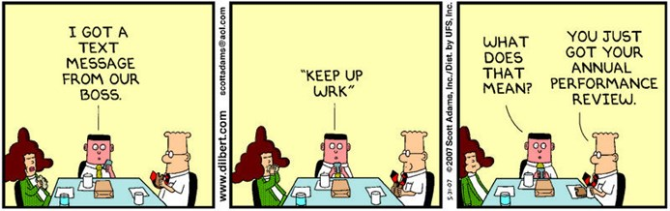

Slide 10

Why Are Com­pa­nies Ditch­ing Annu­al Appraisals
Agile busi­ness­es around the world have come to recognize that the tra­di­tion­al annu­al appraisal has a lot of inher­ent flaws.
Once or twice a year appraisals are not an effec­tive use of time.
95% of man­agers are not sat­is­fied with their organization's annu­al per­for­mance man­age­ment process.
75% of employ­ees see year­ly reviews as unfair.
Anoth­er study has found that only 8% of com­pa­nies believe that their tra­di­tion­al per­for­mance man­age­ment process dri­ves busi­ness val­ue.
https://www.clearreview.com/resources/guides/continuous-performance-management/

Slide 11

Performance Management
With­out ques­tion, per­for­mance man­age­ment is expe­ri­enc­ing a rev­o­lu­tion. Com­pa­nies are re-eval­u­at­ing how they con­duct per­for­mance dis­cus­sions, their atti­tude toward Objec­tives and Key Results (OKRs) and how the annu­al appraisal process has impact­ed employ­ee engage­ment and com­pa­ny culture.
https://www.clearreview.com/resources/guides/continuous-performance-management/

Slide 12

What Is Con­tin­u­ous
Per­for­mance Management?
Con­tin­u­ous per­for­mance man­age­ment, in a human resource (HR) man­age­ment con­text, is defined as per­for­mance man­age­ment process­es that take place through­out the year on an ongo­ing basis.
It is a con­tin­u­al holis­tic process, as opposed to those based on tra­di­tion­al annu­al appraisals. As feed­back occurs more often, it feels more nat­ur­al for both man­ag­er and employ­ee, who can devel­op more of a healthy, authen­tic work­place relationship.

Slide 13
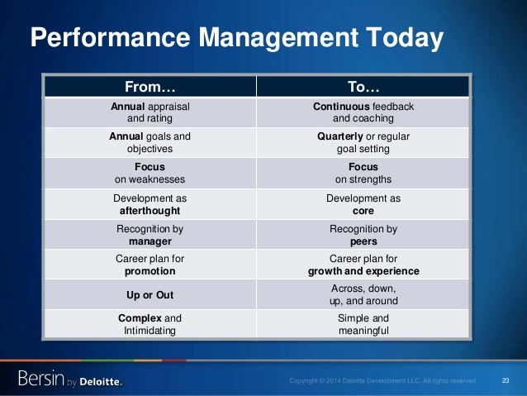

Slide 14
Personal goals, projects & tasks, ideally aligned with the organization’s goals, are assigned and recorded
The employee reports on tasks and goals until accomplished, manager reviews progress (No longer than weekly)
Co-workers and managers give real-time feedback on activities, identify strengths, and make suggestions for improvement
Manager and employee hold periodic check-in discussions, either in person or electronically (No longer than monthly)
Manager aggregates and summarizes employee’s progress for formal review (No longer than 3 months)
The
CPM PROCESS
Great­ly appeals to the mod­ern Mil­len­ni­al work­force.

Slide 15
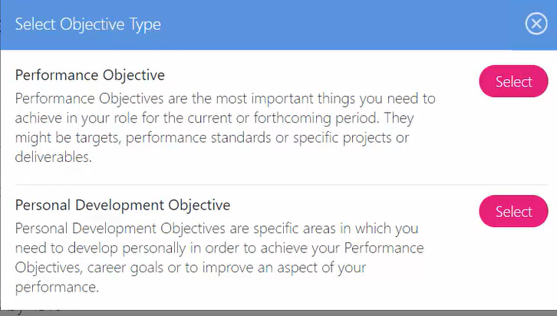

Slide 16
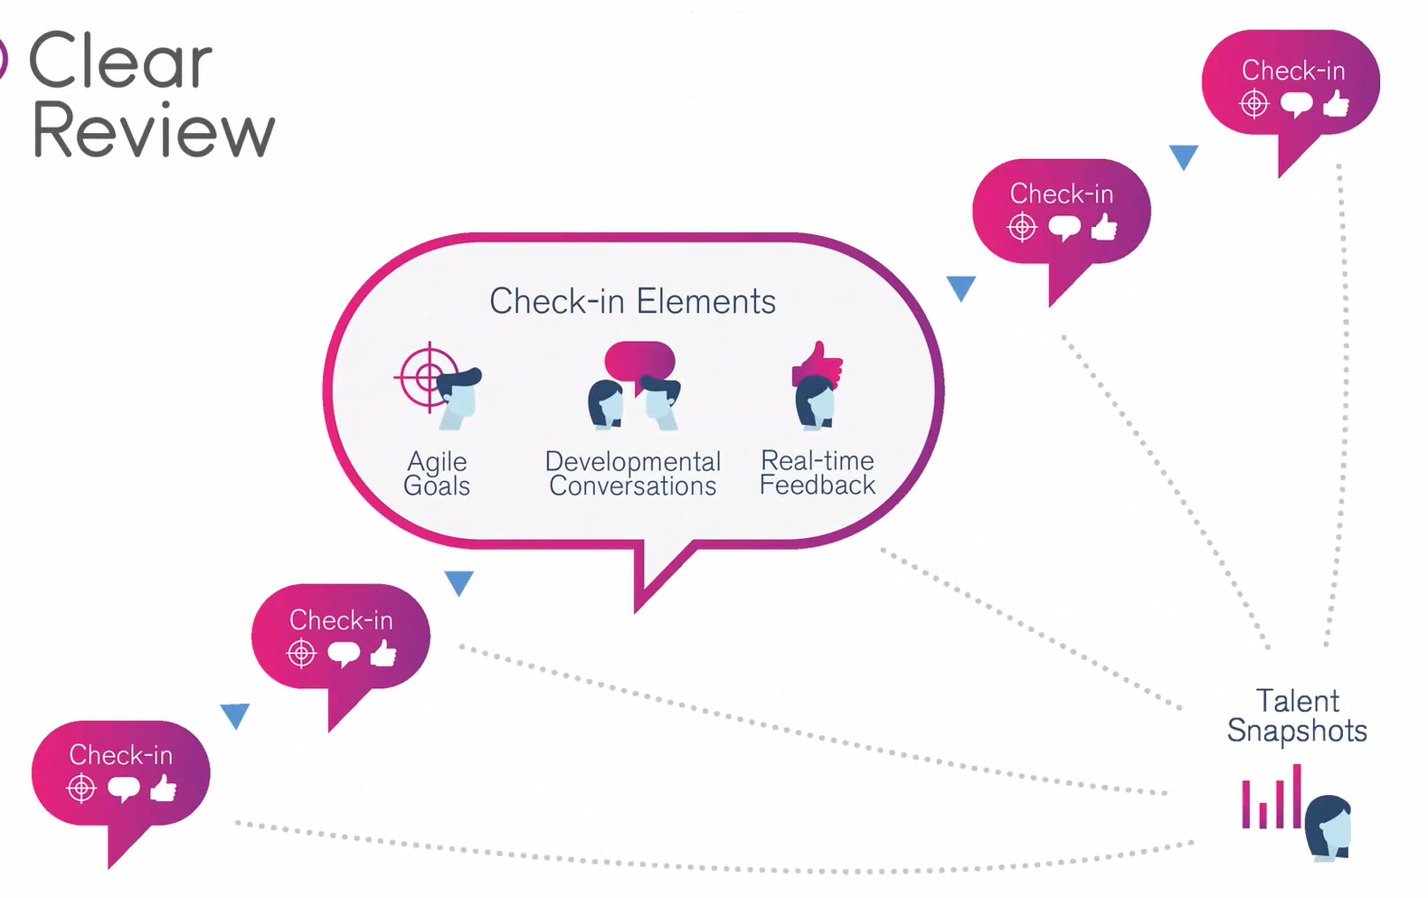

Slide 17
How to Implement
Get your peo­ple on board
Trans­paren­cy and good dia­logue are key to a smooth tran­si­tion. A lack of com­mu­ni­ca­tion will result in resis­tance, con­fu­sion and frustration.
Pro­vide the right train­ing
Train­ your lead­ers so they know what to dis­cuss dur­ing employ­ee one-to-ones.
Cre­ate a dynam­ic goal set­ting process
Encour­age employ­ees to work with man­ag­ers to define their own SMART goals that are near-term and aligned to the organization's goals.
Pro­vide devel­op­ment oppor­tu­ni­ties
Explain how this new system it will ben­e­fit them.
Con­duct reg­u­lar reviews of your new sys­tem

Slide 18
Highly Engaged
What can I do for others?
I inspire others to do their best.
Engaged
I’m a vital part of the business.
I feel important at work.
Almost Engaged
I know I’m part of something bigger.
I’m almost engaged but there are times when I’m not.
I love working here.
I’m a high flyer.
I’m really busy and very likely highly stressed.
I’m an achiever.
I’ll leave if something much better comes along.
Disengaged
I’m proud to work here but I wouldn’t shout it from the rooftops.
I might leave if I’m tempted.
I’m interested in overtime.
Not Engaged
There are no career development prospects here.
I have more sick days than I should.
I have poor working conditions.
I don’t like my manager or my team.
I don’t like my job much, but I get on with it.
I read job ads.
I’m here for the money.
I’m leaving when I can.
I’m not satisfied with my job.
My work doesn’t excite me.
I’m a clock watcher.

Slide 19
Highly Engaged
What can I do for others?
I inspire others to do their best.
Engaged
I’m a vital part of the business.
I feel important at work.
Almost Engaged
I know I’m part of something bigger.
I’m almost engaged but there are times when I’m not.
I love working here.
I’m a high flyer.
I’m really busy and very likely highly stressed.
I’m an achiever.
I’ll leave if something much better comes along.
Disengaged
I’m proud to work here but I wouldn’t shout it from the rooftops.
I might leave if I’m tempted.
I’m interested in overtime.
Not Engaged
There are no career development prospects here.
I have more sick days than I should.
I have poor working conditions.
I don’t like my manager or my team.
I don’t like my job much, but I get on with it.
I read job ads.
I’m here for the money.
I’m leaving when I can.
I’m not satisfied with my job.
My work doesn’t excite me.
I’m a clock watcher.
What can I do for others?
I inspire others to do their best.
I love working here.
I’m a high flyer.

Slide 20
Highly Engaged
What can I do for others?
I inspire others to do their best.
Engaged
I’m a vital part of the business.
I feel important at work.
Almost Engaged
I know I’m part of something bigger.
I’m almost engaged but there are times when I’m not.
I love working here.
I’m a high flyer.
I’m really busy and very likely highly stressed.
I’m an achiever.
I’ll leave if something much better comes along.
Disengaged
I’m proud to work here but I wouldn’t shout it from the rooftops.
I might leave if I’m tempted.
I’m interested in overtime.
Not Engaged
There are no career development prospects here.
I have more sick days than I should.
I have poor working conditions.
I don’t like my manager or my team.
I don’t like my job much, but I get on with it.
I read job ads.
I’m here for the money.
I’m leaving when I can.
I’m not satisfied with my job.
My work doesn’t excite me.
I’m a clock watcher.
I’m a vital part of the business.
I feel important at work.
I’m really busy.
I’m highly stressed.
I’m an achiever.
I’ll leave if something much better comes along.

Slide 21
Highly Engaged
What can I do for others?
I inspire others to do their best.
Engaged
I’m a vital part of the business.
I feel important at work.
Almost Engaged
I know I’m part of something bigger.
I’m almost engaged but there are times when I’m not.
I love working here.
I’m a high flyer.
I’m really busy and very likely highly stressed.
I’m an achiever.
I’ll leave if something much better comes along.
Disengaged
I’m proud to work here but I wouldn’t shout it from the rooftops.
I might leave if I’m tempted.
I’m interested in overtime.
Not Engaged
There are no career development prospects here.
I have more sick days than I should.
I have poor working conditions.
I don’t like my manager or my team.
I don’t like my job much, but I get on with it.
I read job ads.
I’m here for the money.
I’m leaving when I can.
I’m not satisfied with my job.
My work doesn’t excite me.
I’m a clock watcher.
I know I’m part of something bigger.
I’m almost engaged but there are times when I’m not.
I’m proud to work here but I wouldn’t shout it from the rooftops.
I might leave if I’m tempted.
There are no career development prospects here.

Slide 22
Highly Engaged
What can I do for others?
I inspire others to do their best.
Engaged
I’m a vital part of the business.
I feel important at work.
Almost Engaged
I know I’m part of something bigger.
I’m almost engaged but there are times when I’m not.
I love working here.
I’m a high flyer.
I’m really busy and very likely highly stressed.
I’m an achiever.
I’ll leave if something much better comes along.
Disengaged
I’m proud to work here but I wouldn’t shout it from the rooftops.
I might leave if I’m tempted.
I’m interested in overtime.
Not Engaged
There are no career development prospects here.
I have more sick days than I should.
I have poor working conditions.
I don’t like my manager or my team.
I don’t like my job much, but I get on with it.
I read job ads.
I’m here for the money.
I’m leaving when I can.
I’m not satisfied with my job.
My work doesn’t excite me.
I’m a clock watcher.
I’m interested in overtime.
I have more sick days than I should.
I have poor working conditions.
I don’t like my manager or my team.
I don’t like my job much, but I get on with it.
I read job ads.

Slide 23
Highly Engaged
What can I do for others?
I inspire others to do their best.
Engaged
I’m a vital part of the business.
I feel important at work.
Almost Engaged
I know I’m part of something bigger.
I’m almost engaged but there are times when I’m not.
I love working here.
I’m a high flyer.
I’m really busy and very likely highly stressed.
I’m an achiever.
I’ll leave if something much better comes along.
Disengaged
I’m proud to work here but I wouldn’t shout it from the rooftops.
I might leave if I’m tempted.
I’m interested in overtime.
Not Engaged
There are no career development prospects here.
I have more sick days than I should.
I have poor working conditions.
I don’t like my manager or my team.
I don’t like my job much, but I get on with it.
I read job ads.
I’m here for the money.
I’m leaving when I can.
I’m not satisfied with my job.
My work doesn’t excite me.
I’m a clock watcher.
I’m here for the money.
I’m leaving when I can.
I’m not satisfied with my job.
My work doesn’t excite me.
I’m a clock watcher.

Slide 24

Highly Engaged
What can I do for others?
I inspire others to do their best.
Engaged
I’m a vital part of the business.
I feel important at work.
Almost Engaged
I know I’m part of something bigger.
I’m almost engaged but there are times when I’m not.
I love working here.
I’m a high flyer.
I’m really busy and very likely highly stressed.
I’m an achiever.
I’ll leave if something much better comes along.
Disengaged
I’m proud to work here but I wouldn’t shout it from the rooftops.
I might leave if I’m tempted.
I’m interested in overtime.
Not Engaged
There are no career development prospects here.
I have more sick days than I should.
I have poor working conditions.
I don’t like my manager or my team.
I don’t like my job much, but I get on with it.
I read job ads.
I’m here for the money.
I’m leaving when I can.
I’m not satisfied with my job.
My work doesn’t excite me.
I’m a clock watcher.
15%
49%
Where is each member of your team?
18%
a recent Gallup poll

Slide 25

How con­tin­u­ous feed­back adds real val­ue to the bot­tom line

Slide 26
To learn more …
https://www.clearreview.com/resources/guides/continuous-performance-management/
https://joshbersin.com/2018/07/continuous-performance-management-innovation-reigns/
https://www.tlnt.com/how-to-get-started-with-continuous-performance-management/

Slide 27


Slide 28


