Slide 1

Financial Management and Profitability
Mark R. Wright, OD, FCOVD
mwright@pathways-o.com

Slide 2
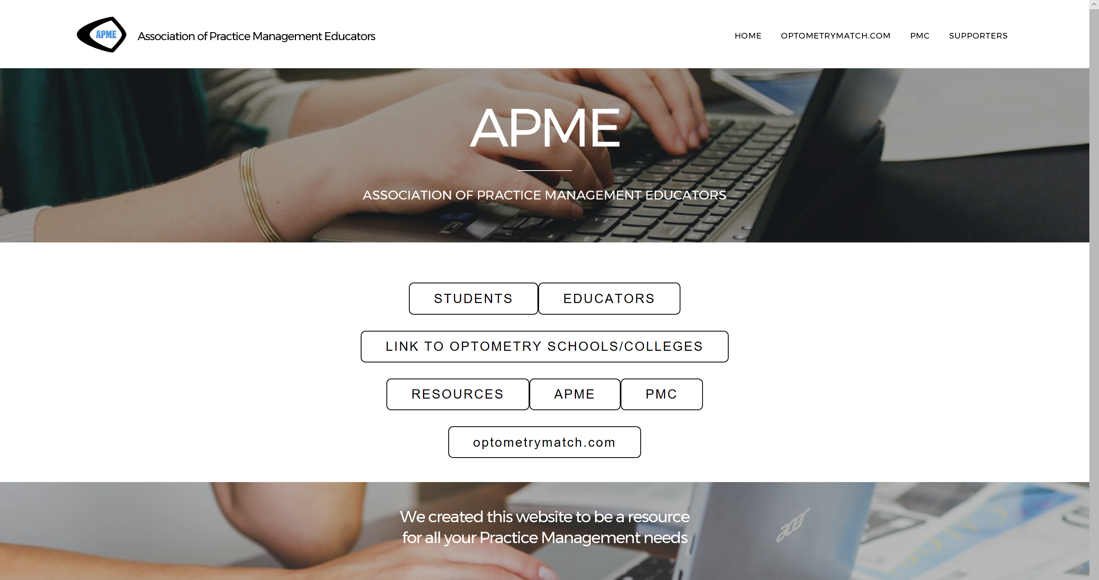
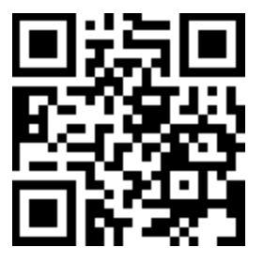
optometrybusiness.com

Slide 3
Create Profit Centers
CLINIC
Revenue
Expenses
Net
EYEWEAR
Revenue
Expenses
Net
CLs
Revenue
Expenses
Net
39% 43% 16%
-
-
-

Slide 4
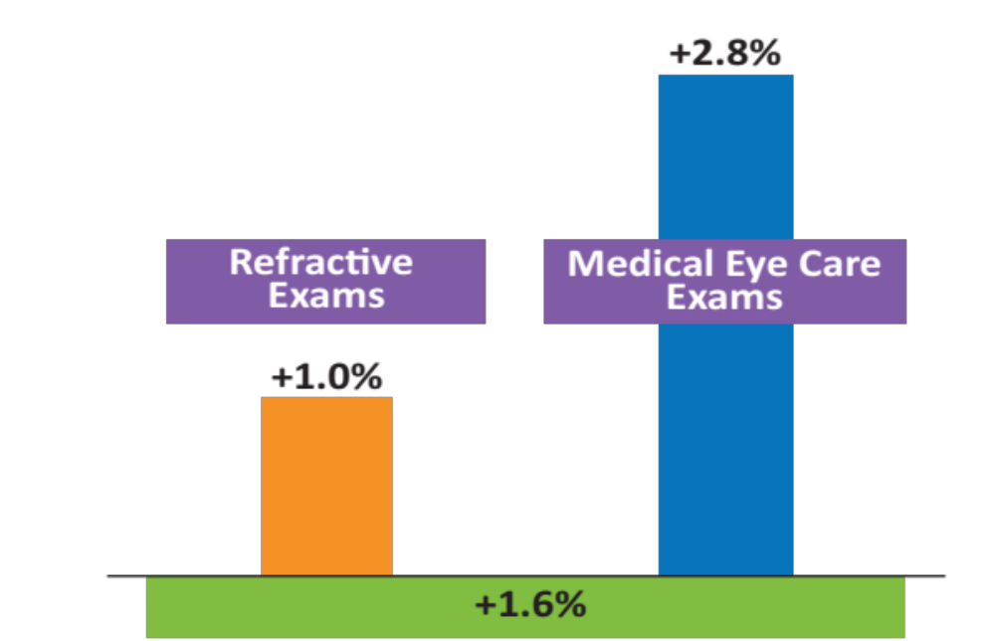
Growing Demand
for Medical Eyecare
Projected Annual Exam
Growth 2016-2025
Notes:
Among the fastest growing components of eyecare demand through 2025 will be medical eyecare.
Medical eyecare exams are expected to increase nearly three times as fast as refractive exams through 2025. The growth rates shown here do not reflect any fee increases, but only the number of exams performed, so the annual revenue impact of medical eyecare growth will be greater than these numbers suggest.
The rapid growth in demand for medical eyecare relates to the aging of the population, but also to the growing diagnoses and treatment of prevalent ocular conditions such as dry eye and ocular allergies and expanded use of diagnostic tests such as retinal scans and OCT.

Slide 5
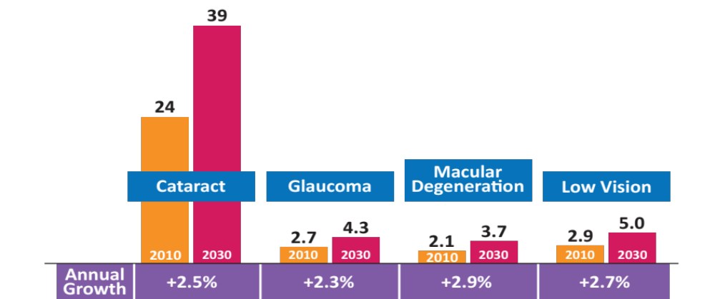
Growing Prevalence
of Ocular Disorders
(million adults)
Diabetic
Retinopathy
11.4
7.7
2030
2010
3.5%
Source: National Eye Institute
Notes:
As mentioned, one driver of demand for medical eyecare is the increasing prevalence of ocular disorders in the population, related to the aging of the Baby Boom generation.
For cataracts, glaucoma, macular degeneration and low vision, the number of Americans suffering from these conditions will increase 2.3% to 2.9% annually through 2030, according to the National Eye Institute.

Slide 6
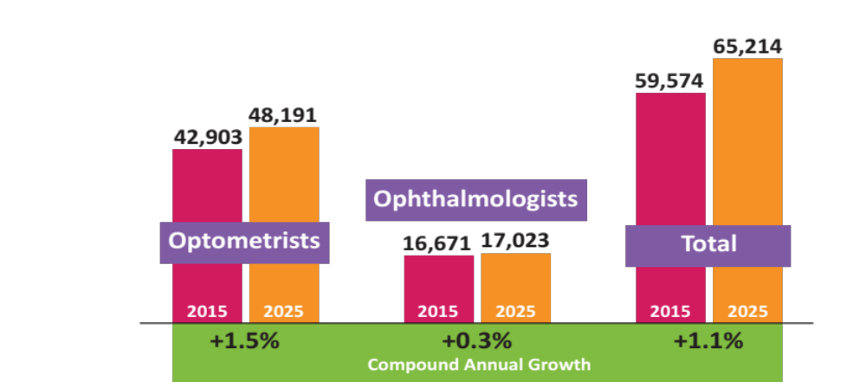
Professional
Workforce Growth
Notes:
There have been several workforce studies of ODs and ophthalmologists in recent years including the Jobson estimates shown here. [MRW – THERE IS A DIFFERENCE BETWEEN A STUDY AND A PREDICTION. THIS SLIDE APPEARS TO BE A PREDICTION NOT A STUDY.]
All of the studies agree that, based on the age of doctors in practice and the numbers of new doctors entering the professions annually, the number of ODs will steadily grow, as the number of ophthalmologists remains flat through 2025.
Within both professions, the proportion of women in practice will rise substantially. [MRW – THESE TWO SENTENCES ARE NOT LINKED, BUT THE WAY THEY ARE ALIGNED MAKES IT SEEM LIKE THEY ARE.] In 2025 there will be over 48,000 ODs in practice, compared to about 43,000 today.

Slide 7
Frameboard management
Mark Wright, OD, FCOVD

Slide 8
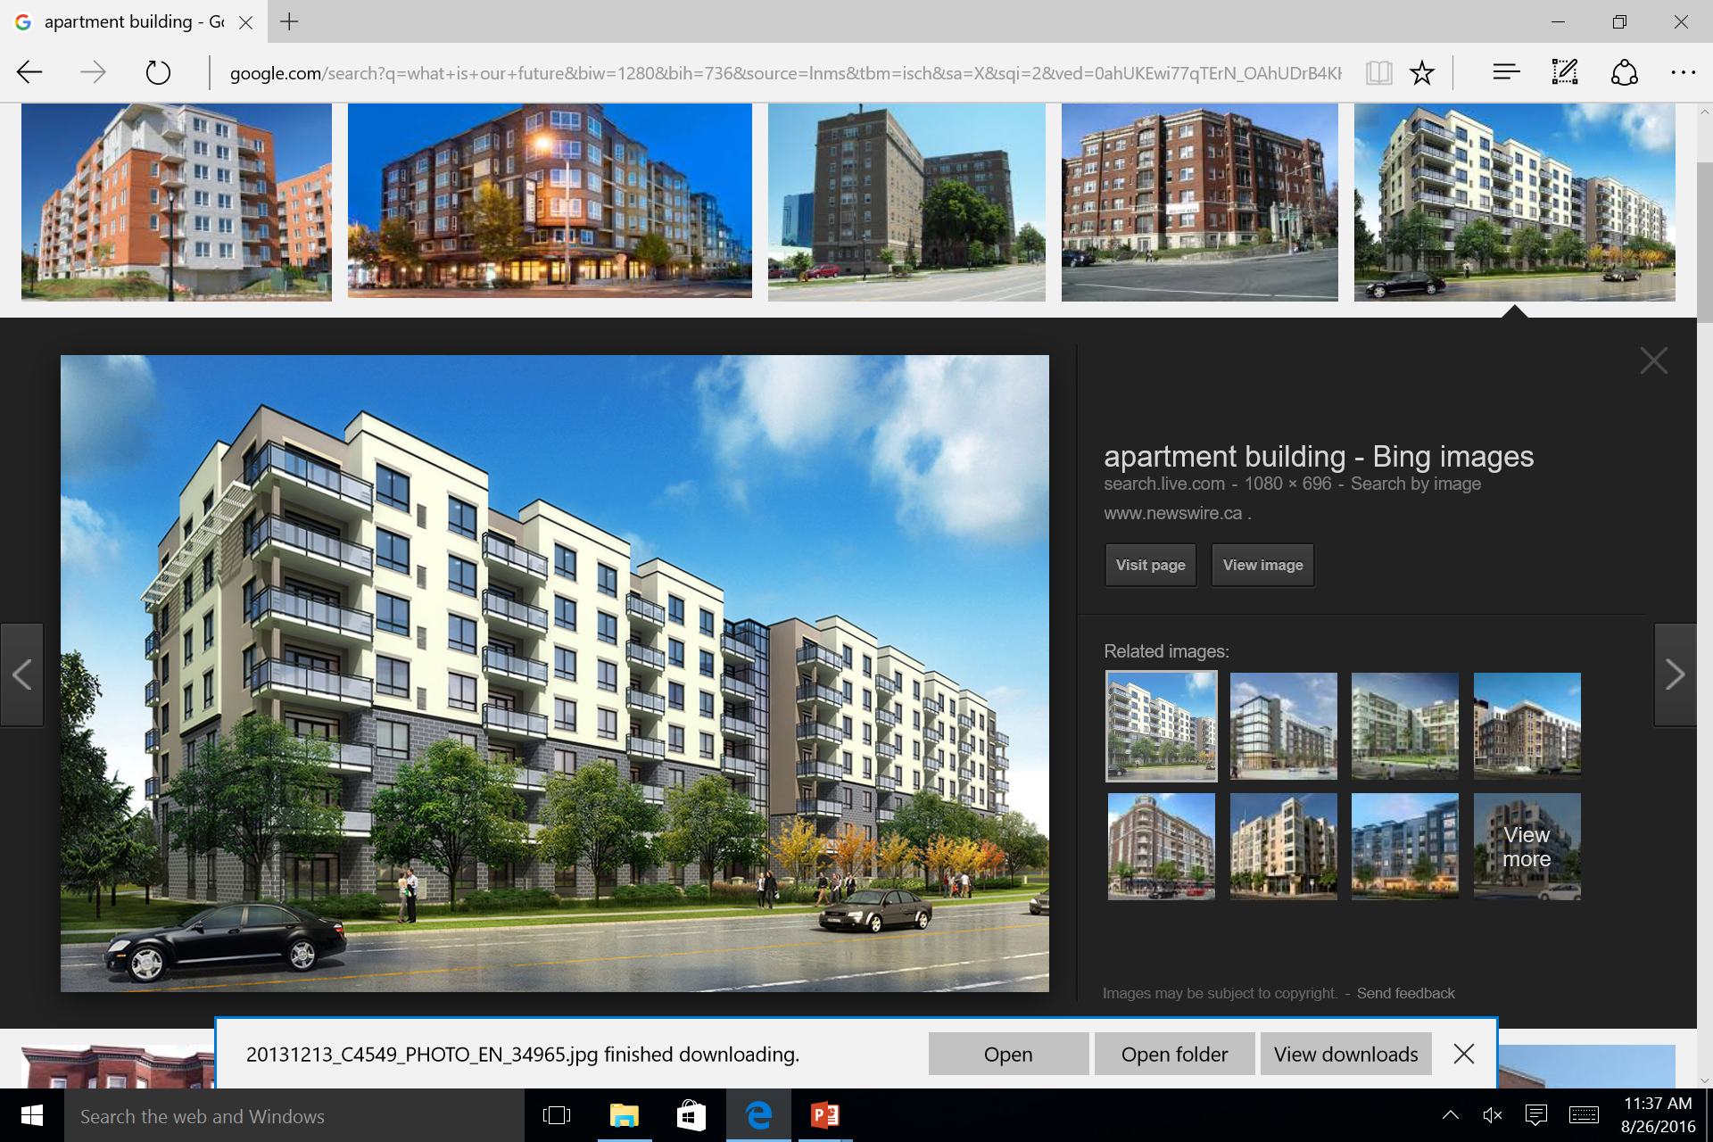

Slide 9
Managing COGS
Manage purchases
  Utilize prompt pay discount
  Buy in bulk
  Consolidate vendors
Manage utilization
  Manage inventory
  Manage shipping & handling fees
  Manage shrinkage

Slide 10

Am I in the right place?

Slide 11
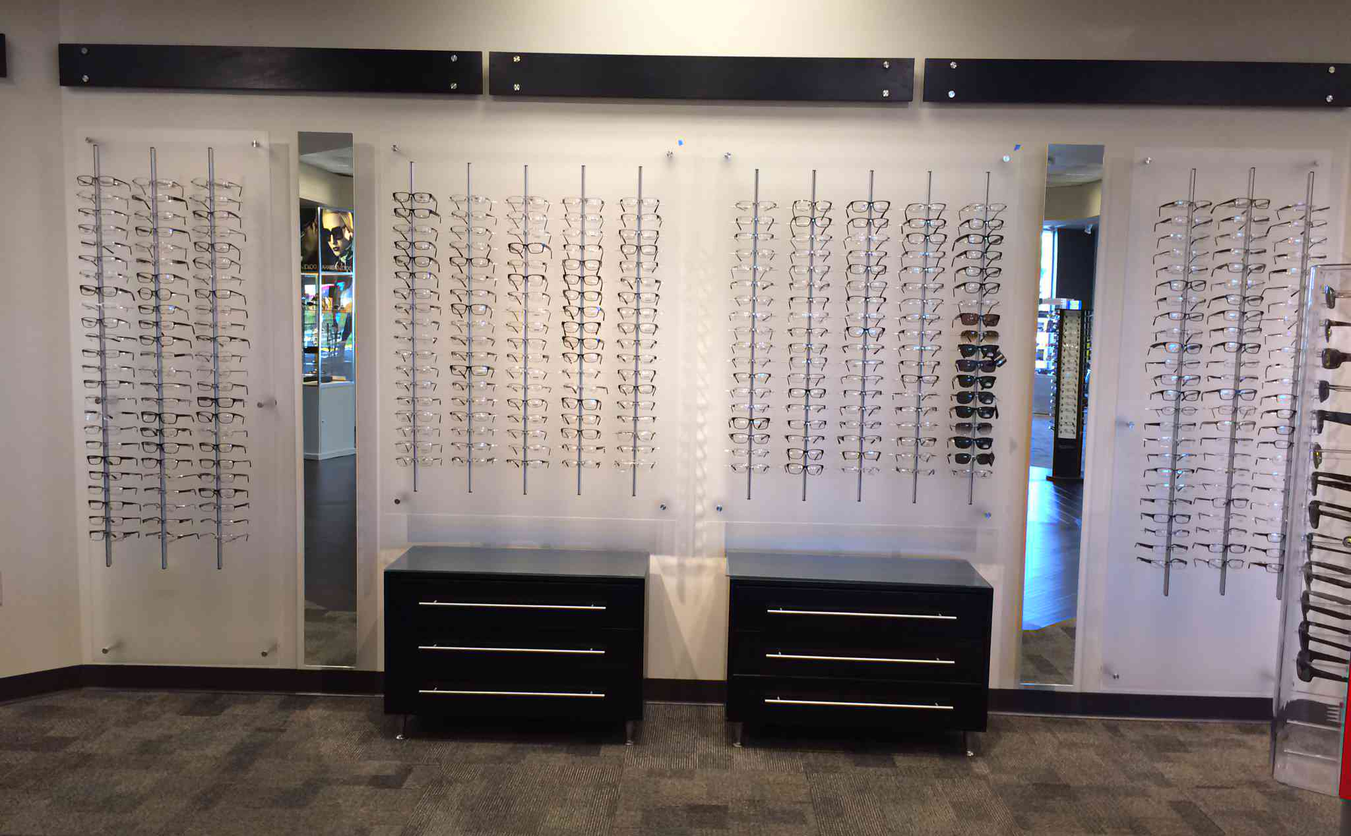

Slide 12
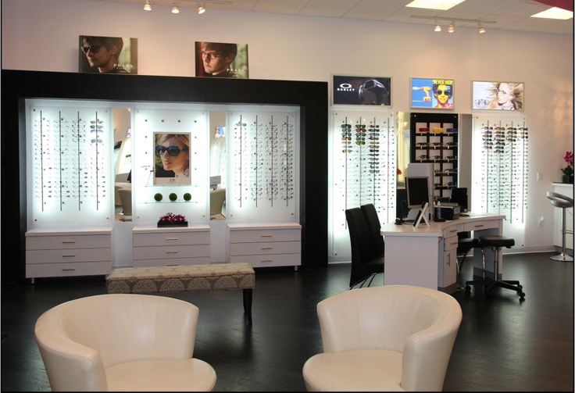

Slide 13
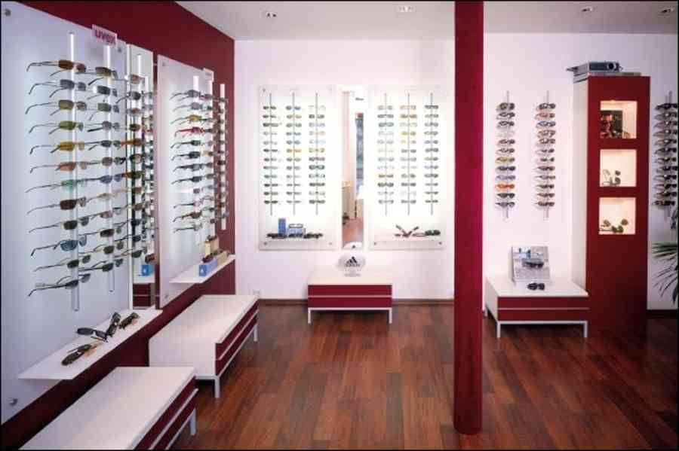

Slide 14
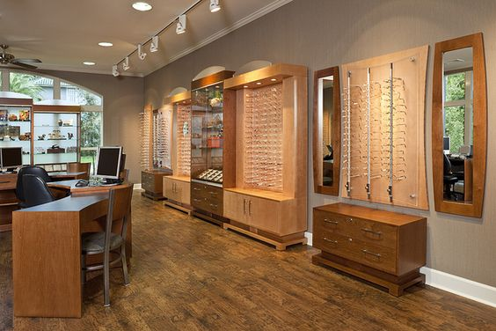

Slide 15
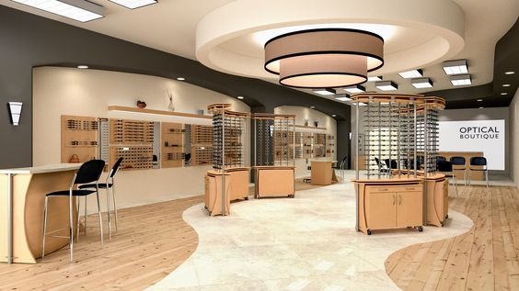

Slide 16
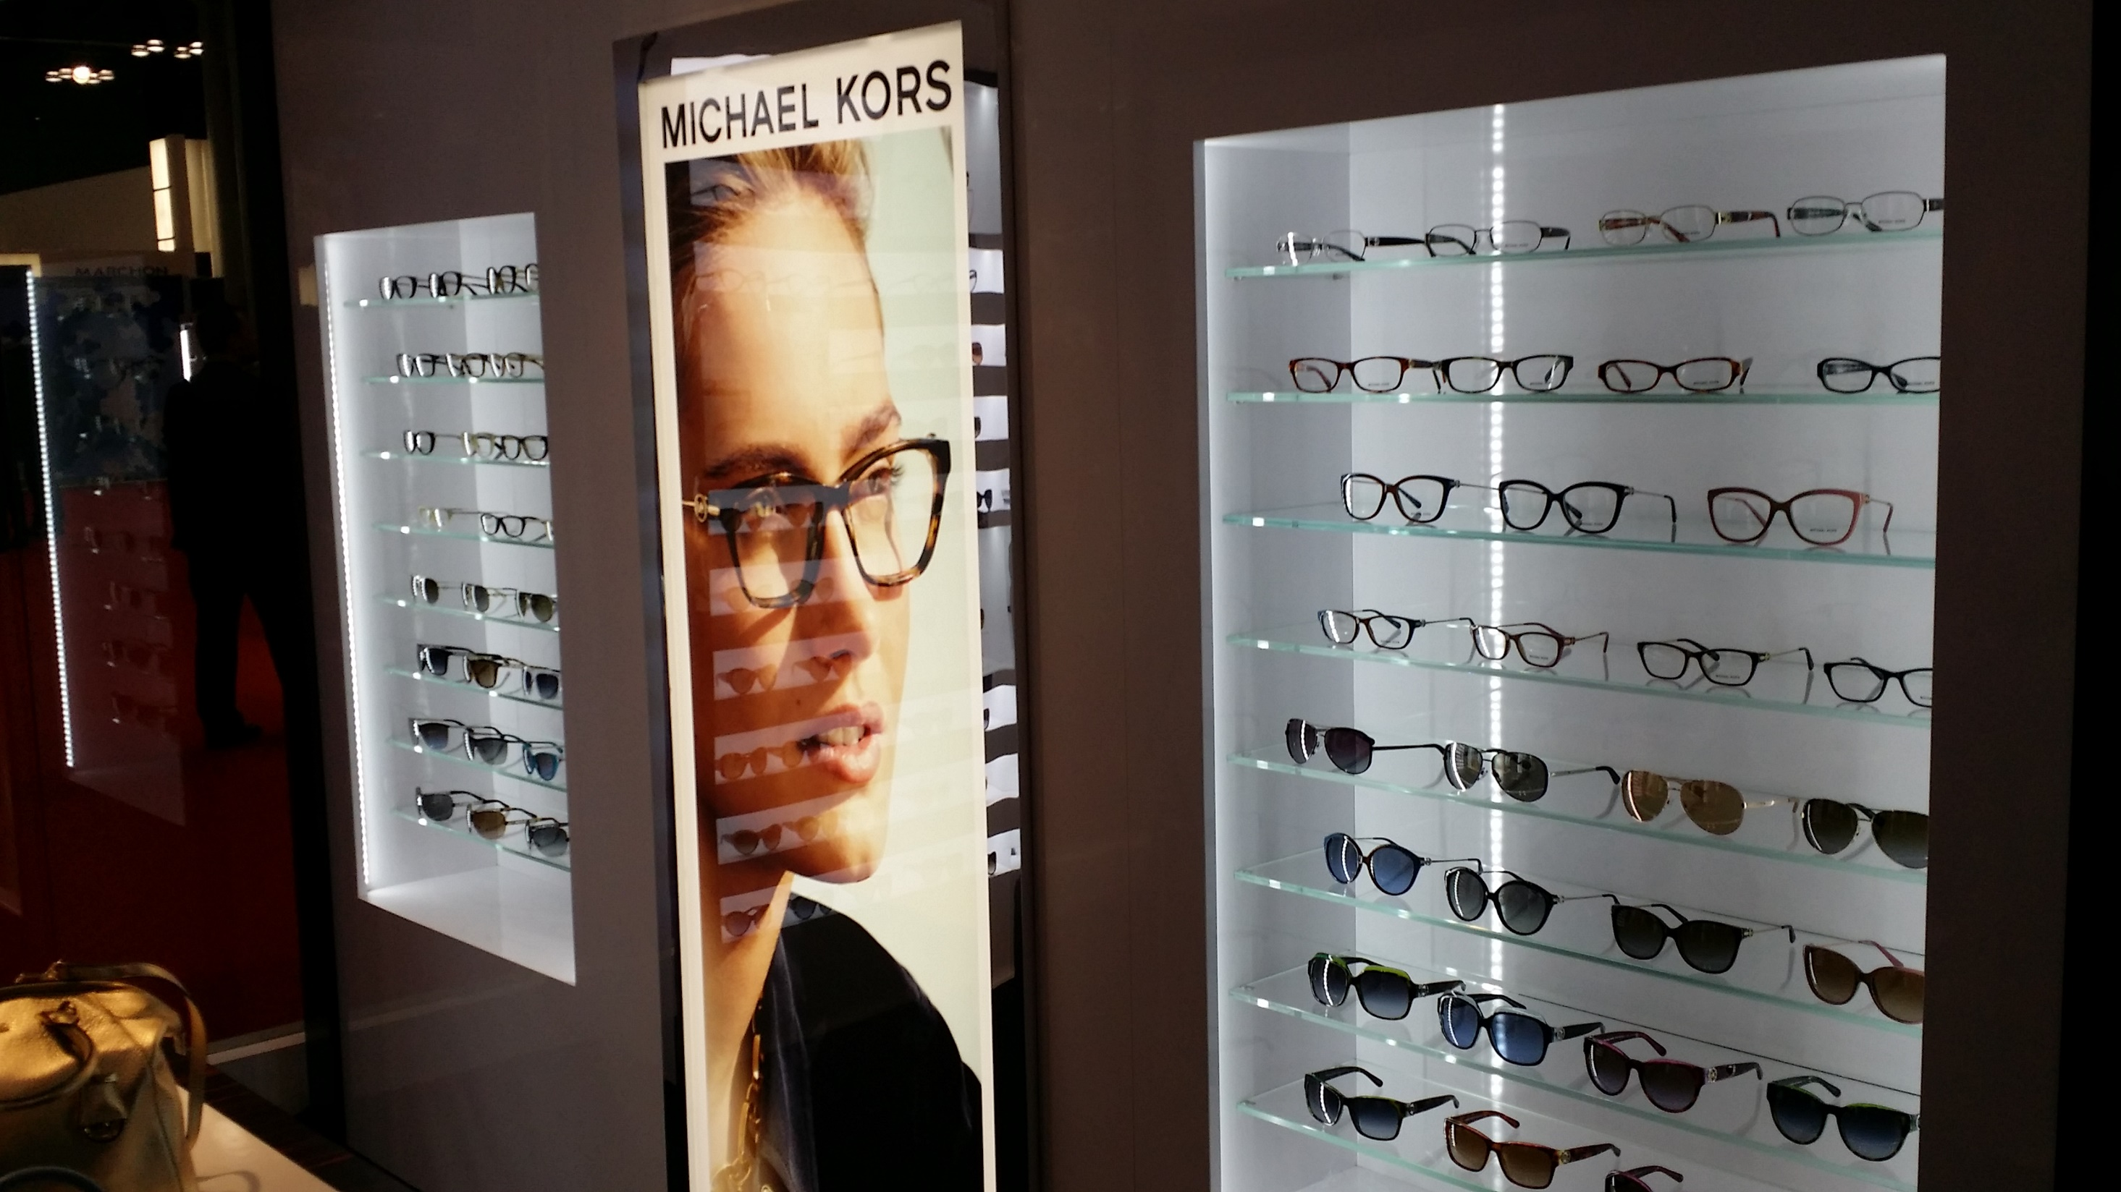

Slide 17
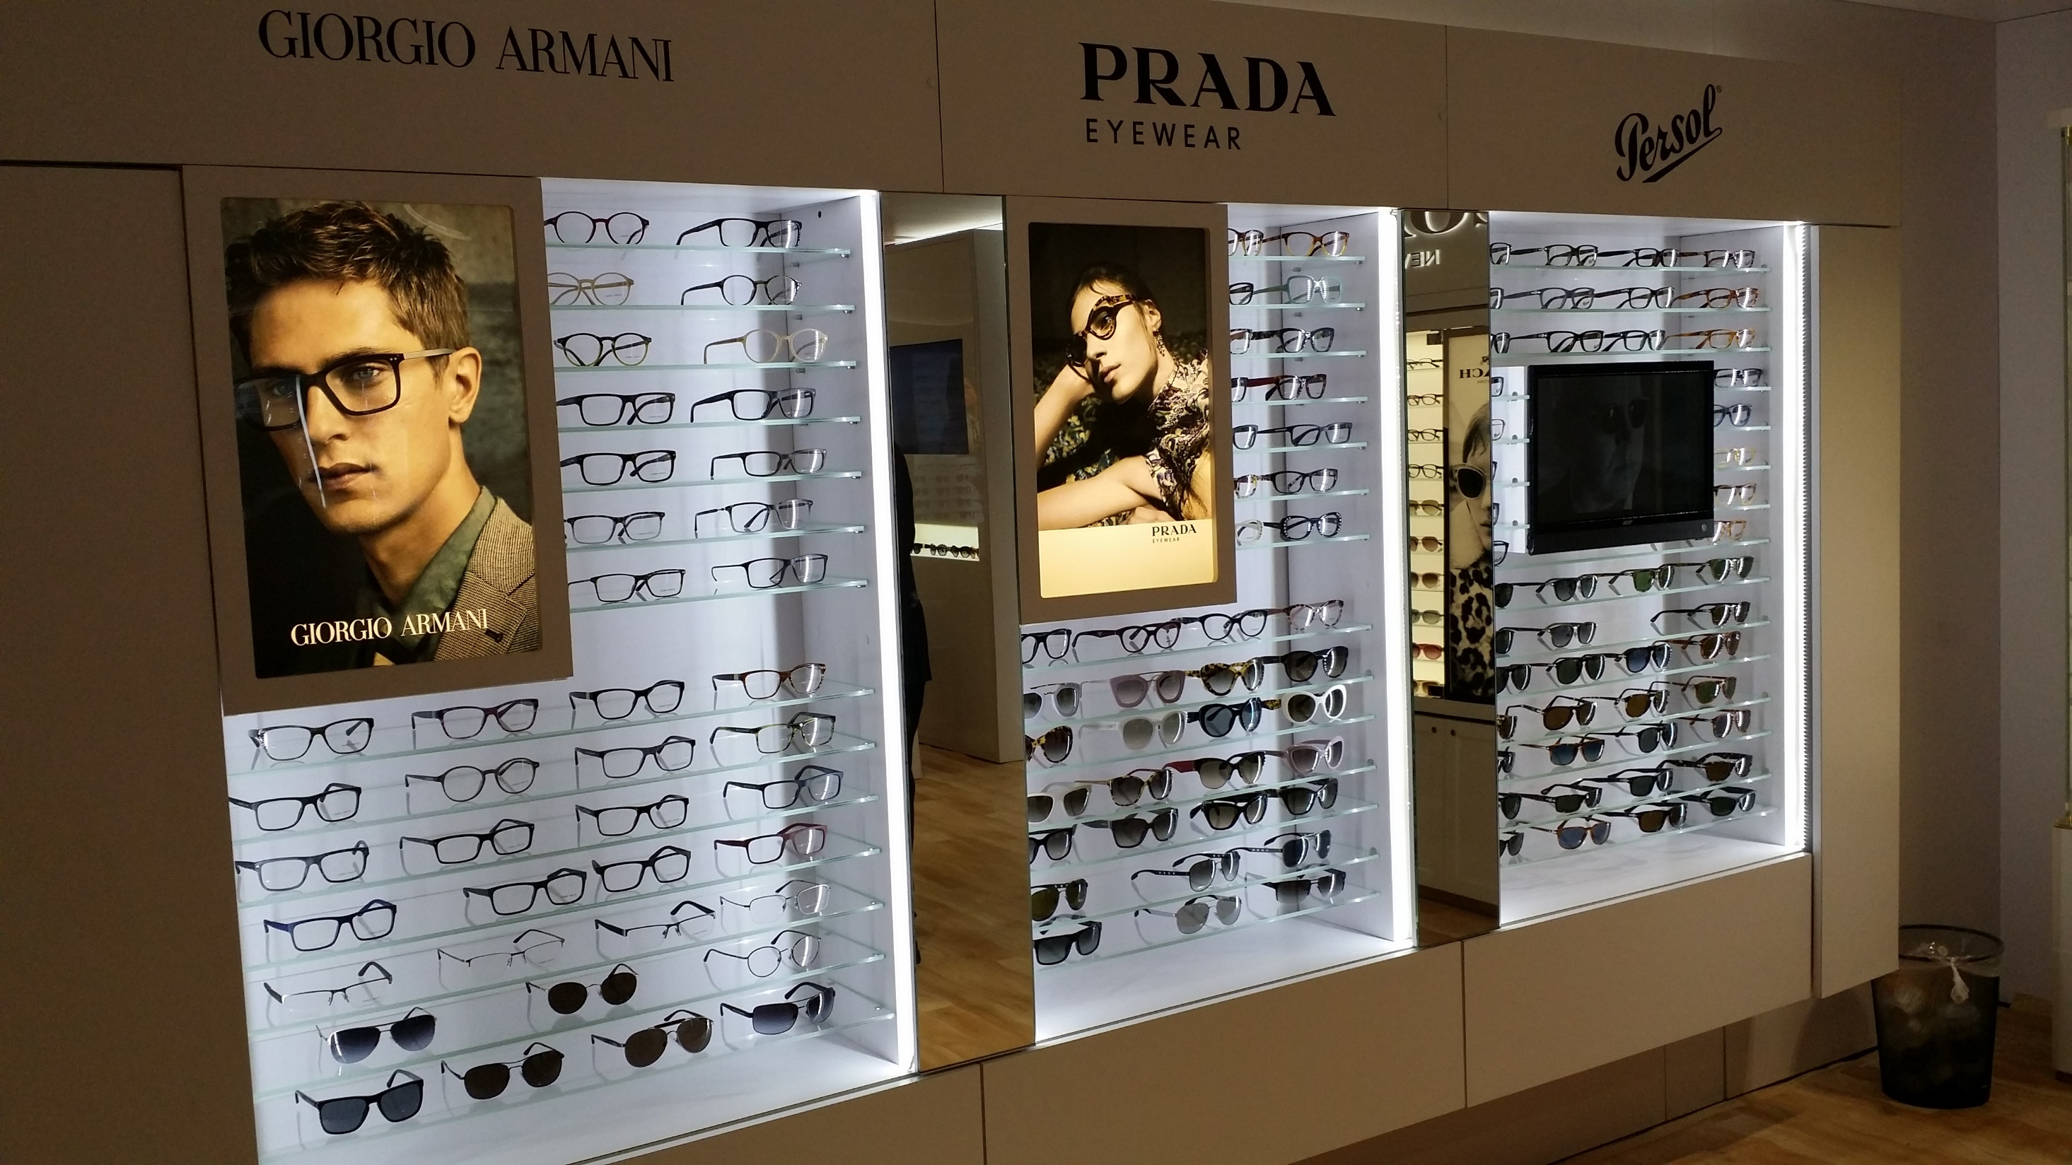

Slide 18
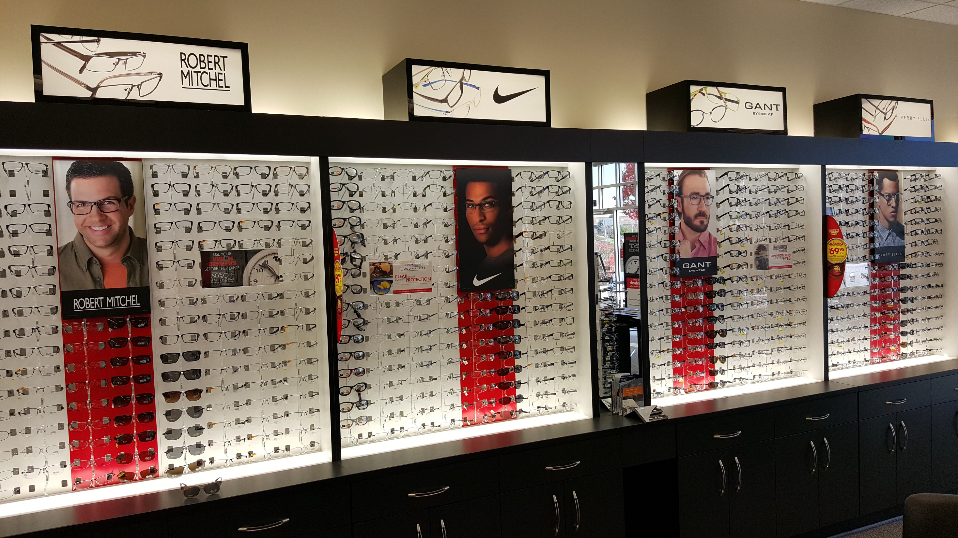

Slide 19
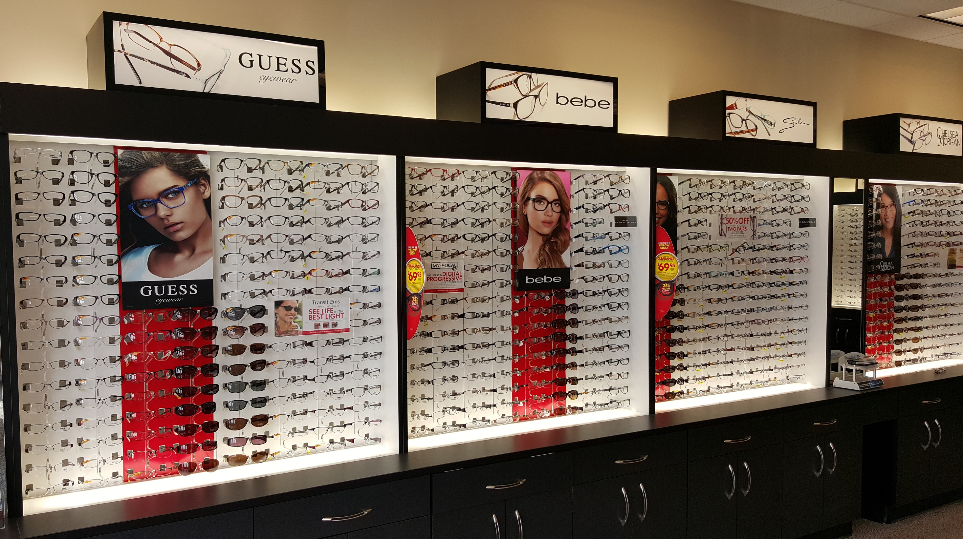

Slide 20
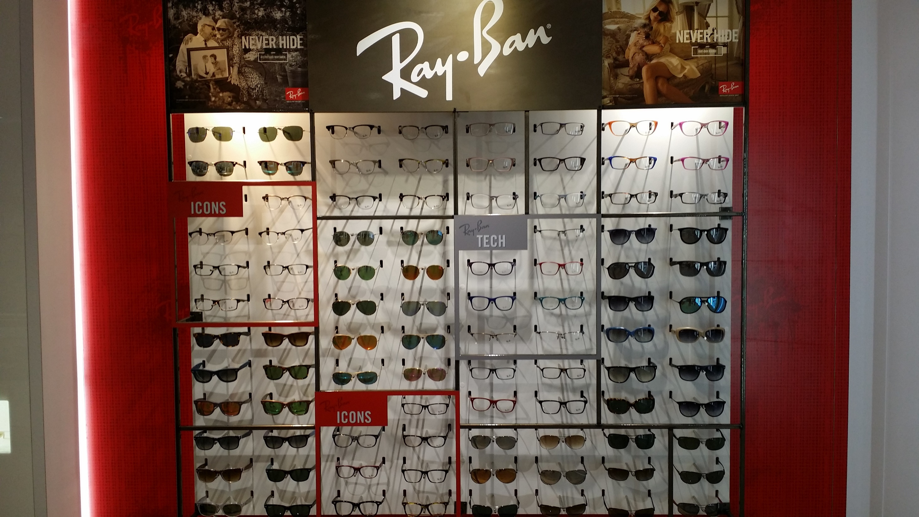

Slide 21
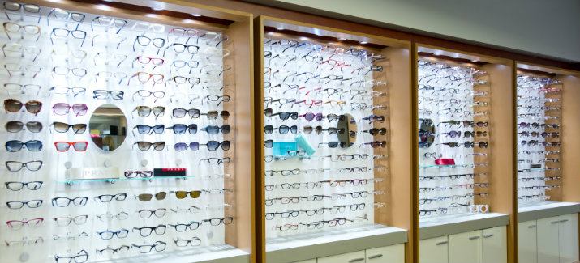
HIDDEN COSTS
What does it cost you to have a Frame on your Frameboard?
$15
Ordering the frame
Unpacking the frame
Checking in the frame
Adjusting the frame
Putting the frame on display
Cleaning the frame

Slide 22

How do you price frames?
Cost x Variable Market Determination

Slide 23
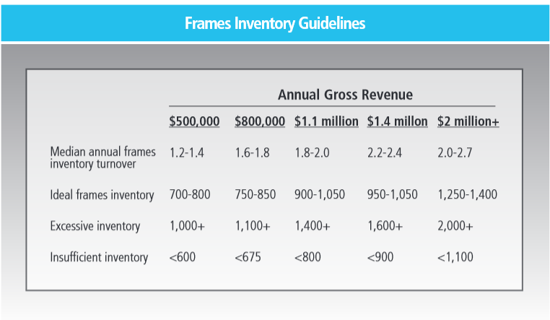

Slide 24
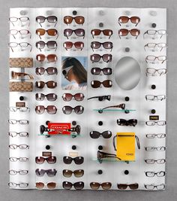
What is the minimum number of frames of any line to display on your frameboard?
1
2
3
4
5
6
7
8
9
10
11
12
13
14
14/28

Slide 25

How many times per year should a frame line turn?

Slide 26
Adult Frame Distribution
40 – 30 – 30

Slide 27
FRAMEBOARD DISTRIBUTION
Sample practice
$0-200 22%
$201-280 37%
$281-360 18%
$361-449 13%
> $450 10%

Slide 28
FRAMEBOARD MANAGEMENT
PRICE POINT | HOW MANY | # SOLD
> $500
$450 - $499
$400 - $449
$350 - $399
$300 - $349
$250 - $299
$200 - $249
$150 - $199
$100 - $149
<$100

Slide 29
Fashion Forward
Contemporary
Conservative
CONSERVATIVE
PRICE POINT | HOW MANY | # SOLD
> $500
$450 - $499
$400 - $449
$350 - $399
$300 - $349
$250 - $299
$200 - $249
$150 - $199
$100 - $149
<$100
MEN’s
WOMEN’s
UNISEX

Slide 30
MEN - CONSERVATIVE
PRICE POINT | HOW MANY | # SOLD
> $500
$450 - $499
$400 - $449
$350 - $399
$300 - $349
$250 - $299
$200 - $249
$150 - $199
$100 - $149
<$100
MEN - CONTEMPORARY
PRICE POINT | HOW MANY | # SOLD
> $500
$450 - $499
$400 - $449
$350 - $399
$300 - $349
$250 - $299
$200 - $249
$150 - $199
$100 - $149
<$100
MEN – FASHION FORWARD
PRICE POINT | HOW MANY | # SOLD
> $500
$450 - $499
$400 - $449
$350 - $399
$300 - $349
$250 - $299
$200 - $249
$150 - $199
$100 - $149
<$100

Slide 31
How do you price spectacle lenses?
Cost x Variable Market Determination

Slide 32
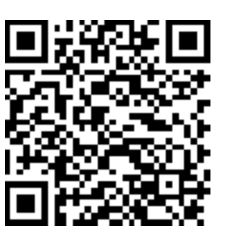
Package pricing versus a la carte pricing
https://valueandpricing.com/packages-and-bundles-vs-a-la-carte-pricing/

Slide 33

Do people buy based on Price or Value

Slide 34
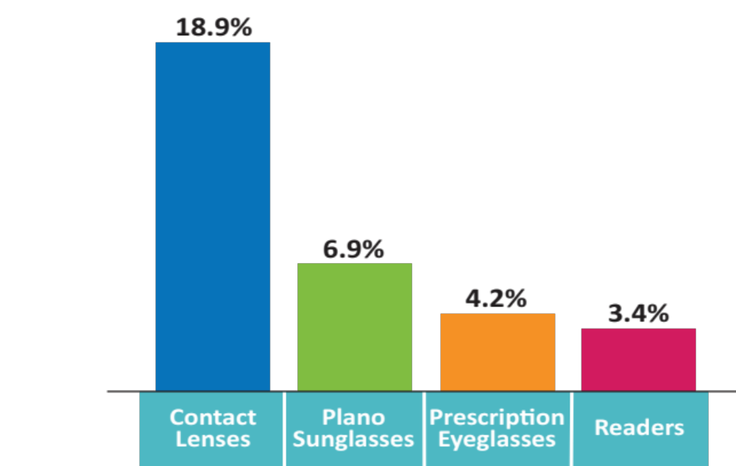
Slow Penetration of
Internet Eyewear Retailing
Internet Purchase
of Optical Products: 2016
(% of most recent consumer purchases
made on the Internet)
Source: Vision Council 2016 Internet Influence Report
Notes:
Vision Watch regularly monitors consumer purchase of optical products on the Internet. Its latest data indicate that nearly one-in-five contact lens wearers currently uses the Internet to buy contacts – a ratio which has not changed much in recent years. Currently just 4% of eyeglass prescriptions are purchased on the Internet.
Although Internet purchase of eyewear has grown rapidly on a small base, it is clear that Internet sellers face substantial obstacles to gain a major market share -- the principal one being that consumers highly value the personal interaction with and advice of trained professionals as they navigate the complex task of choosing frames and lenses. Nevertheless, as consumers increasingly use the Internet to make purchases across the entire spectrum of product categories – both to save money and make shopping easier – it’s likely that Internet providers will gradually increase their share of the corrective eyecare market.

Slide 35

What is your action plan against online?

Slide 36

Can I buy CLs from you at
8 pm

Slide 37


Slide 38
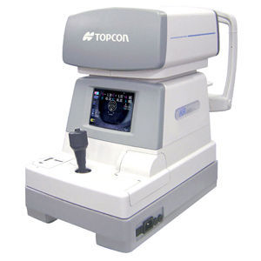
Auto refractors are the end of practice as we know it … or maybe not

Slide 39
Online Refraction
• Opternative
  • Online refraction in 39 states
  • $6 million private equity investment
  • Partnering with 1-800-Contacts
• Smart Vision Labs
  • Marketing online refraction system to optical retailers
• Warby Parker
  • May 2017 introduction of customers-only online refractions app
Notes:
Online refraction poses the most disruptive threat to the traditional model of how consumers acquire vision correction products.
There are many technology platforms under development to enable online prescription of eyewear and contact lenses, and it seems inevitable that one or more will prove reliable and accurate enough to survive legal challenges. To the extent that the technology works, it is probable that it will be soon adopted by many optical chains to gain a competitive edge.
It is easy to envision the day when such technology is used by independent ECPs to accelerate the purchase cycle or to ease excess patient flow in their offices [MRW – OR TO MANAGE PATIENTS WITH REFRACTICE CHANGES SUCH AS CHILDREN GOING THROUGH RAPID GROWTH OR OUT OF CONTROL DIABETICS.].
Among current developments in this arena are:
Opternative, a Chicago start-up operating in 39 states, has attracted equity capital to expand its system to attract a larger patient base. It is partnering with 1 800 Contacts. It faces a number of legal challenges which have slowed its progress.
Smart Vision Labs is marketing its system to optical retailers as a means to attract new customers.
Recently Warby Parker announced an online refraction app, initially available only to existing customers. All these developments should be monitored closely as a means of assessing their ultimate impact on optometric practice.
PANEL DISCUSSION: Mick, let me call on you for some interpretation: What are the first steps you would take to meet the challenges of capturing more medical model, changing consumer preferences in services and purchasing eyewerar—and in creating the patient experience in your practice?
MICK KLING: Consumers want a unique experience….

Slide 40
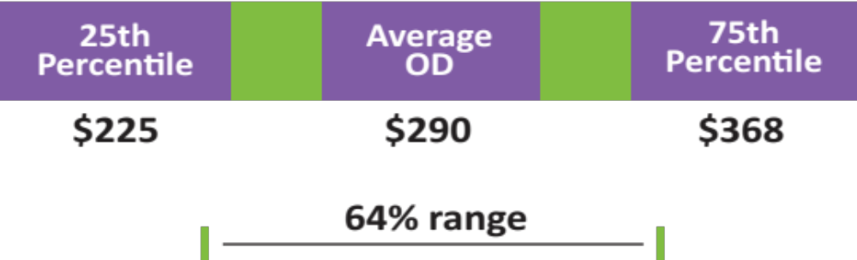
Upgrade Product Mix
Independent OD Eyewear Average Sale
t
u
Process, not patient demographics, explain sales mix variance
Source: Estimates based on Vision Watch and Management & Business Academy data
Notes:
Independent ECPs have the ability to heavily influence patient demand for products and services through their education and recommendations, yet many are reluctant to exercise this influence. [MRW – THE NUMBER ONE ‘EXCUSE’ OFFERED IS “I DON’T WANT TO BE SEEN AS SELLING TO PATIENTS.”]
There is a great disparity in the average eyewear sale among independent ODs, which cannot be explained by demographic differences among practices, but is the result in differences in product presentation processes.
A patient’s overall satisfaction with an eyecare provider is heavily shaped by their satisfaction with the corrective products dispensed to them. Encouraging purchase of higher performance products improves patient satisfaction and loyalty, as well as financial performance.

Slide 41


Slide 42
Top 5 Mistakes Preventing Your Practice Growth
Mark R. Wright, OD, FCOVD

Slide 43
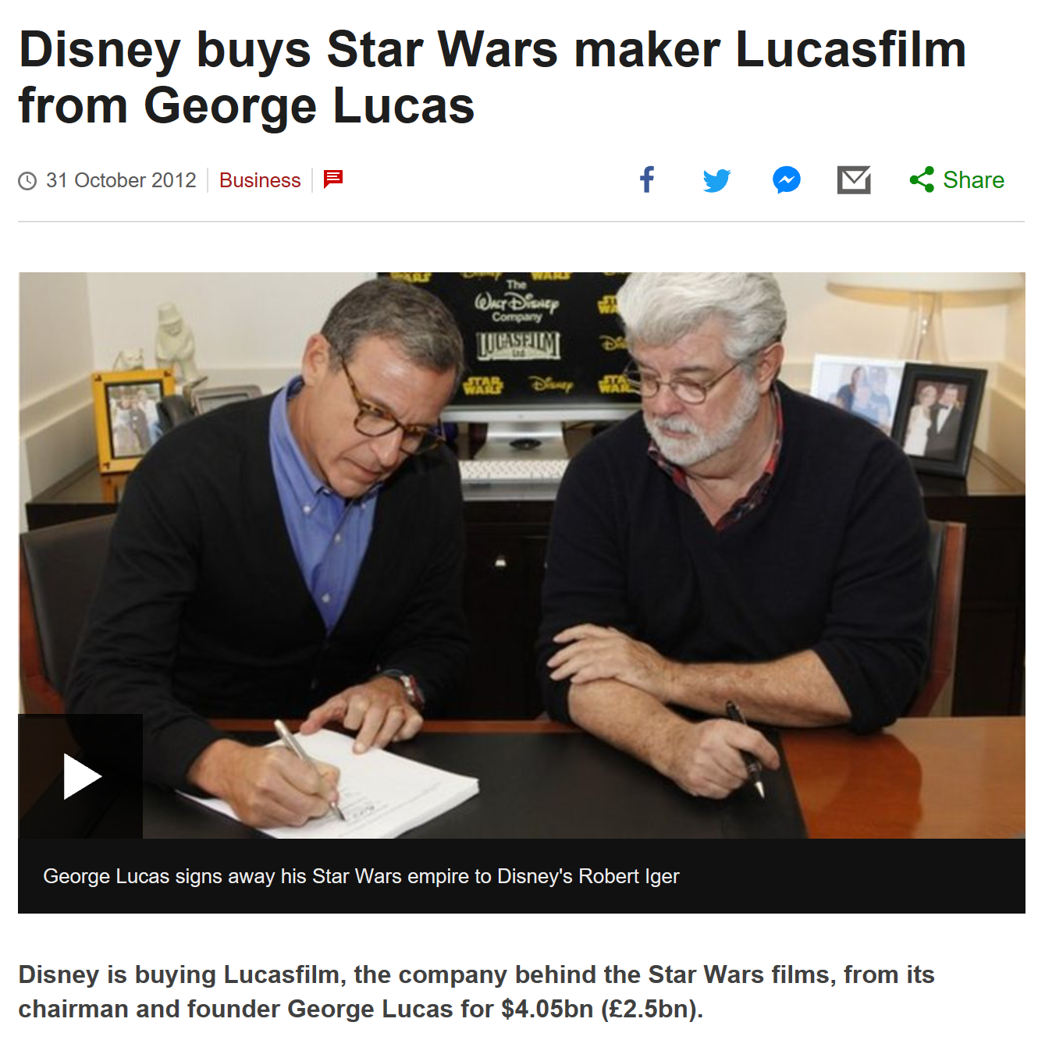

Slide 44
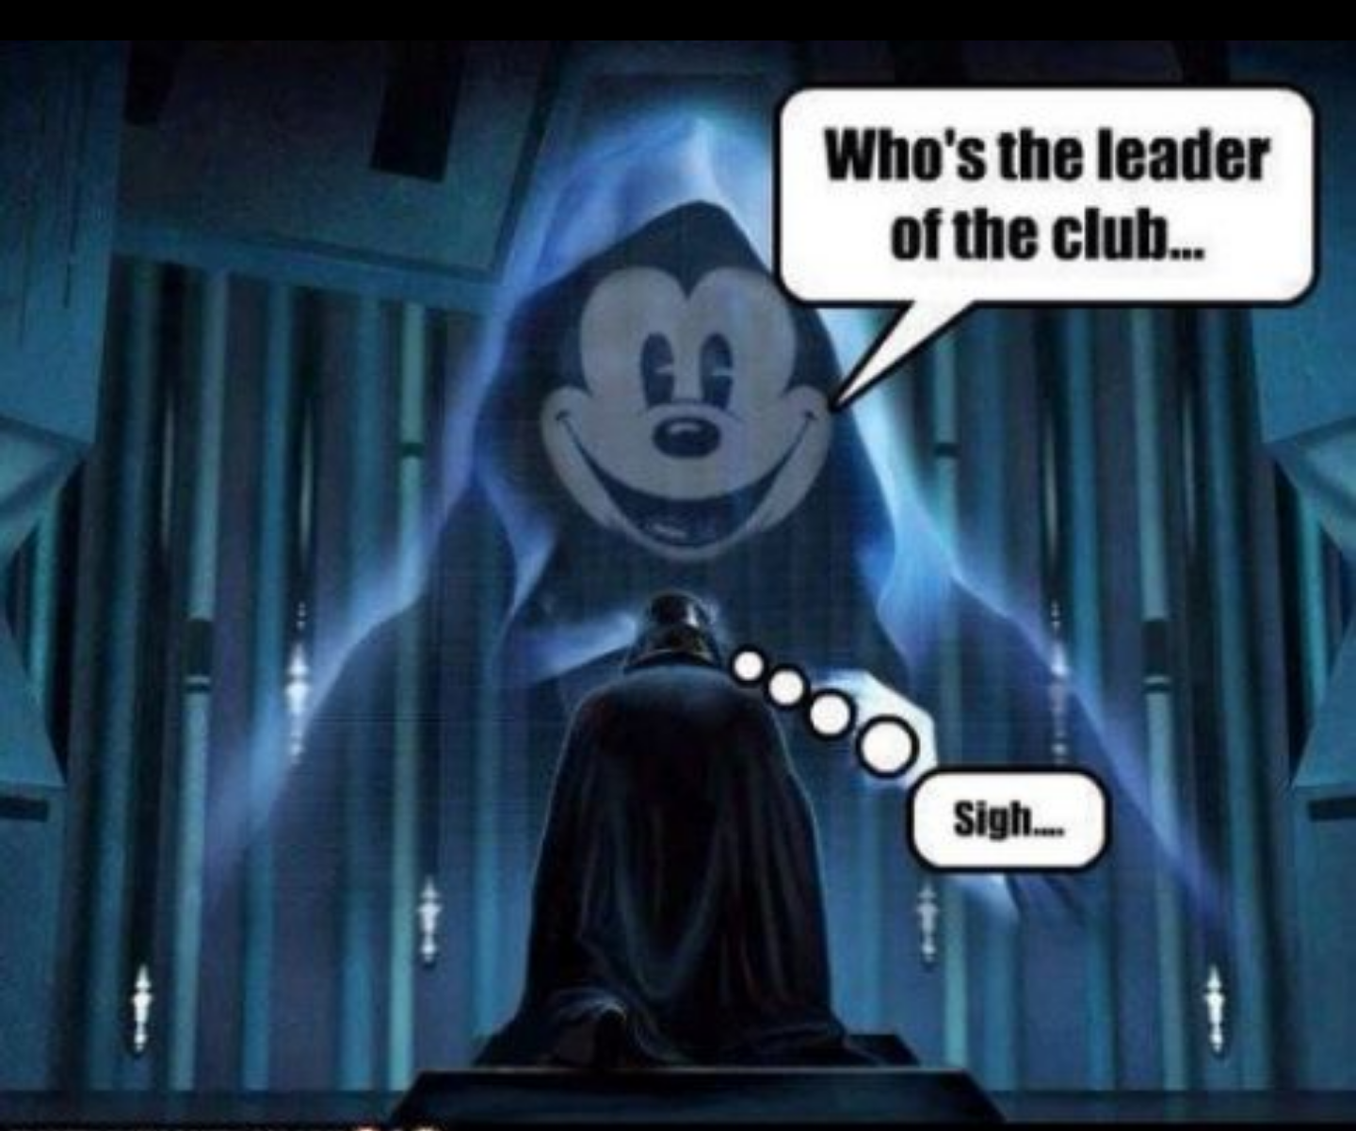

Slide 45
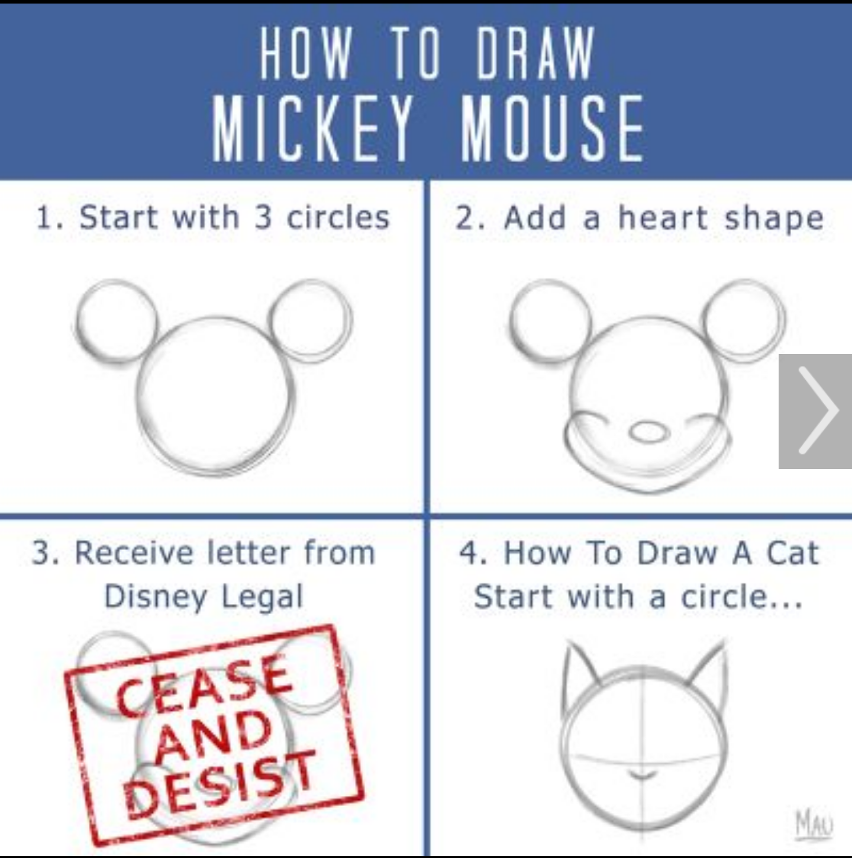

Slide 46
Learning objectives
The attendee will be able to …
Utilize third parties more effectively in the practice
Deliver a more effective case presentation
Design and implement better practice systems
Increase the number of patients through the office
Improve staff productivity

Slide 47
Top 5 Mistakes
Preventing Your Practice Growth
Third parties are ruling your practice
Case presentation is not well thought out
Missing or poorly designed practice systems
Not enough patients
Staff not productive

Slide 48


The purpose of being in a third party is patient access
3rd parties are ruling your practice

Slide 49

Golden Rule
3rd parties are ruling your practice

Slide 50
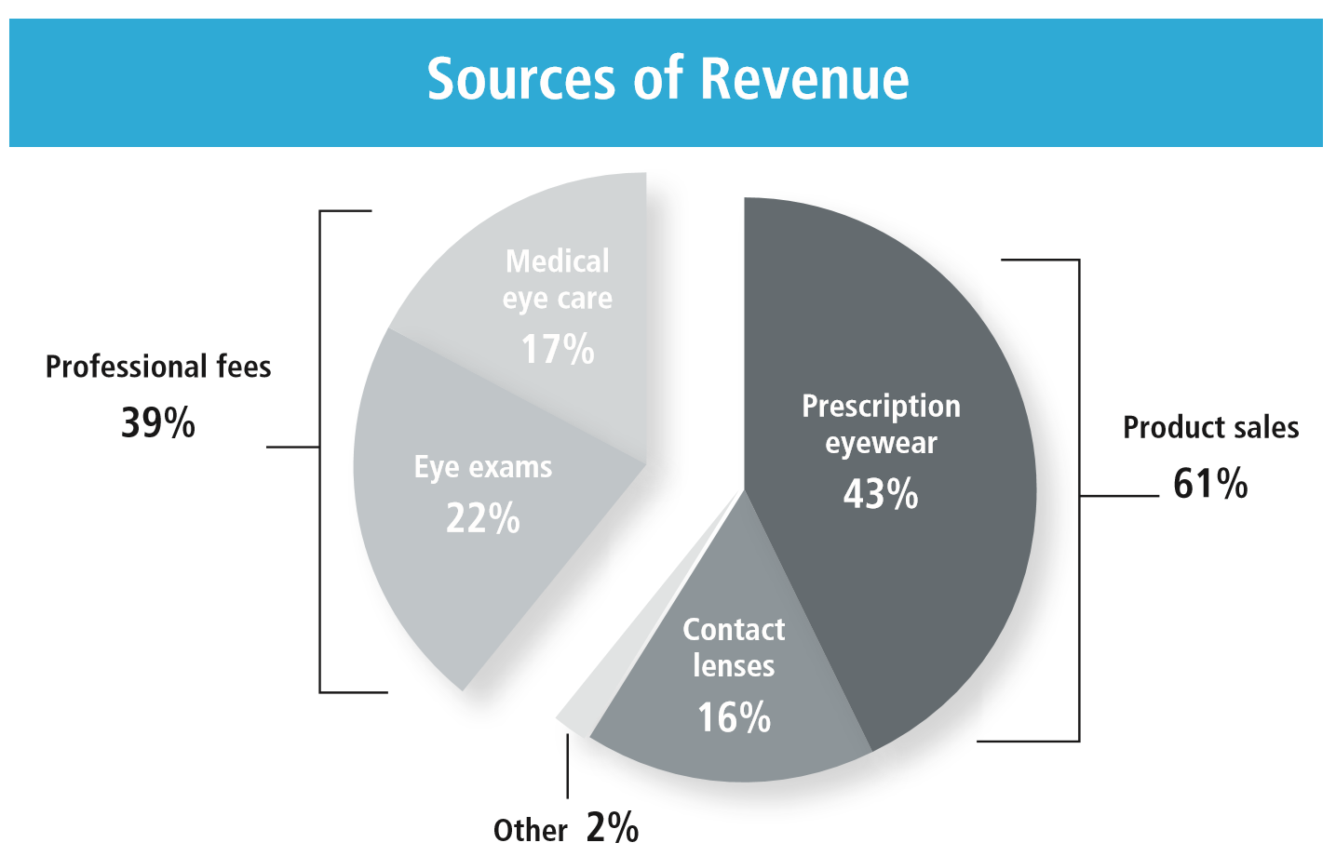
Mantra: Do more for less
3rd parties are ruling your practice

Slide 51
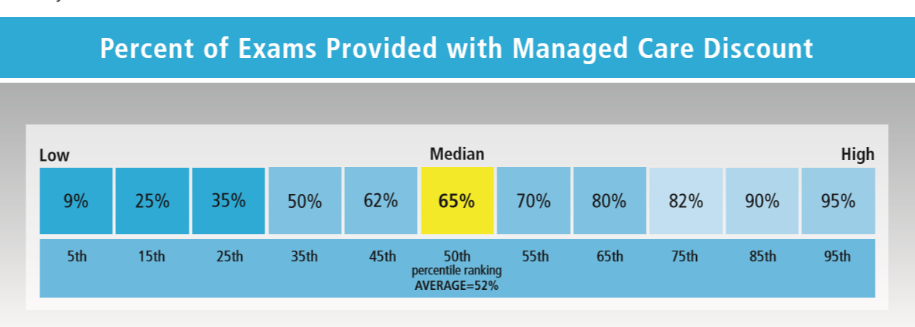
Mantra: Do more for less
3rd parties are ruling your practice

Slide 52
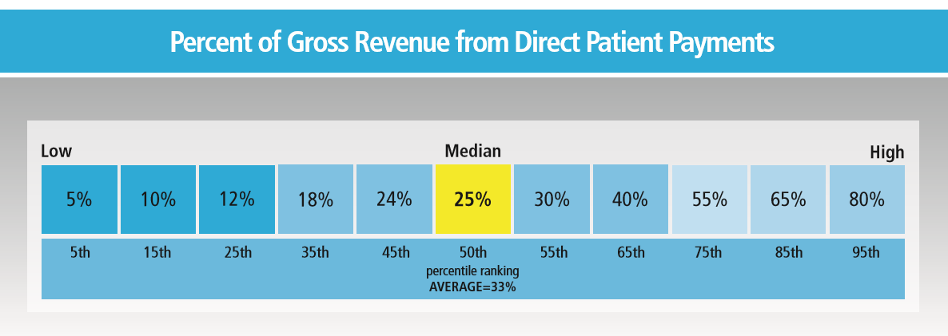
Mantra: Do more for less
3rd parties are ruling your practice

Slide 53


Mantra: Do more for less
3rd parties are ruling your practice
for

Slide 54


Slide 55
“I only want what my insurance covers.”
Change “covers” to “contributes”
Change “insurance” to “vision benefits”

Slide 56


Do you present fees the way 3rd parties have taught you?
3rd parties are ruling your practice
INSURANCE BILLING LANGUAGE
CONSUMER LANGUAGE
The normal fees would be $512, but because you have insurance, your out-of-pocket expense is only $127.
Your base fee is $85, Transitions is $75, Glare free is $70 …

Slide 57
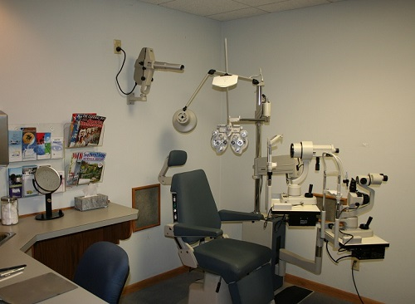
Doctors need to prescribe in the exam room
Your case presentation is not planned well
Prescribe

Slide 58
3 case presentations
Plan your case presentation
Optical
Rx for computer
Rx for driving
Medical
Additional testing
Consult with ___
Recall
“You need to see me in __ months, because __.”
Rx for dress
Write out what you are prescribing for the patient in front of you

Slide 59


You talk patients out of care
Plan your case presentation
Planned & practiced scripts for …
  I can’t afford that.
  Can’t you just do 1 Rx?
  Don’t you have a less expensive …

Slide 60
Tell patients what you are prescribing and why
If you cannot tell me as a patient why you are prescribing the product, then why do I need you?
  I just need to know the power and the modality
“I am prescribing ___ for you, because ___”
There are over 160 lens brands in the soft lens space

Slide 61
Make sure you are telling patient about more than just the change in their prescription
“Mrs. Jones, there has been a change in the power of your prescription and I’m going to prescribe this for you so that you can see clearer.
But I’m also prescribing the material, …
the design of the prescription in your lenses, …
… and the manufacturing process so that you will see the best. It’s more than just your prescription, you need to have all of these other things exactly as I’m prescribing them to see your best.”

Slide 62
Practice organizational structure
Missing or poorly designed practice systems
Human relations
  Hiring and Training
  HR Reporting and Management
  Firing
Procurement
  Equipment
  Clinic Supplies
  Inventory
Information Technology
  Computer System
  Telephone System
  E-Mail and Website Management
Operations
  Scheduling
  Examination
  Treatment and Dispensing
Finance
  Revenue
  Expenses
  Tax Reporting
Quality Control
  Staff Proficiency Testing, Education and Discipline
  Patient Quality Control
  Laboratory Quality Control
Public Relations
  Internal Marketing
  External Marketing
  Success Stories
Administration & Management
  Risk Management
  Future Planning
  Practice Management

Slide 63


Slide 64
How many patients can we see in a year?
Not enough patients
48 wks / yr; 5 days / wk; 8 hrs / day; 1 pat / hr
48 x 5 x 8 x 1 = 1920 patients
Radical thought:
What if I saw 2 patients / hour ?
1920 x 2 = 3840 exam slots

Slide 65

What is our current efficiency ?
2200 / 3840 = 57 % fill rate
43% empty rate

Slide 66
Could we see more patients?
20 more patient exams a week
(AOA Workforce Study)
50 weeks/yr X 20 1,000 more patient exams a year
@ $306 per comprehensive exam
(MBA Key Metrics, Median number)
$306,000 more a year in revenue collected

Slide 67


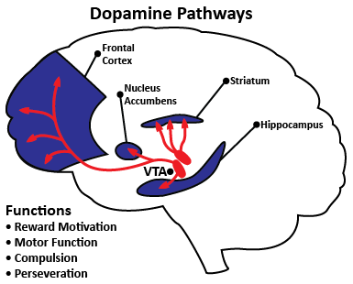
How do you get new patients
Not enough patients
All 3 parts MUST be present

Slide 68
Staff is not productive
Every staff member needs at least one number to control
STAFF MEMBER | STAT
Recall | # of exams seen
Marketing | # of new patients
Optician | $/patient
Receptionist | # of mins/patient visit
Bookkeeper | $ in Accounts Receivable
Doctor | % of Tx plans completed

Slide 69


Slide 70
How money flows through a practice
GROSS REVENUE per FTE OD | $700,000
Eye exams | 22%
Medical eyecare | 17%
Prescription eyewear | 43%
Contact lenses | 16%
Other | 2%
EXPENSES
COGS | 25%
Staff payroll | 20%
Doctor payroll | 20%
Occupancy | 8%
Marketing | 1%
Cinical equipment | 1%
Overhead | 10%
NET | 15%
Frames = 21%
Specs = 22%
20 + 15 = 35%

Slide 71
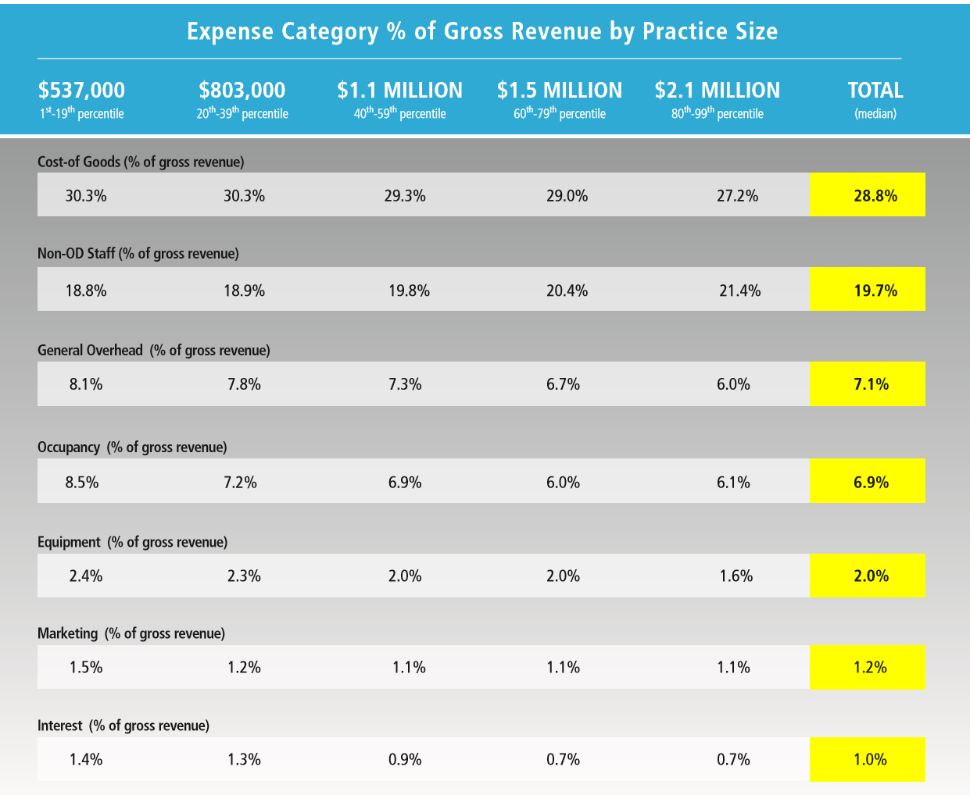

Slide 72
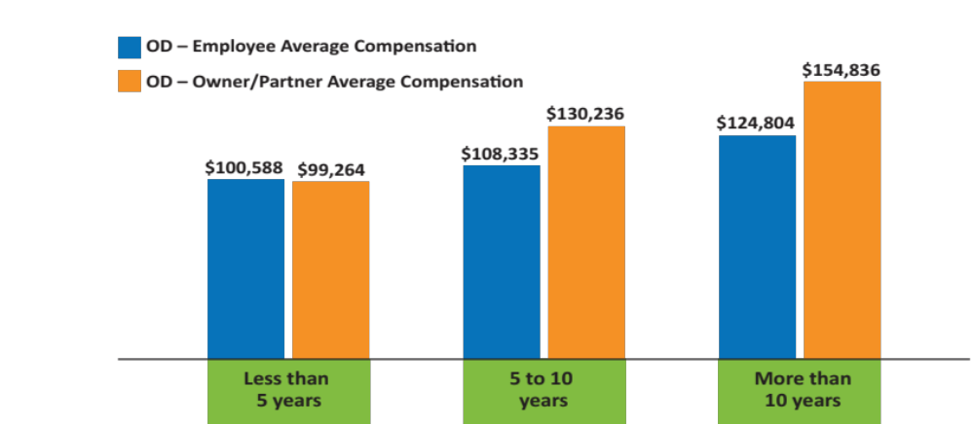
OD Compensation
by Years in Profession
Source: 2017 ECP Compensation Study
Notes:
Take a look at compensation, according to a recent Jobson survey.
Optometry remains a profitable profession—more so, if you take step to own a practice as a whole or in partnership with other ODs.

Slide 73
Follow the money
OWNER vs EMPLOYEE
NOW vs 40 YEARS
$1 Million
$3 Million
$1-3 Million
$3-5 Million

Slide 74
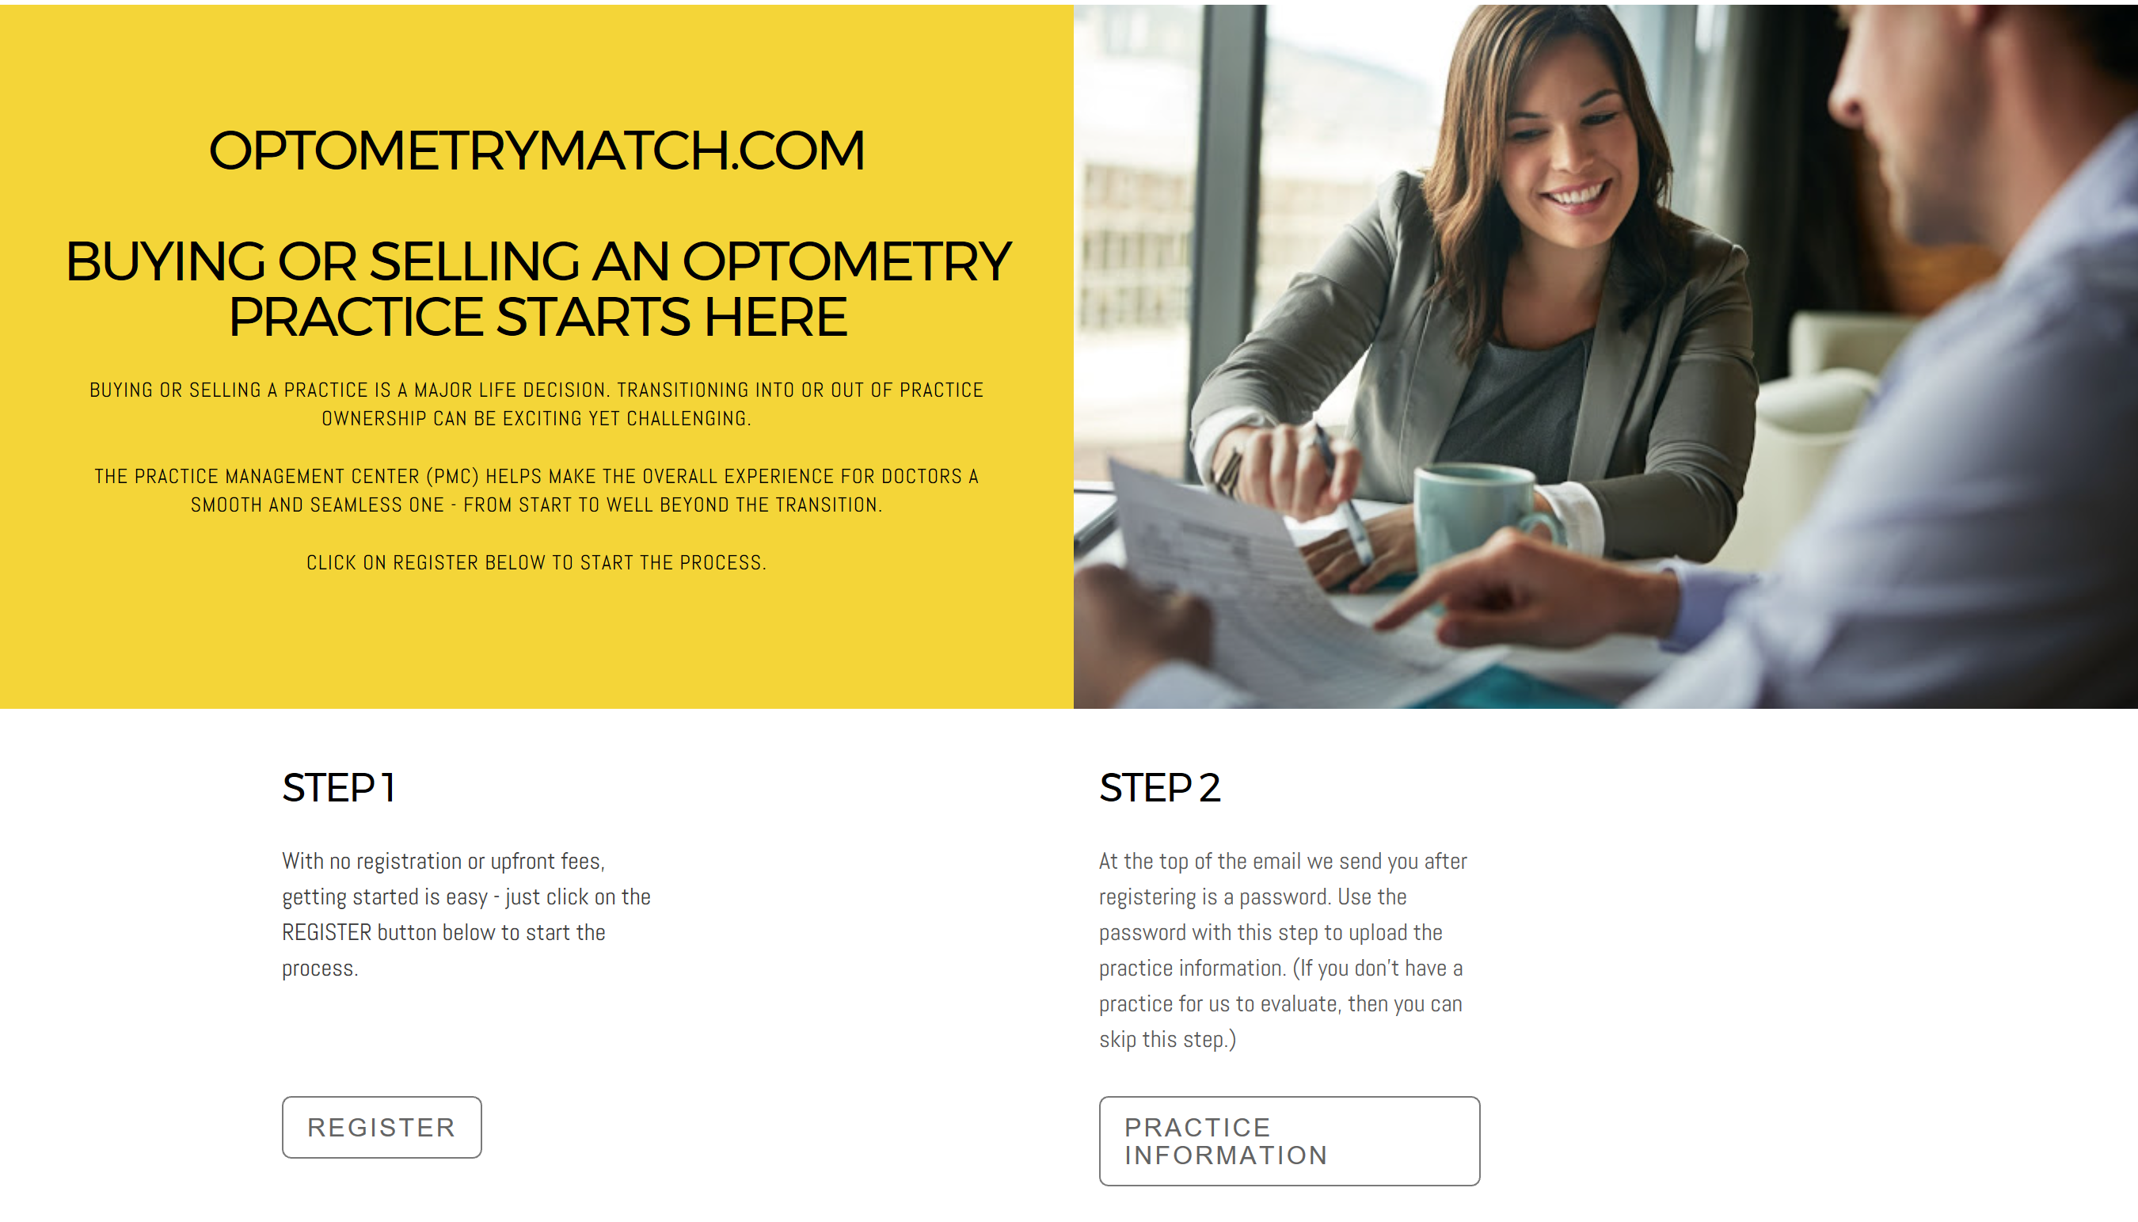
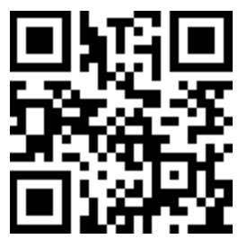

Slide 75
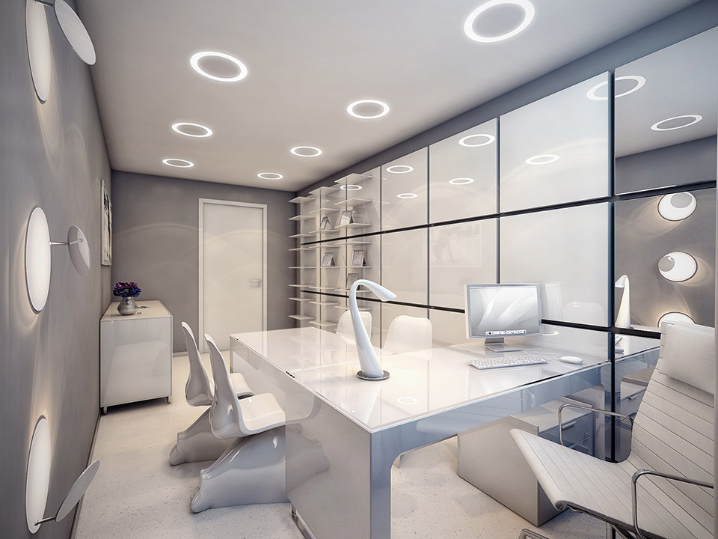

Slide 76


Slide 77
BEFORE THE PATIENT ARRIVES AT THE OFFICE
On-line appointment scheduling
Social medial used to pre-set patients to purchase
Digital messaging to remind patients of appointments
Software permitting patients to fill out the pre-exam history questionnaire before arriving at the office (the information goes directly into the practice EMR)

Slide 78
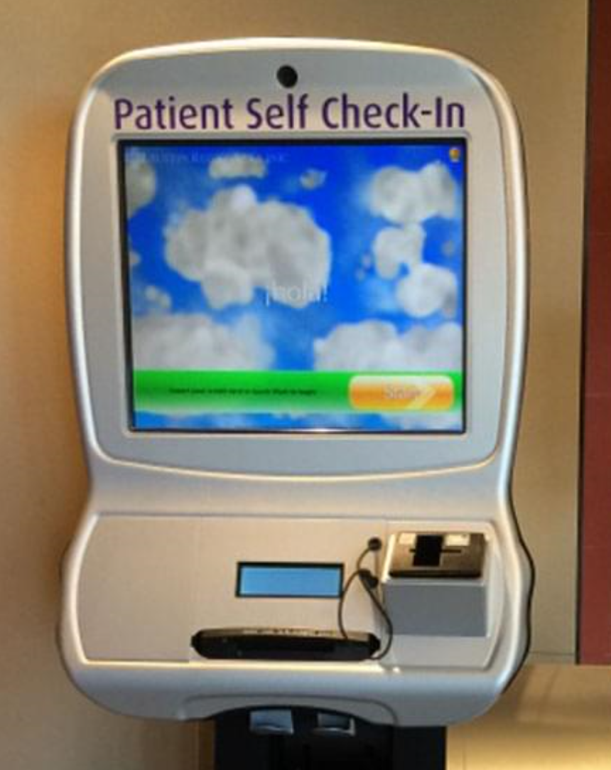
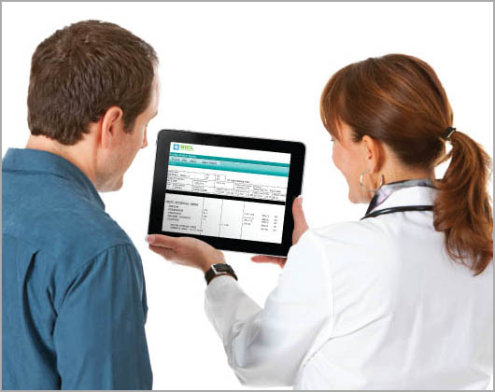

Slide 79
WHEN THEY GET TO THE OFFICE
Kiosk check-in
Tablets for patients who didn’t fill out the pre-exam history questionnaire
Software that tracks the patient as they move through the office (generates reports on log-jams)
Digital internal office messaging showing who is needed where (e.g.: Doctor needed in Exam 1)
Video messages presetting patients to purchase presentations as the patient moves through the office

Slide 80
EXAMINATION
All examination results are automatically put into the EHR from the testing equipment
Digital refracting system
Video slit lamp
System showing how the new Rx looks through a standard lens versus a digital front and back surface lens

Slide 81
OPTICAL
RFID chips on frames giving reports about what frames are touched and how many times as well as doing automatic frame inventory
Video screens that tell the story of the frame being touched by patients and offer examples of similar frames
On-line optical for frames that are not being shown in the office
Sophisticated method of measuring the patient in their new frame

Slide 82
OPTICAL
3-D imaging during frame selection
3-D frame printing
Social media to help patients select the best frame (Facebook Live)
  Facebook notice the day before, Tune in live at 2 pm tomorrow to help Paige choose the sunwear to take on vacation, after the live presentation post on your Facebook page, ask to share, 2 min
Social media posting patient success stories
System to help patients pay over time

Slide 83


Slide 84
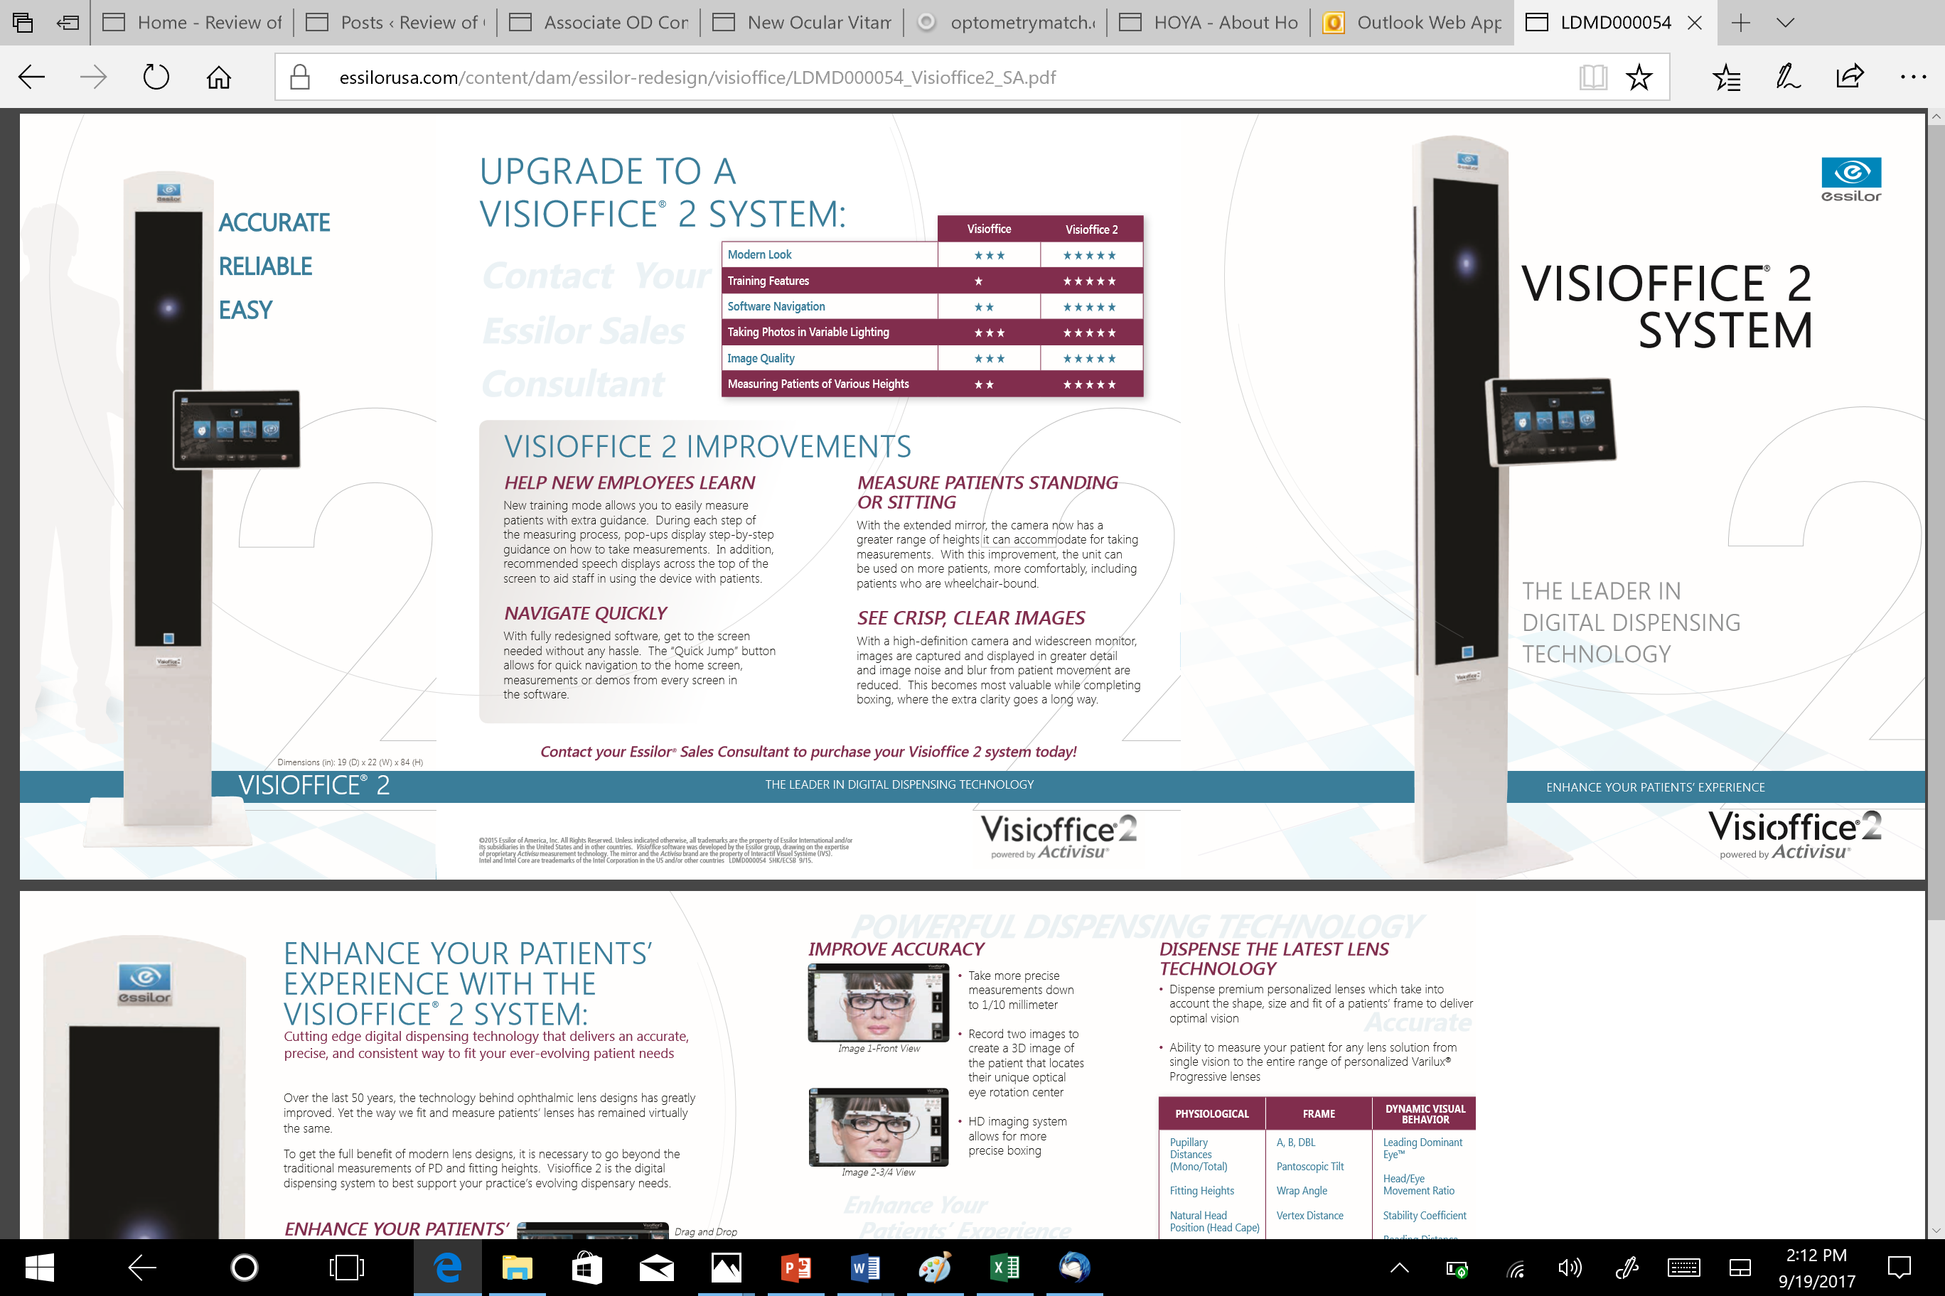
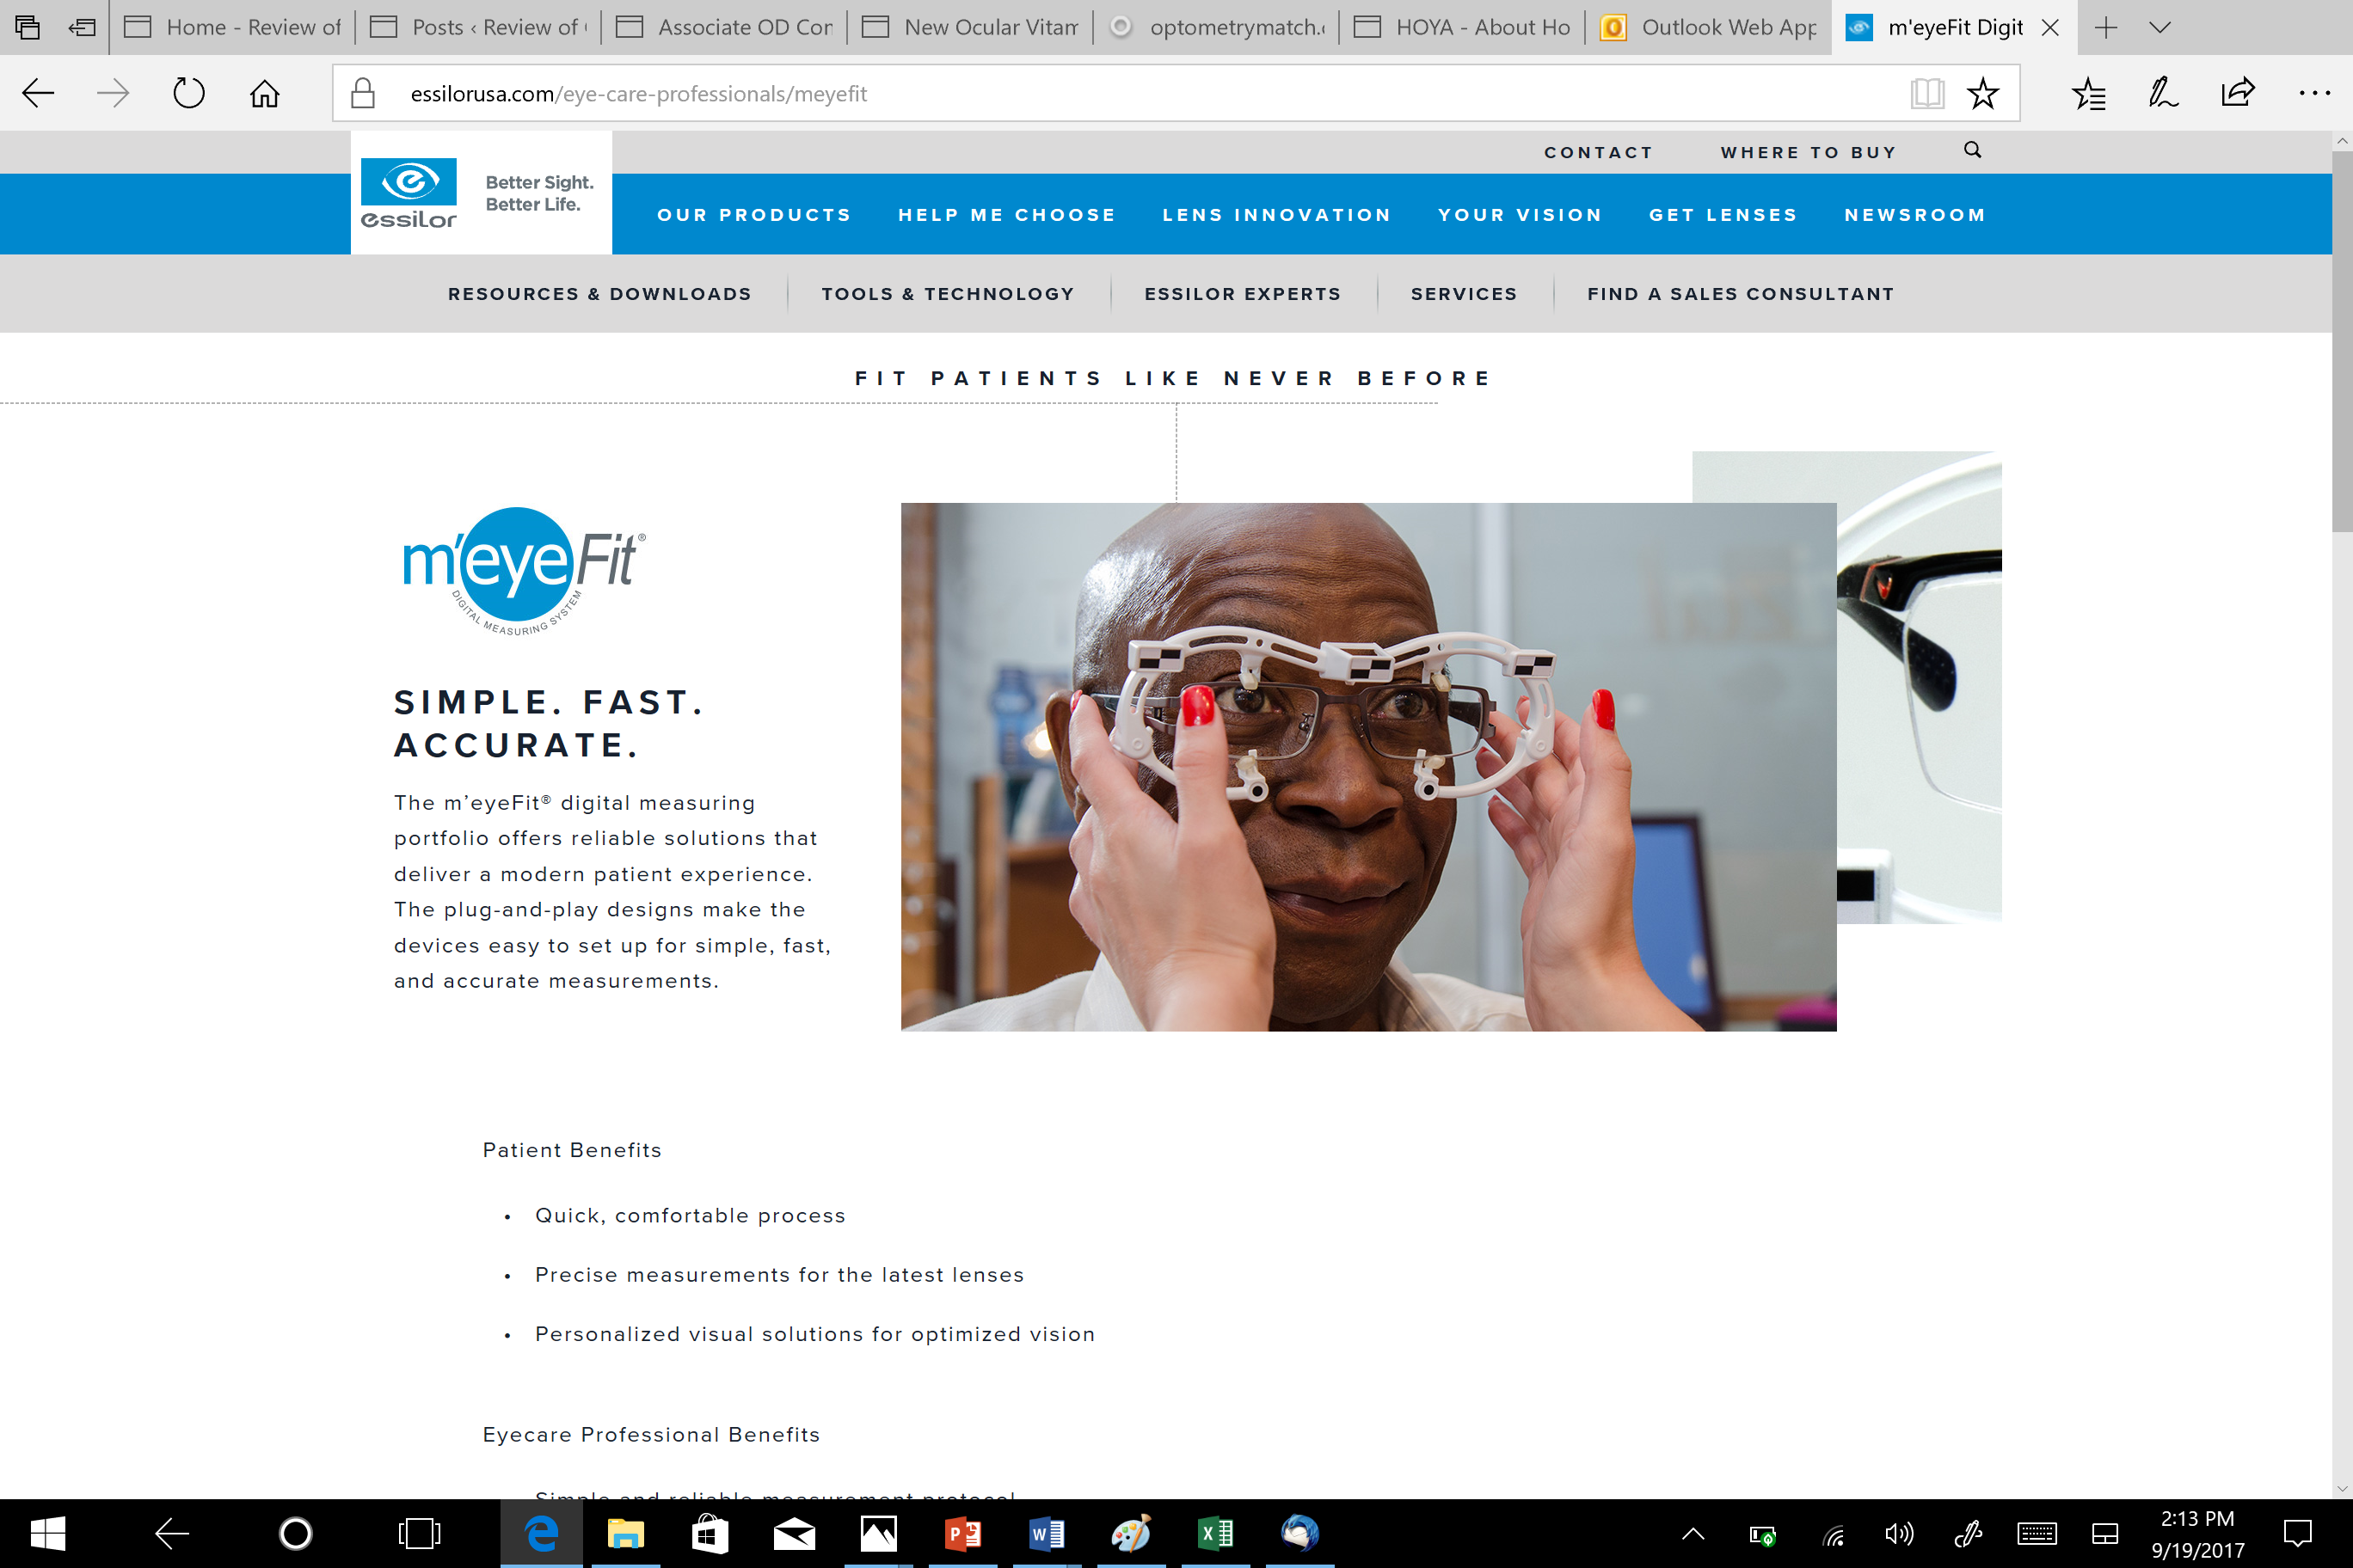

Slide 85
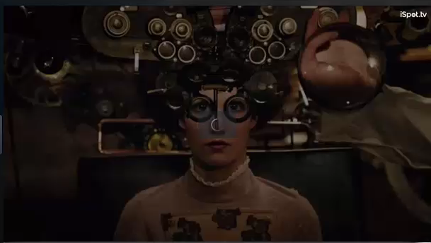

Slide 86
AFTER THE EXAM
Automatic electronic billing
Automatic report generation for patients
Secure patient portal for patients to access their exam results and ask questions
Mechanism for helping patients post on Yelp and similar sites
Patient surveys about their experience

Slide 87
AFTER THE EXAM
Software that assists in both patient recall and re-activating established patients that have not returned
Practice management software that assists in data mining
Patient messaging reminding them of treatment plan follow through (e.g.: when to take meds, when to replace contact lenses)
Automatic report generation for managers about practice Key Performance Indicators

Slide 88
What’s coming soon …
Telemedicine & Digital Information Exchange
Artificial Intelligence (exam, drugs, practice analysis)
Big Data Analysis (evidenced based medicine, practice analysis)
Virtual Reality (education)
Wearable Technology
3-D Manufacturing of Personalized Optical Solutions
Patient Wellness Teams of Digitally Connected Medical Professionals
Notes:
Among the fastest growing components of eyecare demand through 2025 will be medical eyecare.
WE DEFDINE MEDICAL EYECARE AS…
Medical eyecare exams are expected to increase nearly three times as fast as refractive exams through 2025. The growth rates shown here do not reflect any fee increases, but only the number of exams performed, so the annual revenue impact of medical eyecare growth will be greater than these numbers suggest.
The rapid growth in demand for medical eyecare relates to the aging of the population, but also to the growing diagnoses and treatment of prevalent ocular conditions such as dry eye and ocular allergies and expanded use of diagnostic tests such as retinal scans and OCT.

Slide 89


Slide 90


