Slide 1


On behalf of Vision Expo, we sincerely thank you for being with us this year.
Vision Expo Has Gone Green!
We have eliminated all paper session evaluation forms. Please be sure to complete your electronic session evaluations online when you login to request your CE Letter for each course you attended! Your feedback is important to us as our Conference Advisory Board considers content and speakers for future meetings to provide you with the best education possible.

Slide 2
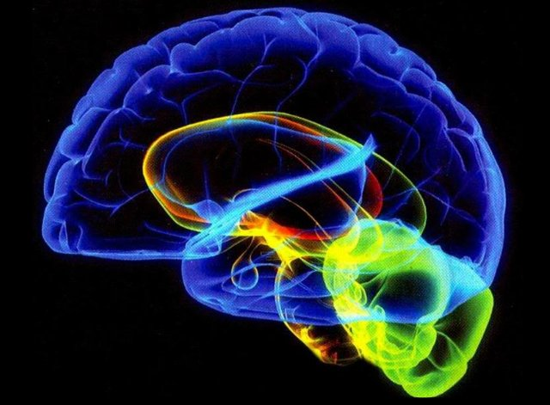
Neuromarketing
Mark R. Wright, OD, FCOVD

Slide 3
This power point presentation was created by
Mark R. Wright, OD, FCOVD
Copyright 2019 – Progressive Publishing Company – All rights reserved

Slide 4

Mark Wright, OD, FCOVD
CEO: Practice Management Center
President: Pathways to Success
Editor: Review of Optometric Business
www.reviewob.com
Author: Coding, Reimbursement and Contracting for Optometry
Director: Bennett/VSP Business Management Program at TOSU
2006 Benedict Professor: University of Houston
1980 – 2007 founder: Professional VisionCare, Westerville, OH
Notes:
4
4
Dr. Wright is a 1980 graduate of The Ohio State University College of Optometry, where he is clinical assistant professor and faculty coordinator of OSU’s Business Management Program. Retired from practice last year, Dr. Wright is president of Pathways to Success, Eyecare Business Training and Progressive Publishing Company. All three of these companies are dedicated to the special practice management needs of eyecare practices. Dr. Wright has lectured extensively throughout the U.S. and abroad. His topics include not only practice management, but also managed care, sports vision and vision and traumatic brain injuries. He is also the practice management editor for the Journal of Optometric Vision Development. This is Mark’s first presentation to the MBA. Please welcome Mark Wright…

Slide 5
SPEAKER FINANCIAL DISCLOSURE STATEMENT
Mark R. Wright, OD, FCOVD
has been a paid speaker for the following companies:
  Alcon
  B&L
  Essilor
  Jobson
  Johnson & Johnson
  VSP
Diversified Ophthalmics
Eye Recommend
IDOC
IVA
PERC
Vision Source
He is an officer of:
  Pathways to Success
  Practice Management Center
  Progressive Publishing Company
He is the professional editor of:
  Review of Optometric Business

Slide 6
Course Description
Neuromarketing
The concept of neuromarketing combines marketing, psychology and neuroscience. Research conducted in this area helps us understand how and why our patients make decisions. The course gives you insights from neuromarketing science and helps you apply this information within your practice to help your patients get the care and products they need.

Slide 7
Course Learning Objectives
Neuromarketing
1 hour course
The attendee will be able to apply the neuromarketing principles of …
Appealing to the Reptilian Brain
Addressing Pain
Being Selfish
Putting Call-To-Actions in the Beginning and End
Keeping it Short and Sweet

Slide 8
Course Outline
Neuromarketing
What is Neuromarketing?
How to Apply the Neuromarketing Principles of …
  Appealing to the Reptilian Brain
  Addressing Pain
  Being Selfish
  12 Examples of Neuromarketing
  Putting Call-To-Actions in the Beginning and End
  Keeping it Short and Sweet

Slide 9
Neuromarketing
Marketing
Psychology
Neuroscience

Slide 10

"Most neuroscientists would agree that well over 90% of our behavior is generated outside of consciousness. We are more slaves to our biology than we realize. Our rational minds represent a very small layer floating atop a vast well of unconscious drivers. Business leaders who understand biological programming and can leverage it possess an enormous advantage," explains neuroscience business expert Janet Crawford.
https://www.marketingprofs.com/articles/2017/31895/five-effective-neuromarketing-principles-that-boost-marketing-efforts

Slide 11
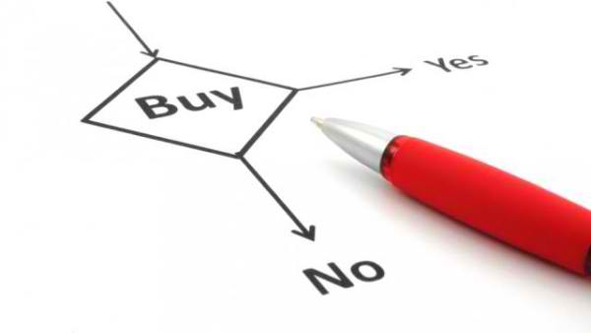
What are we trying to do?
Neuromarketing seeks to understand:
the rationale behind how patients make purchasing decisions
their responses to marketing stimuli in order to apply those learnings in the marketing realm
Vlăsceanu, Sebastian (2014). "New directions in understanding the decision-making process: neuroeconomics and neuromarketing". 17: 758–762 – via Elsevier.
Georges, Patrick M (2014). Neuromarketing in Action : How to Talk and Sell to the Brain. London: Kogan Page Ltd. pp. 9–16.

Slide 12
Techniques used in Neuromarketing
Electroencephalogram
Skin Conductance
Eye Tracking
Facial Coding
Voice Analysis
Magnetoencephalography
Functional magnetic resonance imaging
Research is conducted around the implicit motivations to understand consumer decisions by non-invasive psychoanalysis methods of measuring brain activity.
Market researchers use this information to determine if products or advertisements stimulate responses in the brain linked with positive emotions.
Notes:
Neuromarketing, a recent method utilized to understand consumers. The concept of neuromarketing combines marketing, psychology and neuroscience. Research is conducted around the implicit motivations to understand consumer decisions by non-invasive psychoanalysis methods of measuring brain activity. These include electroencephalography (EEG), magnetoencephalography (MEG) and functional magnetic resonance imaging (fMRI), eye tracking, electrodermal response measures and other neuro-technologies. Researchers investigate and learn how consumers respond and feel when presented with products and/or related stimuli. Observations can then be correlated with a participants surmised emotions and social interactions. Market researchers use this information to determine if products or advertisements stimulate responses in the brain linked with positive emotions.
https://en.wikipedia.org/wiki/Neuromarketing

Slide 13
The Neuromarketing Process
Dx the PAIN
Differentiate your CLAIMS
Demonstrate the GAIN
Deliver to the OLD BRAIN

Slide 14
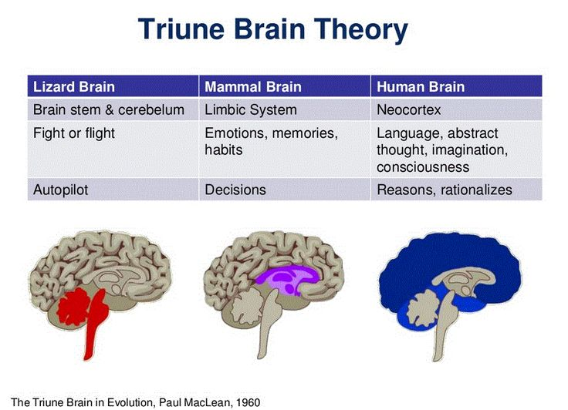
Lizard + Mammal Brain
referred to as the attention gatekeeper or the decision maker
where most cognitive biases take place
immediate reactions in three seconds or less
pain points, selfishness, contrast, tangibility, visuals, and emotional connection
Master subject line, headline, or featured image

Slide 15
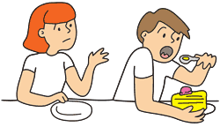
Be Selfish
Patients care about survival, and to survive you must be selfish.
So, when talking to patients, within seconds, you need to address what you’ll do for them.
If this is not obvious to patients, then they won’t care.
To take advantage of patients’ selfish attitudes, avoid using the words “I” and “We,” and instead, focus on using “You.”

Slide 16

12 Powerful Examples of Neuromarketing in Action https://imotions.com/blog/neuromarketing-examples/

Slide 17

1. The Importance of Eye Gaze
It is old news that ads that include people are much more effective than those that do not.
In particular, images and videos that include babies tend to attract longer and more focused attention from potential customers.
Advertisers have long attempted to boost sales for baby products using close ups of adorable baby faces – with the help of eye tracking technology they have identified that this alone is not enough.

Slide 18


Researchers discovered that when the infant looks face on, viewers will be far more focused on the baby’s face to the detriment of focusing on the ad content. However, if the infant is directing its gaze at the product or text then the viewer will in fact focus on the advertising content.

Slide 19
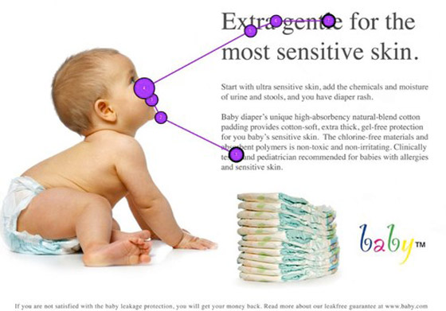

Slide 20
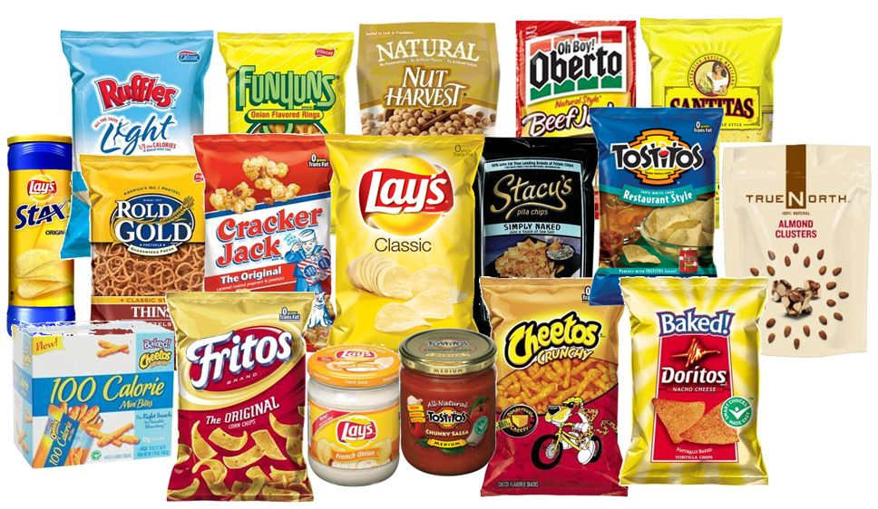
2. Using Effective Packaging
In studies, customers were shown packaging with their responses recorded as positive, negative or neutral.
This research revealed that customers had a negative response to shiny packaging, but didn’t show a negative response to packaging when it was matte.
Look at your optical.
Can the patient differentiate?

Slide 21

3. Color is Key
Colors can evoke a wide range of emotions, with studies consistently showing a link between certain colors and certain emotions.
One of the most infamous examples is Coca Cola’s use of the color red.
Cool blues, for example, are the go-to color if you wish to attract professionals.

Slide 22
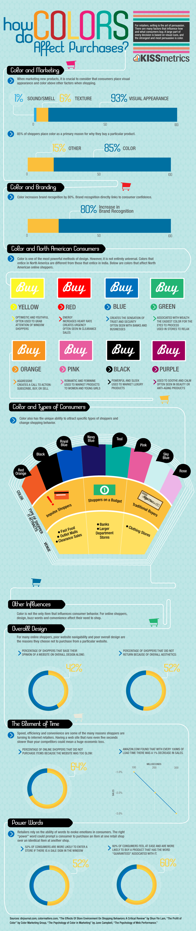
https://www.bing.com/images/search?view=detailV2&id=86C1CF67595628F6417D6C8B887F9E98863277EE&thid=OIP.Ep39C0-SglGHTRRRlLyfGQHajD&mediaurl=http%3A%2F%2Fwww.fabiopiccigallo.com%2Fwp-content%2Fuploads%2F2014%2F06%2Fcolor-purchases-lrg.png&exph=4734&expw=1000&q=color+and+purchases&selectedindex=0&qpvt=color+and+purchases&ajaxhist=0&vt=0&eim=1,2,6

Slide 23

Sound and color
Psychologists and neuroscientists have known for years, which is that sound and color can have significant impact on the human brain. Moreover, sight and sound appear to be strongly intertwined.
To illustrate this fact in the context of neuromarketing, a study was done in a supermarket.
  Researchers collaborated with a large supermarket to see if the sale in bananas could be influenced by manipulating shelve lightness and audio frequencies. The color lightness was manipulated by creating both white and black shelves to stock the bananas on.
  The audio was manipulated by mixing the same supermarket music with either prominent high-or low pitched frequencies.
  It turns out that the high pitched music made people buy almost twice as much bananas from the white shelf as opposed to the black shelf. The reverse effect was found with low frequency music and black shelfs.
PEOPLE BOUGHT 2 X AS MUCH
High pitched music – White shelf
Low frequency music – Black shelf
https://www.newneuromarketing.com/six-inspiring-examples-of-neuromarketing-done-right

Slide 24

4. Decision Paralysis
A study by Columbia University revealed that too many choices may actually be a deterrent for potential customers. Using different types of setups, they found that displays containing a wide array of options were less likely to get customers to stop.
Patients can be overwhelmed by too many choices.

Slide 25
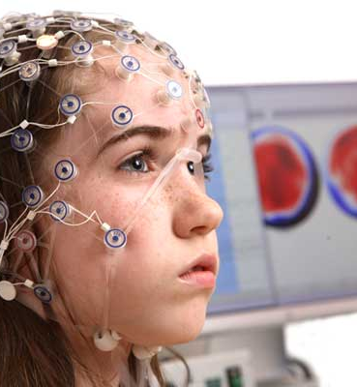
5. Evaluating Satisfaction
Emotion Response Analysis (ERA) uses EEG imaging to identify the emotional response an individual has to a product, advertisement, etc.
Our level of engagement or emotional arousal in relation to a product is invaluable to the advertiser.
NET PROMOTER SCORE

Slide 26
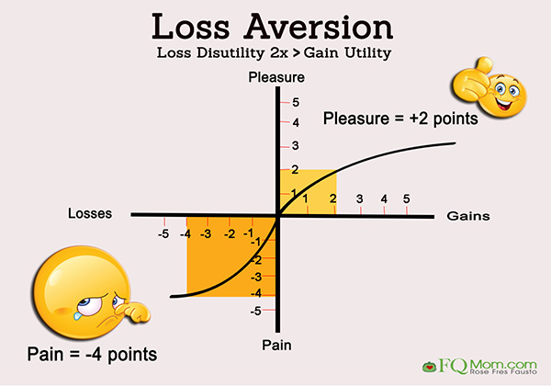
6. Loss Aversion
People with a high need for uniqueness prefer to hear what they will miss when they don’t buy the product.
People with low need for uniqueness need to hear what there is to gain from buying it.
Framing
Buy before it’s gone
Limited edition
Notes:
One interesting finding utilized by neuromarketing is that people really don’t want to lose out. People are just as worried about what they might lose as what they might gain. For this reason “buy before it’s gone” strategies are highly effective.
When the alternative option is posed as a loss, consumers are much more likely to buy. For this reason, a concept called “framing” is highly important in neuromarketing. This technique is how advertisers present decisions to consumers in a way that makes them more likely to splash the cash.
Takeaway: Consumers hate to feel they are missing out on a bargain, so make sure to emphasize if they are set to lose out.
Of course, neuromarketing is also being used to influence people through advertisements. Neuromarketing in advertisements generally relies on more psychological concepts to persuade consumers. Fine examples of this are advertisements showing a limited edition like a bottle of coke with special packaging.
Limited editions rely on the concept of scarcity. When things are scarce, people are more eager to buy them because they fear the item might sell out. It feels like a chance that we don’t want to miss.
For many marketers, the power of scarcity is nothing new. It is a well-known principle borrowed from social psychology. But there’s more to concepts like scarcity. A good neuromarketer understands the conditions in which these concepts are most effective.
Research has shown, for example, that the way scarity cues are framed matter as well. People with a high need for uniqueness prefer to hear what they will miss when they don’t buy the product, while people with low need for uniqueness need to hear what there is to gain from buying it.
Gain frames are sentences like: “get the new edition now”, while loss frames are sentences like “be sure not to miss the new edition”. As certain brands tend to serve consumers that are in general seeking conformity or uniqueness, it’s good to match scarcity cues to the target audience.

Slide 27

7. Anchoring
The first piece of information your patient receives is highly important. It can become the basis for any subsequent decision making and set the tone for purchasing behavior.
Neuroscientists have discovered a flaw in the workings of the mind, and how it reaches decisions.
As individuals, we are rarely able to evaluate the value of something based on its intrinsic worth, but instead compare it with the surrounding options.

Slide 28

8. The Need for Speed
PayPal conducted a study which found that the promise of convenience activated the brain more than security.
http://www.straylight.se/tbt-remembering-five-of-the-best-known-cases-in-neuromarketing/

Slide 29

9. Reward and Punishment
Video game design uses reward and punishment in order to make engaging games and to keep people playing them.
By increasing the reward presented by the game, the action may also increase the levels of dopamine within the brain.
Dopamine is associated with pleasure and positive associations.
Takeaway: Create a pleasurable experience for patients to keep them attached and coming back.

Slide 30

Reward and Punishment
Use delayed rewards, like a certain amount of points with each purchase that can be converted into credit at a later point.
Has a company ever congratulated you with a checkmark or even exclaiming ‘great choice’ after putting an item in your basket?
Or have you ever received a free gift if you order before tomorrow?
If you did, you witnessed effective neuromarketing.
https://www.newneuromarketing.com/six-inspiring-examples-of-neuromarketing-done-right

Slide 31

10. Setting the Right Price
Rounded figures are more likely to work alongside emotional decision making, while more complex figures work better when the logical brain is engaged
'Charm pricing': Reduce the left digits by one
'Prestige' pricing strategy
'BOGO': Buy one, get one
Comparative pricing: placing expensive next to standard -
visually highlight the different prices
https://www.entrepreneur.com/article/279464

Slide 32

11. Website Layout
Rules of thumb when it comes to creating websites
Use certifications, testimonials and social widgets to draw patients in
Newer, horizontal style website layouts are less effective than traditionally vertical

Slide 33

12. Memorable Headlines
When a familiar phrase is slightly altered, our hippocampus is activated, and our attention is piqued.
“Good marketing makes the company look smart. Great marketing makes the customer feel smart.” – Joe Chernov
“Just because you can measure everything doesn’t mean that you should.” – W. Edward Deming
“Martin Luther King did not say ‘I have a mission statement.’” – Simon Sinek

Slide 34

4. Put Call-To-Actions in the Beginning and End
We don’t like unnecessary thinking because it takes energy to run the brain, especially when processing new stimuli.
The brain is 2% of our body mass, but it burns 20% of our energy. Since our brain is optimized to conserve energy, it is not going to waste it by concentrating on things unnecessary for survival.
Consequently, the brain is alert when changes occur requiring us to evaluate danger.
Changes mostly occur at the beginning and end of a commercial, video, and most other types of stimuli.
Since the middle portion of your advertisement won’t receive as much attention, make sure to put your call-to-actions at the beginning and end.

Slide 35

Keep it Short and Sweet
You don’t want your patients to overthink their decisions.
Displaying too much information will do just that.
An analysis of eCommerce websites revealed surprising behavior: visitors who were exposed to additional details and information about a product were actually less likely to purchase it compared to visitors who were exposed only to the product image and a few general details.
Research showed that visitors who purchased the product, whether on their first time on the page or their fifth visit, spent significantly less time on the sales page than visitors who did not purchase.
The takeaway: keep your marketing messages short and sweet.

Slide 36
Principles of NeuroMarketing https://sunilmaulik.com/2015/09/16/principles-of-neuromarketing/
Appeal to the Reptilian Brain
Address Pain
Be Selfish
Put Call-To-Actions in the Beginning and End
Keep it Short and Sweet

Slide 37
To learn more …
https://www.marketingprofs.com/articles/2017/31895/five-effective-neuromarketing-principles-that-boost-marketing-efforts
https://en.wikipedia.org/wiki/Neuromarketing
https://juiceboxinteractive.com/blog/how-pepsi-won-the-battle-but-lost-the-challenge/
https://imotions.com/blog/neuromarketing-examples/

Slide 38


Slide 39


