Slide 1


On behalf of Vision Expo, we sincerely thank you for being with us this year.
Vision Expo Has Gone Green!
We have eliminated all paper session evaluation forms. Please be sure to complete your electronic session evaluations online when you login to request your CE Letter for each course you attended! Your feedback is important to us as our Conference Advisory Board considers content and speakers for future meetings to provide you with the best education possible.

Slide 2
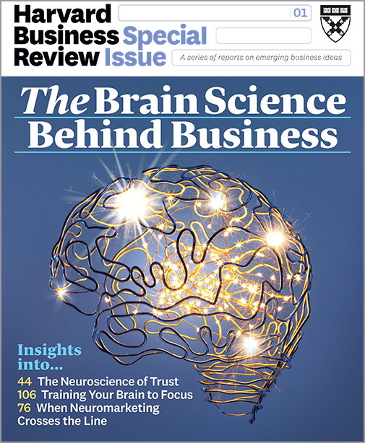
Mark R. Wright, OD, FCOVD
How to apply The 4 Networks in the practice.
How to unlock Innovation in staff and doctors.
How to best structure Incentives.
How to manage for Trust.
How to create Achievable Goals in the practice.
How to structure Conversations to maximize positive neurochemistry.
What happens to your brain when you negotiate about money.
How to best exercise your brain.

Slide 3
This power point presentation was created by
Mark R. Wright, OD, FCOVD
Copyright 2019 – Progressive Publishing Company – All rights reserved

Slide 4
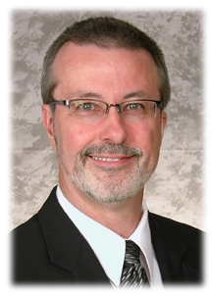
Mark Wright, OD, FCOVD
CEO: Practice Management Center
President: Pathways to Success
Editor: Review of Optometric Business
www.reviewob.com
Author: Coding, Reimbursement and Contracting for Optometry
Director: Bennett/VSP Business Management Program at TOSU
2006 Benedict Professor: University of Houston
1980 – 2007 founder: Professional VisionCare, Westerville, OH
Notes:
4
4
Dr. Wright is a 1980 graduate of The Ohio State University College of Optometry, where he is clinical assistant professor and faculty coordinator of OSU’s Business Management Program. Retired from practice last year, Dr. Wright is president of Pathways to Success, Eyecare Business Training and Progressive Publishing Company. All three of these companies are dedicated to the special practice management needs of eyecare practices. Dr. Wright has lectured extensively throughout the U.S. and abroad. His topics include not only practice management, but also managed care, sports vision and vision and traumatic brain injuries. He is also the practice management editor for the Journal of Optometric Vision Development. This is Mark’s first presentation to the MBA. Please welcome Mark Wright…

Slide 5
SPEAKER FINANCIAL DISCLOSURE STATEMENT
Mark R. Wright, OD, FCOVD
has been a paid speaker for the following companies:
  Alcon
  B&L
  Essilor
  Jobson
  Johnson & Johnson
  VSP
Diversified Ophthalmics
Eye Recommend
IDOC
IVA
PERC
Vision Source
He is an officer of:
  Pathways to Success
  Practice Management Center
  Progressive Publishing Company
He is the professional editor of:
  Review of Optometric Business

Slide 6
Course Description
The Brain Science Behind Business
This course discusses 8 topics from the Harvard Business Review Special Edition The Brain Science Behind Business. The focus is on what insights neuroscience offers business. Current research is showing there is some aspect of neuroscience relevant to almost every function in the field of leadership and business management. This course explores the science but highlights key takeaways that can be implemented to improve your practice management.

Slide 7
Course Learning Objectives
The Brain Science Behind Business
2 hour course
The course attendee will be able to …
Understand how to apply The 4 Networks in the practice.
Understand how to unlock Innovation in staff and doctors.
Understand how to best structure Incentives.
Understand how to manage for Trust.
Understand how to create Achievable Goals in the practice.
Understand how to structure Conversations to maximize positive neurochemistry.
Understand what happens to your brain when you Negotiate about Money.
Understand how to best Exercise your brain.

Slide 8
Course Outline
The Brain Science Behind Business
How to apply The 4 Networks in the practice.
How to unlock Innovation in staff and doctors.
How to best structure Incentives.
How to manage for Trust.
How to create Achievable Goals in the practice.
How to structure Conversations to maximize positive neurochemistry.
What happens to your brain when you negotiate about money.
How to best exercise your brain.

Slide 9

How to apply the 4 Networks in the practice

Slide 10
How to apply The 4 Networks in the practice.
First, what are Brain Networks
  Large scale brain networks are collections of widespread brain regions showing functional connectivity by statistical analysis of the fMRI BOLD signal or other signal fluctuations.
An emerging paradigm in neuroscience is that cognitive tasks are performed not by individual brain regions working in isolation, but by networks consisting of several discrete brain regions that are said to be "functionally connected" due to tightly coupled activity.
https://en.wikipedia.org/wiki/Large_scale_brain_networks

Slide 11
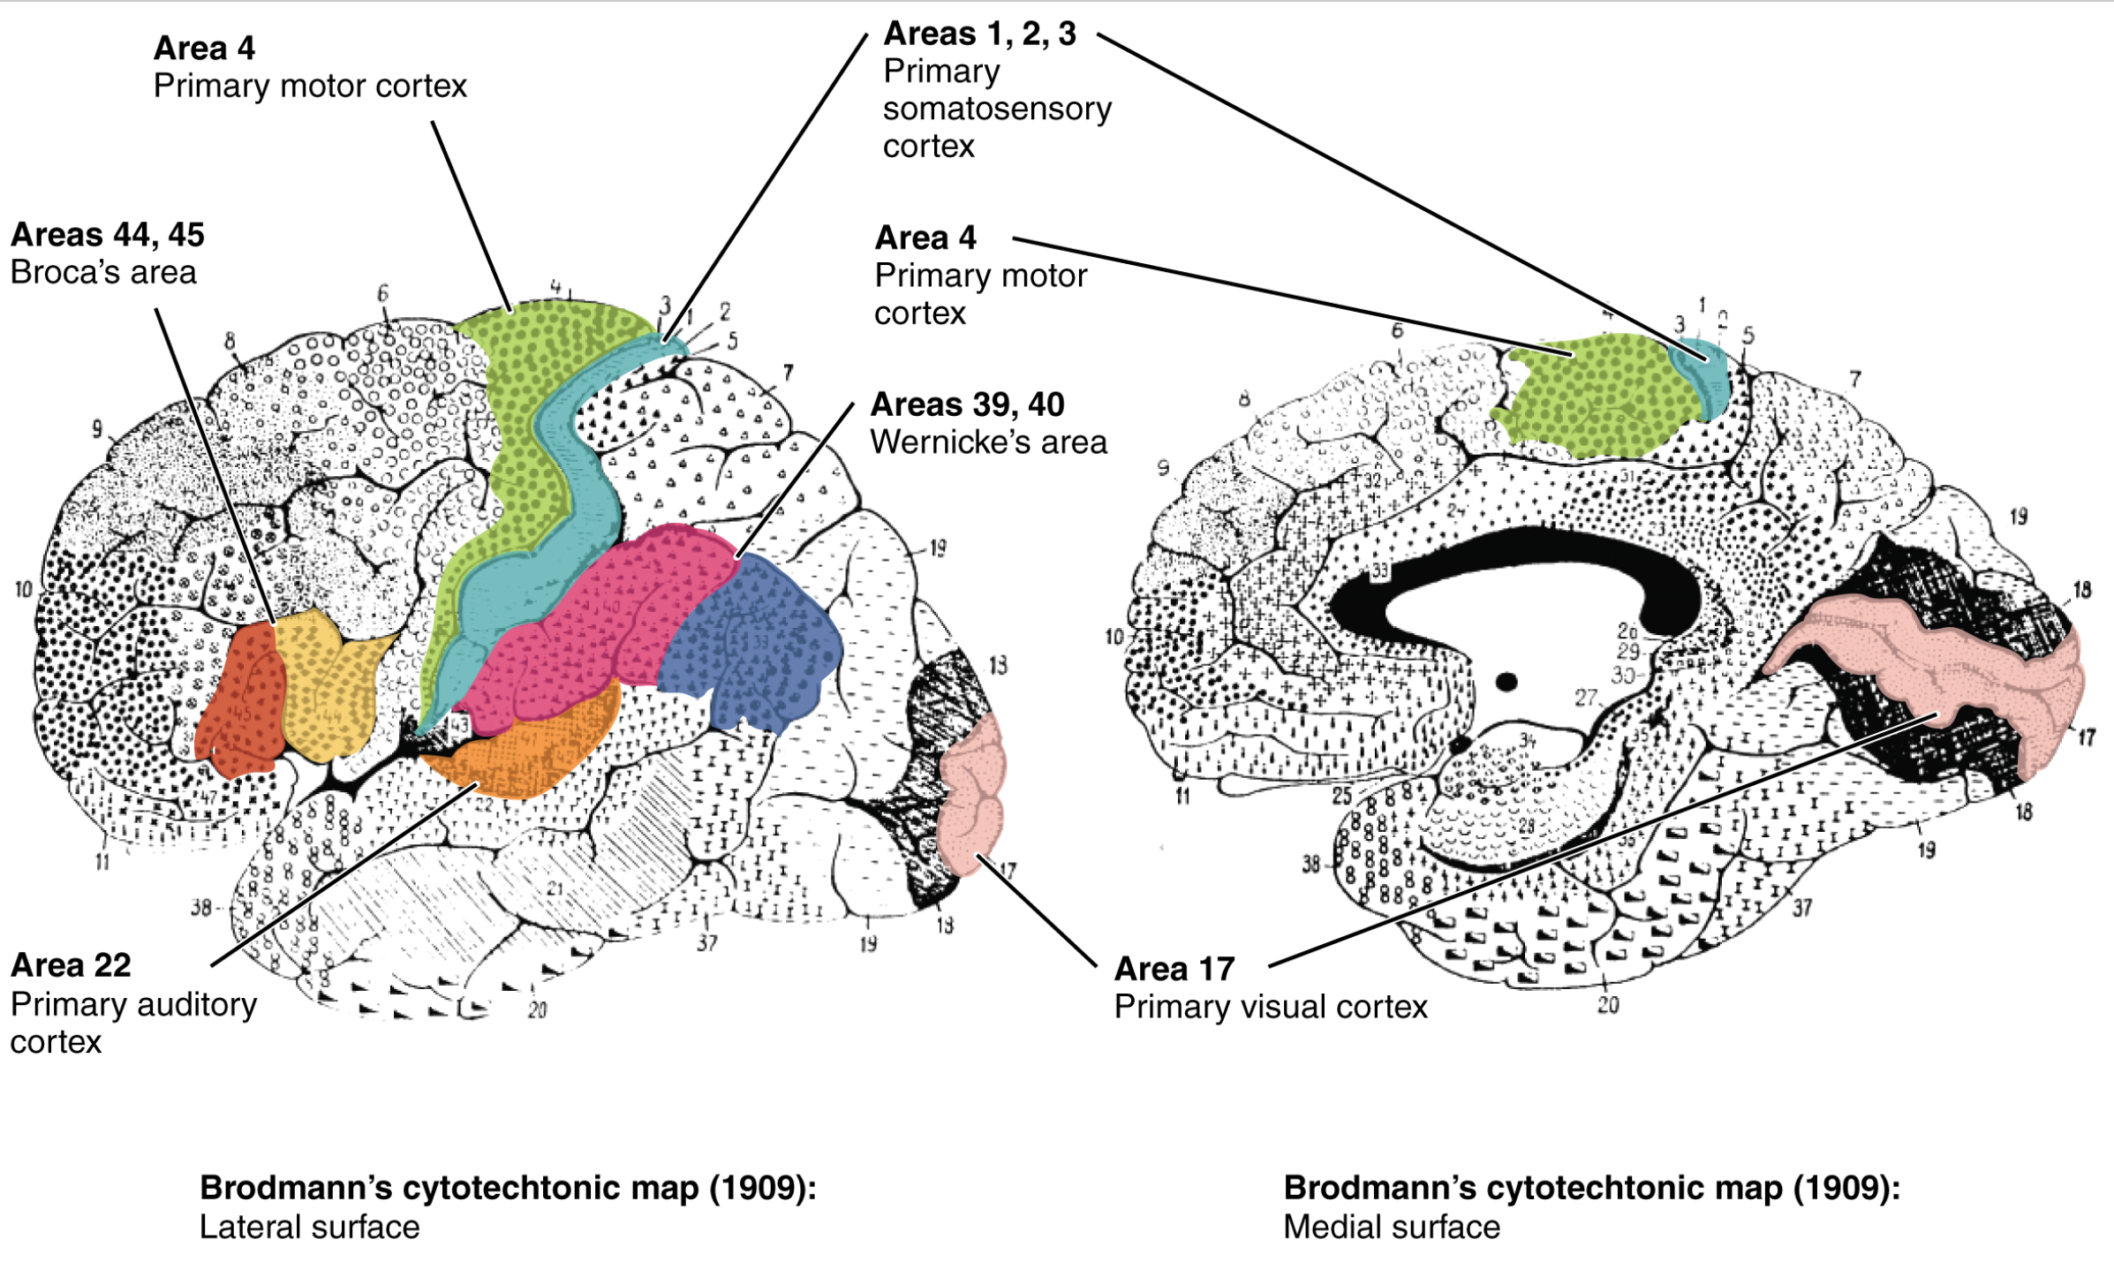
https://en.wikipedia.org/wiki/Brodmann_area#/media/File:1307_Brodmann_Areas.jpg

Slide 12
Six Brain Networks upgraded from 4
Default mode
Dorsal attention
Ventral attention
Salience
Fronto-parietal
Lateral visual

Slide 13
BRAIN NETWORK | DESCRIPTION
Default mode | The default mode network is active when an individual is awake and at rest. It preferentially activates when individuals focus on internally-oriented tasks such as daydreaming, envisioning the future, retrieving memories, and theory of mind. It is negatively correlated with brain systems that focus on external visual signals.
Dorsal attention | Voluntary deployment of attention and reorientation to unexpected events.
Ventral attention | Responds when behaviorally relevant stimuli occur unexpectedly.
Salience | Monitors the salience of external inputs and internal brain events.
Fronto-parietal | Initiates and modulates cognitive control.
Lateral visual | Important in complex emotional stimuli.

Slide 14

How to apply Brain Networks in the practice
We all have different functions in the practice.
But we all need to work together.
And when we all work together in the best way, both the care delivered and the practice itself is better.

Slide 15
How to unlock Innovation in staff and doctors

Slide 16
How to unlock Innovation in staff and doctors innovate or be left behind
Don’t permit innovation – expect it
Experiment, don’t overburden
Celebrate creativity
Campaign for innovation
Commit and continue
https://www.london.edu/lbsr/5-keys-to-unlock-innovation

Slide 17
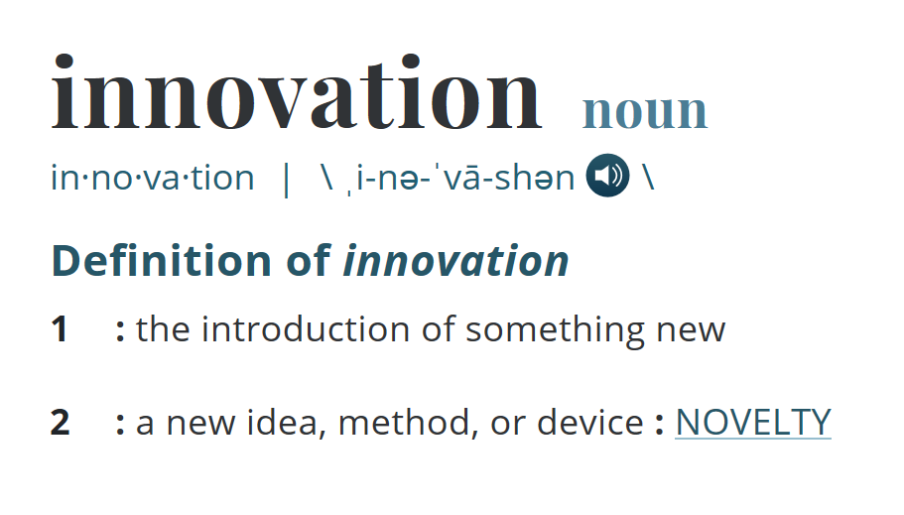
How to unlock Innovation in staff and doctors innovate or be left behind
Look For and Enlist Your Innovators
Create Safety
Disrupt the Comfortable
Sponsor Initiatives
Stand By Failures

Slide 18
Are you practicing the same way today as 10 years ago?
Creative collaboration harnesses the power of diverse perspectives and creativity to develop innovative solutions. The goal of this type of teamwork is to come up with new ideas.
There are two main modes of thinking in the creative collaboration process: divergence and convergence.
In divergence, teams go wide with ideas.
In convergence, you narrow in on what’s most important.
A common misconception is to think of these modes as linear—that you start broad and get increasingly more narrow with your focus.

Slide 19
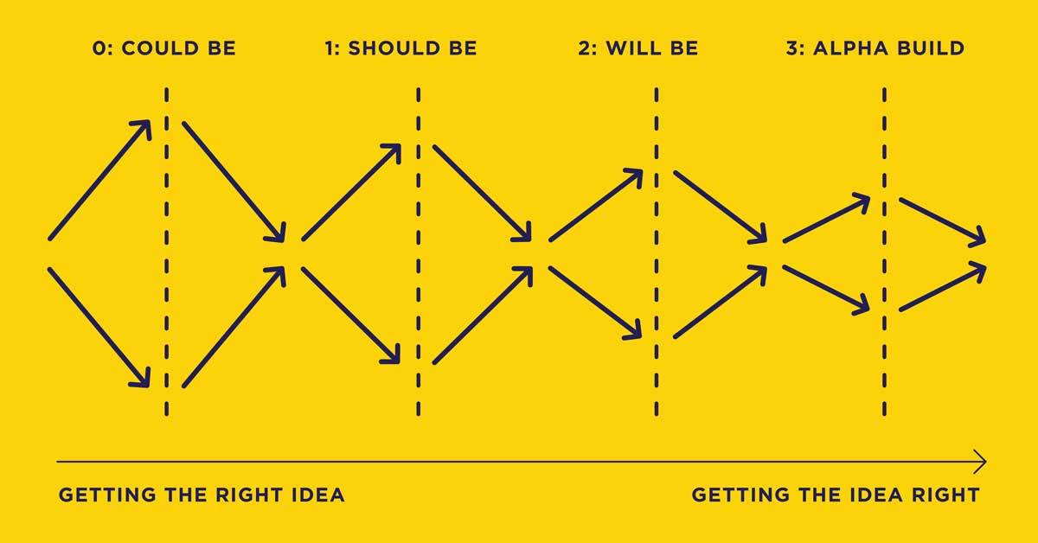
Creative Collaboration
But it’s not so much a funnel as it is “a dance of going out, coming in, going out, coming in, until we get to the best solution.”
https://www.ideou.com/blogs/inspiration/to-unlock-innovation-guide-your-team-through-creative-collaboration

Slide 20
Brainstorming Rules
There are no dumb ideas.
No negativity.
Every person and every idea has equal worth.
Encourage wild and exaggerated ideas.
Don’t criticize other people’s ideas.
Build on other people’s ideas.
Reverse the thought of “quality over quantity.”
Resist tangents like storytelling and joking.

Slide 21
How to best structure Incentives

Slide 22
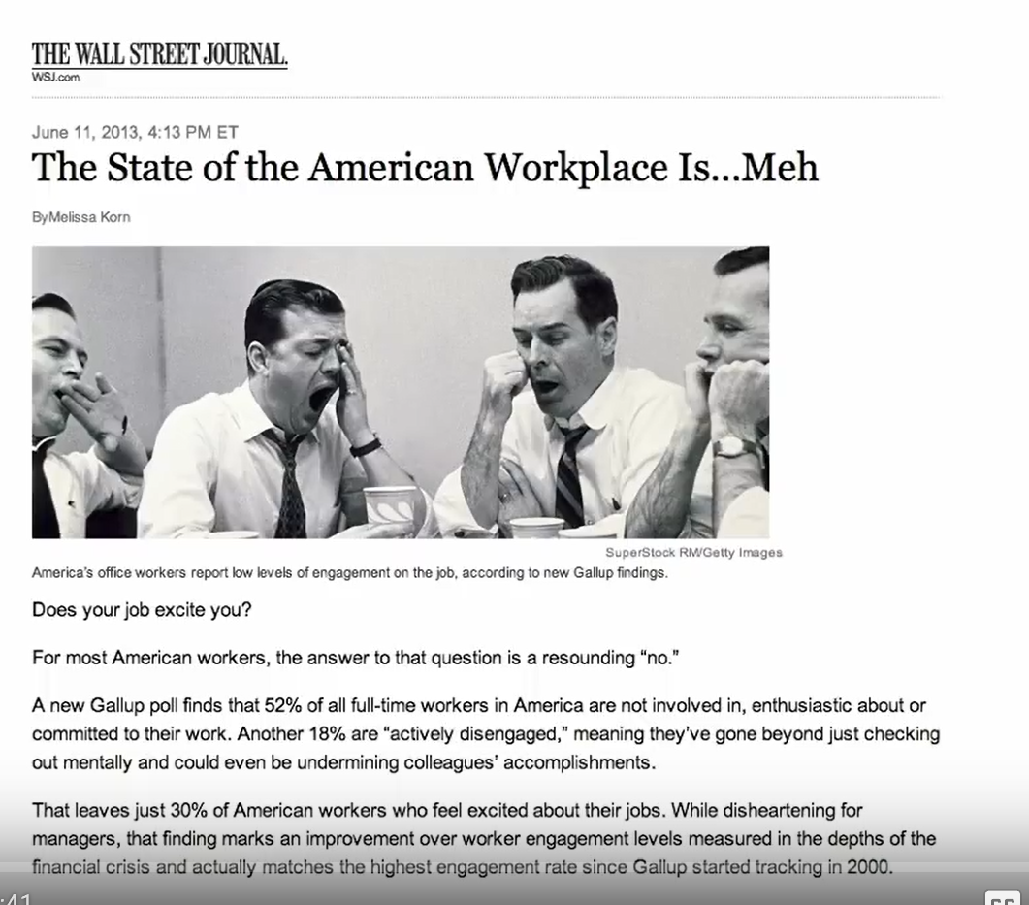
49% Not committed
18% Actively disengaged
70%
+

Slide 23
Highly Engaged
What can I do for others?
I inspire others to do their best.
Engaged
I’m a vital part of the business.
I feel important at work.
Almost Engaged
I know I’m part of something bigger.
I’m almost engaged but there are times when I’m not.
I love working here.
I’m a high flyer.
I’m really busy and very likely highly stressed.
I’m an achiever.
I’ll leave if something much better comes along.
Disengaged
I’m proud to work here but I wouldn’t shout it from the rooftops.
I might leave if I’m tempted.
I’m interested in overtime.
Not Engaged
There are no career development prospects here.
I have more sick days than I should.
I have poor working conditions.
I don’t like my manager or my team.
I don’t like my job much, but I get on with it.
I read job ads.
I’m here for the money.
I’m leaving when I can.
I’m not satisfied with my job.
My work doesn’t excite me.
I’m a clock watcher.
15%
49%
18%
a recent Gallup poll

Slide 24
Daniel Pink youtube Videos
Driving Employee Engagement
  https://www.youtube.com/watch?v=x8PsRWvJz00
Drive: The Surprising Truth About What Motivates Us
  https://www.youtube.com/watch?v=LFlvor6ZHdY
Purpose—Why We Do What We Do
  https://www.youtube.com/watch?v=_p4esMj2EC8

Slide 25
How to best structure Incentives
Money matters – pay people enough to take money off the table
3 Motivaters
Autonomy
Mastery
Purpose

Slide 26
3 Motivaters
Autonomy – The urge to control the who/what/when/where of work.
Mastery – The drive to get better at what we do.
Purpose – The sense of connecting to something bigger.

Slide 27
How to best structure Incentives
Compliance – Management
Engagement – Self Direction

Slide 28
How to best structure Incentives
How To Build Incentive Plans That Actually Work
Incentives need to be pegged to …
Individual performance
Company performance
Example
Weekly meeting
Spreadsheet with all numbers for all to see
https://www.forbes.com/sites/fotschcase/2015/08/24/incentive-plans-that-actually-work/#4928e67661e6

Slide 29
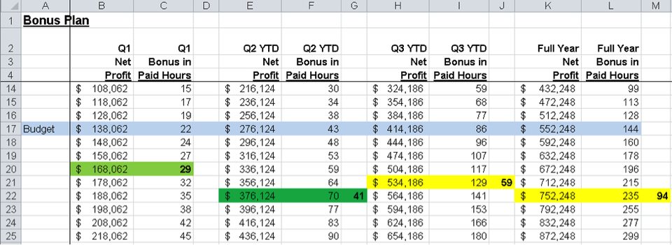

Slide 30
How to manage for Trust

Slide 31
How to manage for Trust
1. Coach don't command.
2. Tell the truth.
3. Follow through.
4. Take blame but give credit.
5. Don't badmouth.
6. Walk the talk.
7. Listen more and talk less.
8. Admit when you're wrong.
9. Make employee success your #1 job.
https://www.inc.com/geoffrey-james/9-ways-to-win-employee-trust.html

Slide 32
How to create Achievable Goals

Slide 33
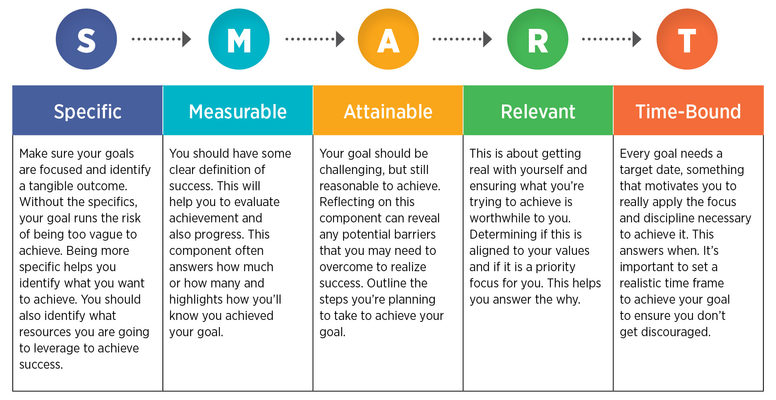
How to create Achievable Goals
https://www.bing.com/images/search?view=detailV2&id=BA3F231F2F6C6B6BA7C54AF8E115296215AFAEB0&thid=OIP.i2QzhqgZi_aMfB0vhGL6KAHaD0&mediaurl=https%3A%2F%2Fcmcoutperform.com%2Fsites%2Fdefault%2Ffiles%2Finline-images%2FSMART.jpg&exph=984&expw=1906&q=smart+goals&selectedindex=7&ajaxhist=0&vt=0&eim=1,2,6

Slide 34
How to structure conversations to maximize positive neurochemistry

Slide 35


How to structure conversations to maximize positive neurochemistry
Cortisol vs Oxytocin

Slide 36
How to structure Conversations to maximize positive neurochemistry.
“When we face criticism, rejection or fear, when we feel marginalized or minimized, our bodies produce higher levels of cortisol, a hormone that shuts down the thinking center of our brains and activates conflict aversion and protection behaviors. We become more reactive and sensitive.
We often perceive even greater judgment and negativity than actually exists. And these effects can last for 26 hours or more, imprinting the interaction on our memories and magnifying the impact it has on our future behavior.
Cortisol functions like a sustained-release tablet – the more we ruminate about our fear, the longer the impact.”
https://hbr.org/2014/06/the-neurochemistry-of-positive-conversations

Slide 37
How to structure Conversations to maximize positive neurochemistry.
Behaviors that increase cortisol levels reduce what is called “Conversational Intelligence” or “C-IQ,” or a person’s ability to connect and think innovatively, empathetically, creatively and strategically with others.
Behaviors that spark oxytocin, by contrast, raise C-IQ.
But oxytocin metabolizes more quickly than cortisol, so its effects are less dramatic and long-lasting.

Slide 38
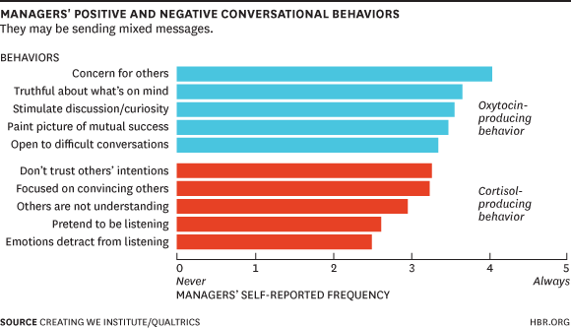

Slide 39
What happens to your brain when you negotiate about money

Slide 40
What happens to your brain when you negotiate about money.
Nothing excites the brain quite like money.
Nucleus accumbens
Researchers compared the brain scans of people who were about to make money with drug addicts high on cocaine.
The results were startling: the brain scans were nearly identical.

Slide 41
What happens to your brain when you negotiate about money.
Nothing excites the brain quite like money.
Nucleus accumbens
Researchers compared the brain scans of people who were about to make money with drug addicts high on cocaine.
The results were startling: the brain scans were nearly identical.
The nucleus accumbens is a brain structure that is part of our pleasure and reward system. It activates our motivation and allows willpower to translate into action. It has an essential role in learning and memory, in laughter, fear, aggression, addictions, the placebo effect, sex, food intake.
https://blog.cognifit.com/nucleus-accumbens/

Slide 42
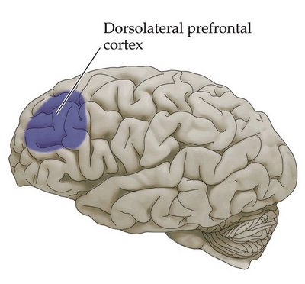
A money game and brain activity
When a responder receives a proposal on how to split the money, it fires his dorsolateral prefrontal cortex.
  This region of the brain is what makes us self-aware, reflective beings and helps us solve complex problems. So it makes sense that it activates when we are evaluating a financial decision.

Slide 43
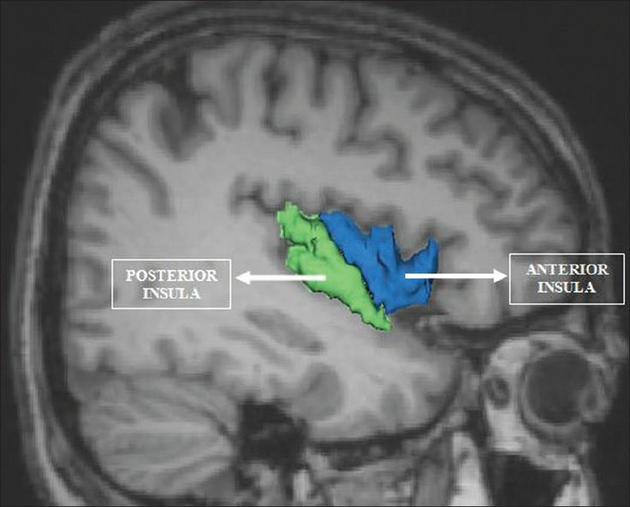
A money game and brain activity
When responders were offered an unfair proposal, another part of the brain activated, the anterior insula, which is part of the emotional wiring of the brain, involved in making us feel anxiety, pain, even hunger.
  The anterior insula has what’s known as “spindle cells” that are more commonly found in the digestive system.
  “Gut feeling”

Slide 44
Where is this going?
Some hedge funds are exploring whether to use brain scans in evaluating prospective job candidates to see whether they are more risk averse or risk seeking.
And the day may come when the brain scans of negotiators, arbitrators, and mediators, are scrutinized to see whether an individual is predisposed to making decisions that are rational or more subject to emotions.
“Getting to yes” may mean taking an MRI first.

Slide 45
How to best exercise your brain

Slide 46
How to best exercise your brain.
Use it
  Challenging and novel brain exercises can be used to protect and strengthen your mind.
Take Care of Your Body
  Healthy behaviors include not smoking, maintaining a healthy BMI, regularly exercising, consuming lots of vegetables and fruits, and consuming a low to moderate amount of alcohol.
Socialize
  People who are socially active are at a lower risk of developing dementia and Alzheimer's disease.
Meditate
  Studies suggest that mindfulness meditation can help engage new neural pathways, resulting in improved self-observational skills and increased mental flexibility.
  Research has also shown that meditation can help improve attention, focus, empathy, immunity, and might even increase the capacity of working memory.
https://www.verywellmind.com/brain-exercises-to-strengthen-your-mind-2795039

Slide 47
To learn more …
https://hbr.org/product/harvard-business-review-special-issue-the-brain-science-behind-business/BR1907-MAG-ENG
https://www.entrepreneur.com/article/311895
http://designbeep.com/2013/02/22/the-science-behind-a-business-card/
https://hbr.org/2012/01/the-science-behind-the-smile
https://www.superoffice.com/blog/science-based-selling/

Slide 48
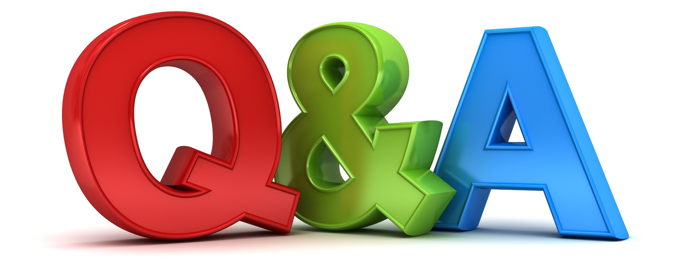

Slide 49


