Slide 1
Top 5 Mistakes Preventing Your Practice Growth
Mark R. Wright, OD, FCOVD
3:00 pm – 5:00 pm

Slide 2
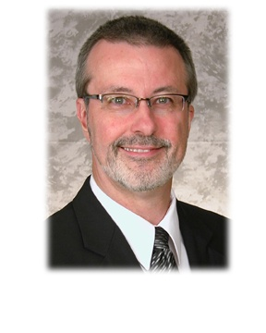
Mark Wright, OD, FCOVD
Director: OSU College of Optometry Business Management Program
Board Member: APME
CEO: Pathways to Success
CEO: Practice Management Center
Editor: Review of Optometric Business
Author: Coding, Reimbursement and Contracting for Optometry
1980 – 2007 founder Professional VisionCare, Westerville, OH
Notes:
2
2
Dr. Wright is a 1980 graduate of The Ohio State University College of Optometry, where he is clinical assistant professor and faculty coordinator of OSU’s Business Management Program. Retired from practice last year, Dr. Wright is president of Pathways to Success, Eyecare Business Training and Progressive Publishing Company. All three of these companies are dedicated to the special practice management needs of eyecare practices. Dr. Wright has lectured extensively throughout the U.S. and abroad. His topics include not only practice management, but also managed care, sports vision and vision and traumatic brain injuries. He is also the practice management editor for the Journal of Optometric Vision Development. This is Mark’s first presentation to the MBA. Please welcome Mark Wright…

Slide 3
SPEAKER FINANCIAL DISCLOSURE STATEMENT
Mark R. Wright, OD, FCOVD has been a paid speaker for the following companies:
  Alcon
  B&L
  ESSILOR
  Jobson
  Vistakon
  VSP
He is an officer of:
  Pathways to Success
  Practice Management Center
  Progressive Publishing Company
He is the professional editor of:
  Review of Optometric Business
Diversified Ophthalmics
Eye Recommend
IDOC
IVA
ODX
PERC
Vision Source

Slide 4
Here’s where the course lives
Optometrybusiness.com
RESOURCES

Slide 5
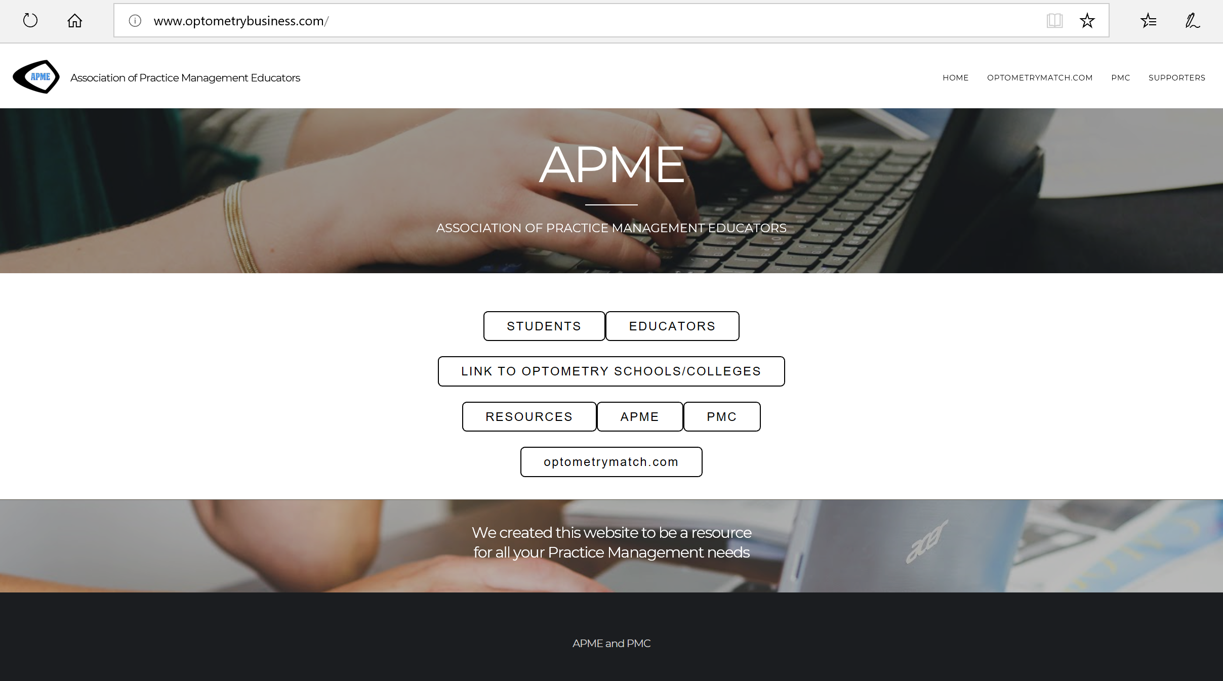

Slide 6
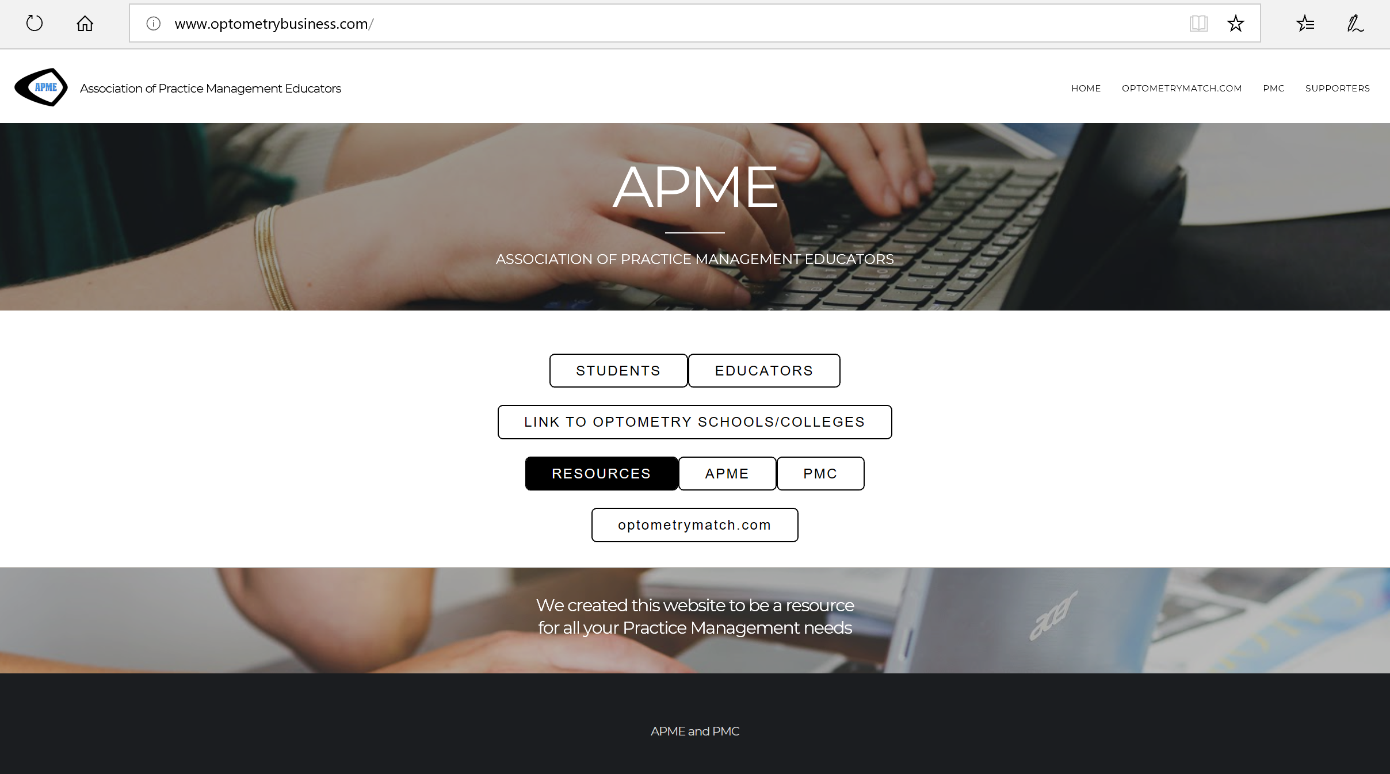

Slide 7
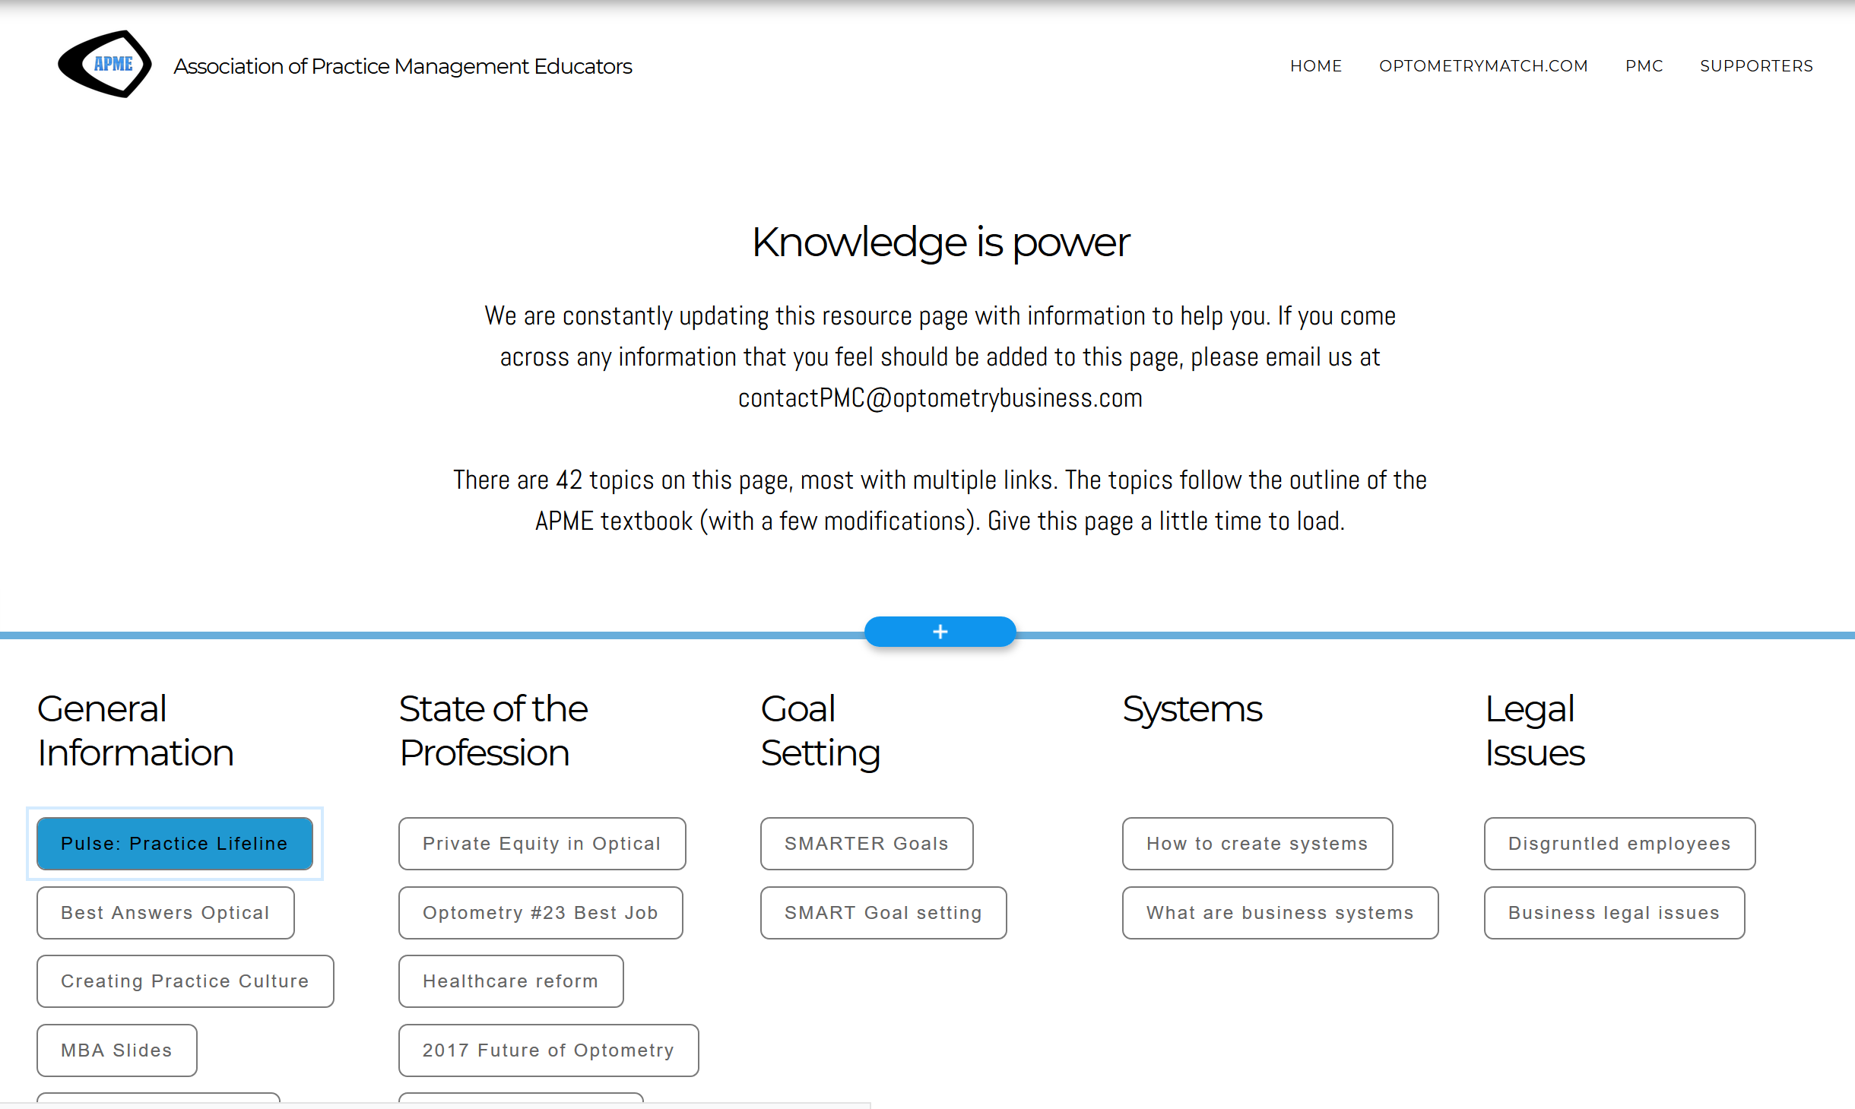

Slide 8
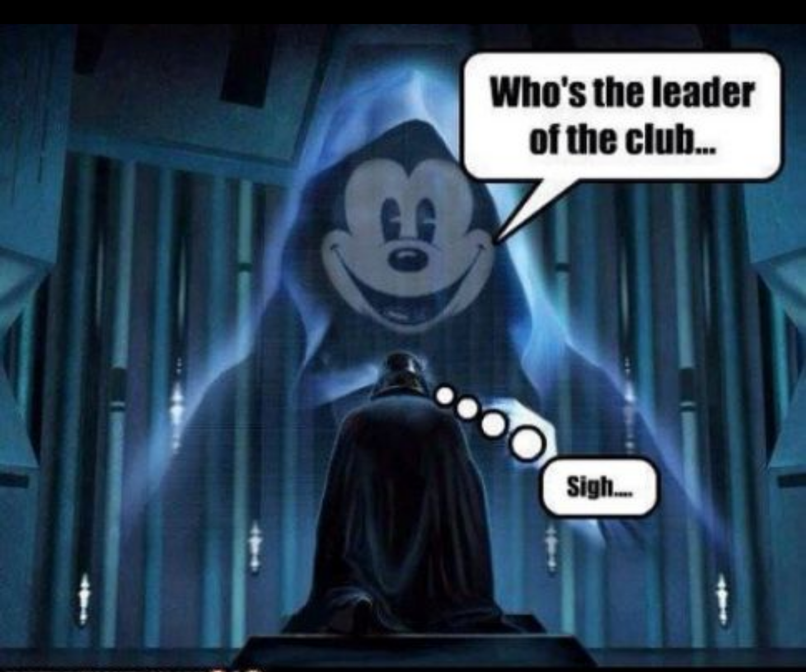

Slide 9
COPE ID: 52355-PM Course Title: Top 5 Mistakes Preventing Your Practice Growth
Format: Live | Category: Practice Management | Total CE Hours: 1
Description: Mistakes not addressed are preventing your practice from growing. Attendees to this course will be able to utilize third parties more effectively in the practice, deliver a more effective case presentation, design and implement better practice systems, increase the number of patients through the office, and improve staff productivity. Fixing these things will grow your practice.
Expires: Course Expires: 01/23/2020
Instructor: Mark Wright O.D.

Slide 10
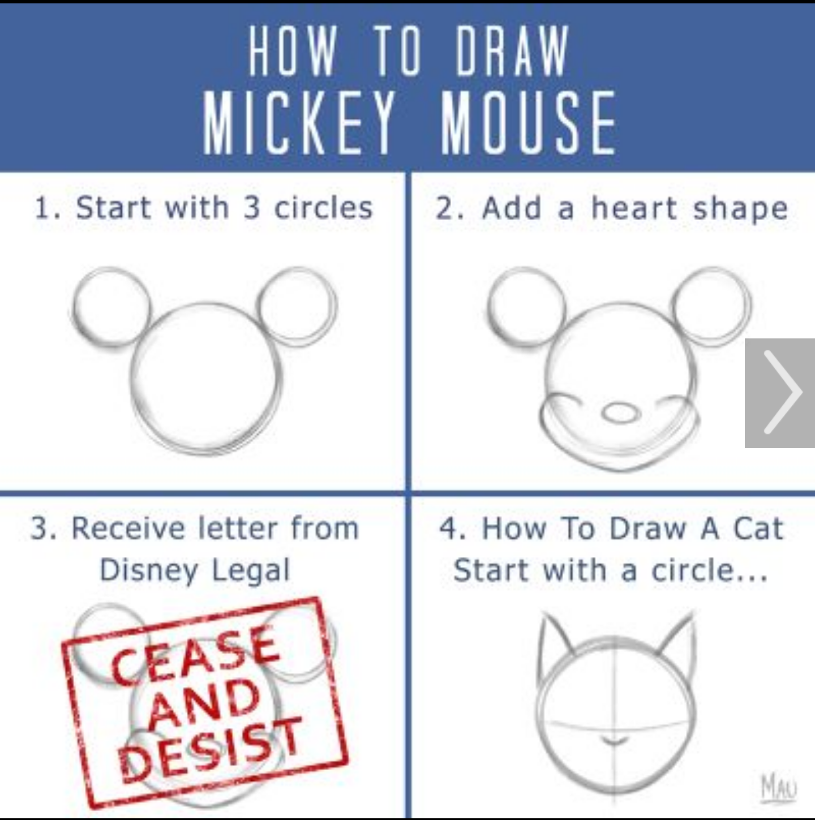

Slide 11
Learning objectives
The attendee will be able to …
Utilize third parties more effectively in the practice
Deliver a more effective case presentation
Design and implement better practice systems
Increase the number of patients through the office
Improve staff productivity

Slide 12
Course Title: Top 5 Mistakes Preventing Your Practice Growth
Live
Course description: Mistakes not addressed are preventing your practice from growing. Attendees to this course will be able to utilize third parties more effectively in the practice, deliver a more effective case presentation, design and implement better practice systems, increase the number of patients through the office, and improve staff productivity. Fixing these things will grow your practice.

Slide 13
Top 5 Mistakes
Preventing Your Practice Growth
Third parties are ruling your practice
Case presentation is not well thought out
Missing or poorly designed practice systems
Not enough patients
Staff not productive

Slide 14

The purpose of being in a third party is patient access
3rd parties are ruling your practice

Slide 15

Golden Rule
3rd parties are ruling your practice

Slide 16
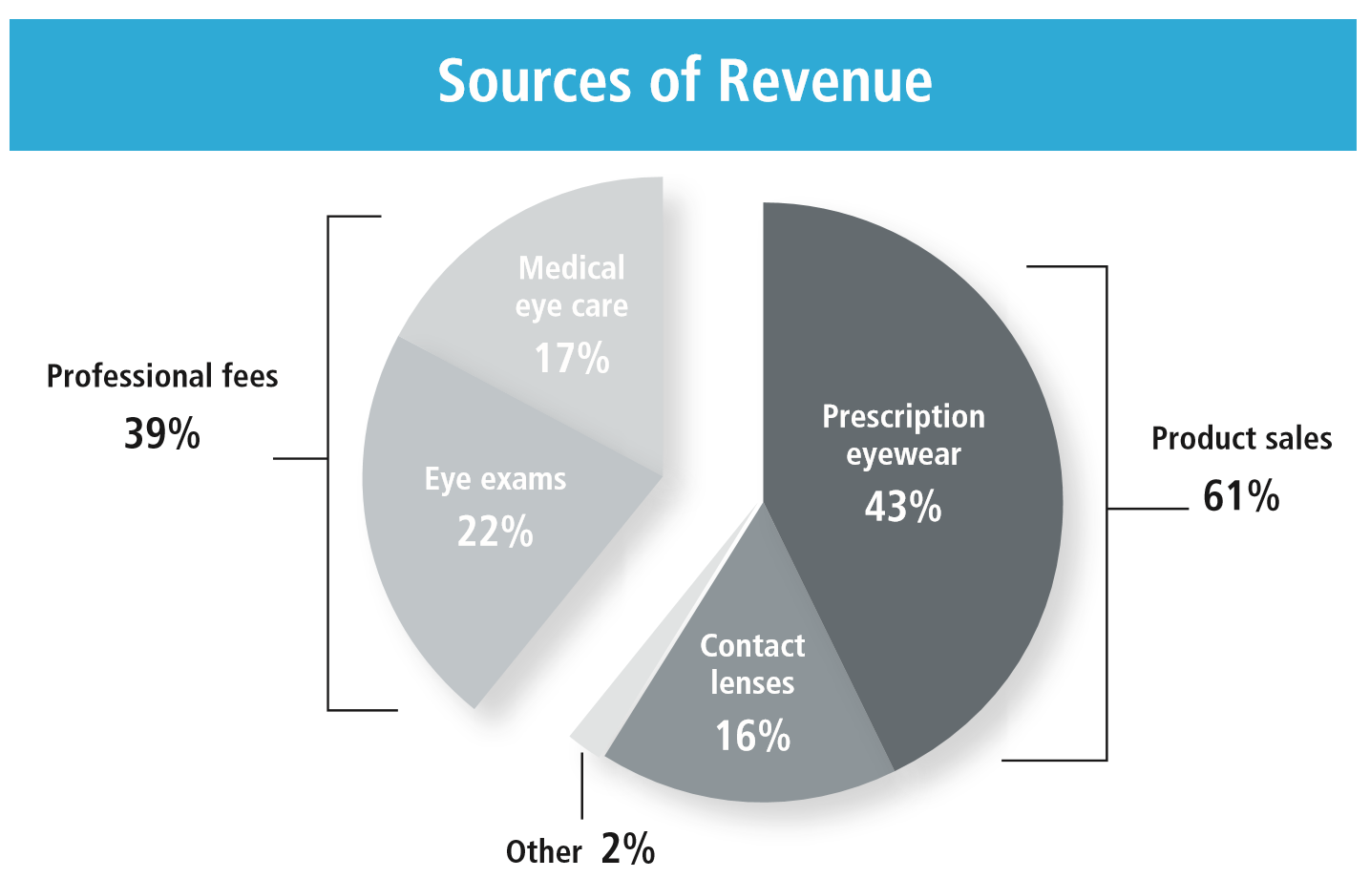
Mantra: Do more for less
3rd parties are ruling your practice

Slide 17
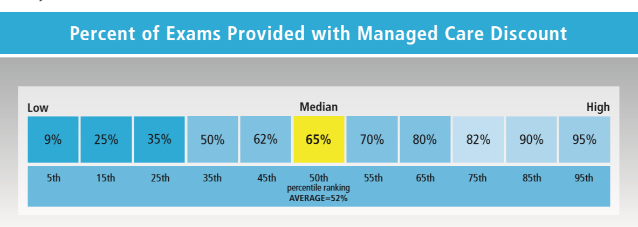
Mantra: Do more for less
3rd parties are ruling your practice

Slide 18
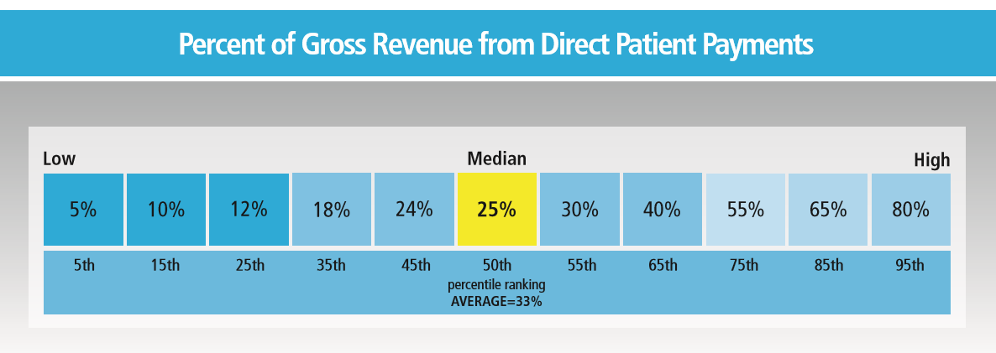
Mantra: Do more for less
3rd parties are ruling your practice

Slide 19


Mantra: Do more for less
3rd parties are ruling your practice
for

Slide 20


Slide 21

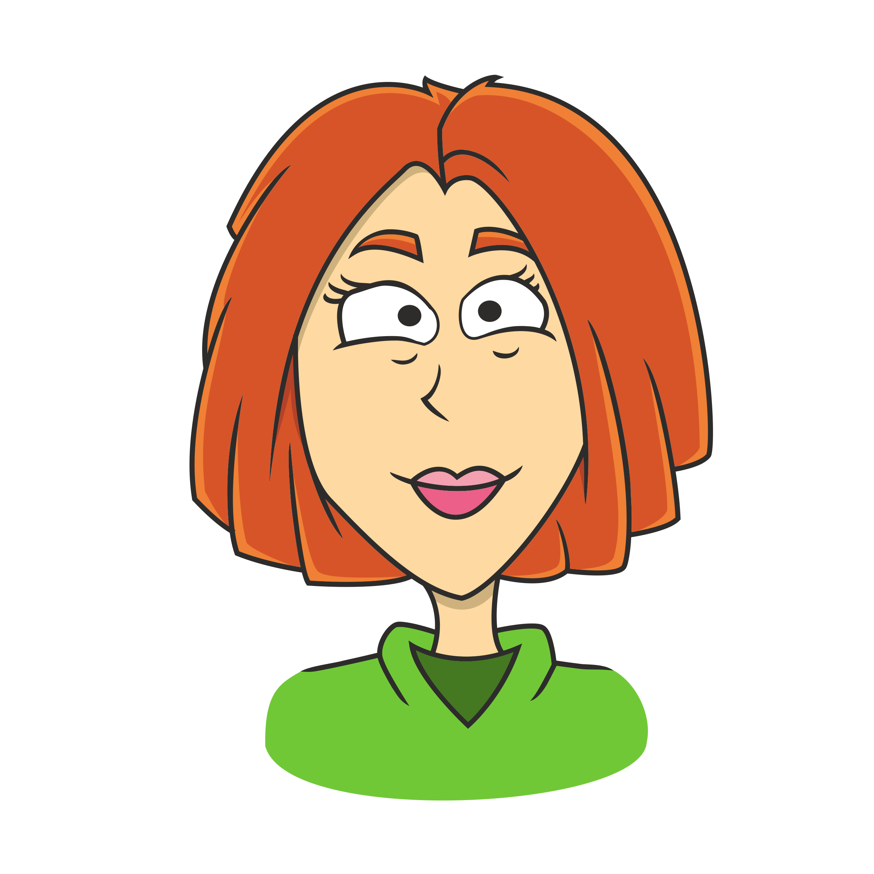
Do you present fees the way 3rd parties have taught you?
3rd parties are ruling your practice
INSURANCE BILLING LANGUAGE
CONSUMER LANGUAGE
The normal fees would be $512, but because you have insurance, your out-of-pocket expense is only $127.
Your base fee is $85, Transitions is $75, Glare free is $70 …

Slide 22
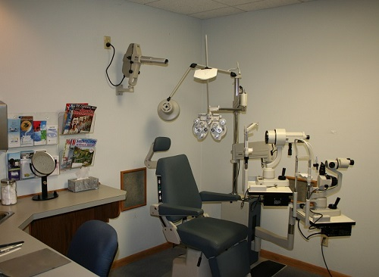
Doctors need to prescribe in the exam room
Your case presentation is not planned well
Prescribe

Slide 23
3 case presentations
Your case presentation is not planned well
Optical
Rx for computer
Rx for driving
Medical
Additional testing
Consult with ___
Recall
“You need to see me in __ months, because __.”
Rx for dress
Write out what you are prescribing for the patient in front of you

Slide 24


You talk patients out of care
Your case presentation is not planned well
Planned & practiced scripts for …
  I can’t afford that.
  Can’t you just do 1 Rx?
  Don’t you have a less expensive …

Slide 25

Practice organizational structure
Missing or poorly designed practice systems
Human relations
  Hiring and Training
  HR Reporting and Management
  Firing
Procurement
  Equipment
  Clinic Supplies
  Inventory
Information Technology
  Computer System
  Telephone System
  E-Mail and Website Management
Operations
  Scheduling
  Examination
  Treatment and Dispensing
Finance
  Revenue
  Expenses
  Tax Reporting
Quality Control
  Staff Proficiency Testing, Education and Discipline
  Patient Quality Control
  Laboratory Quality Control
Public Relations
  Internal Marketing
  External Marketing
  Success Stories
Administration & Management
  Risk Management
  Future Planning
  Practice Management

Slide 26


Slide 27
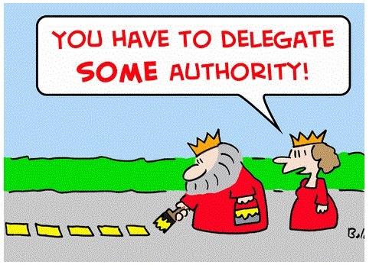
How many patients can we see in a year?
48 wks / yr; 5 days / wk; 8 hrs / day; 1 pat / hr
48 x 5 x 8 x 1 = 1920 patients
What is the difference between a $700K and $1.4M OD?

Slide 28
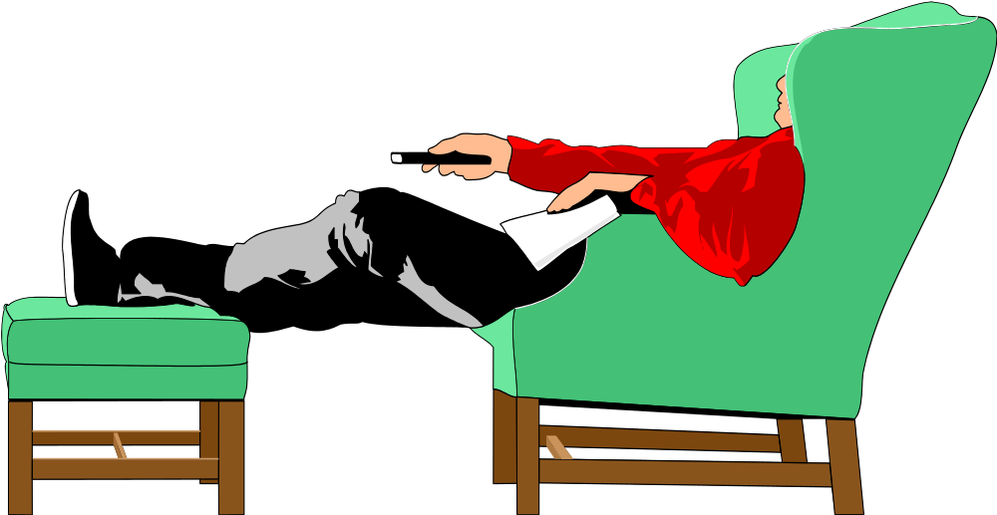
What is our current efficiency ?
1920 x 2 = 3840
2200 / 3840 = 57 % fill rate
43% empty rate

Slide 29


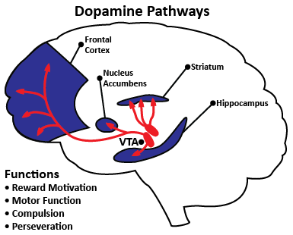
How do you get new patients
Not enough patients
All 3 parts MUST be present

Slide 30
Staff is not productive (they may be very busy)
Every staff member needs at least one number to control
STAFF MEMBER | STAT
Recall | # of exams seen
Marketing | # of new patients
Optician | $/patient
Receptionist | # of mins/patient visit
Bookkeeper | $ in Accounts Receivable
Doctor | % of Tx plans completed

Slide 31



Slide 32


Slide 33


